Slide 1
Global Comparative Politics (4)
Luca Verzichelli
University of Siena
Master Program
Public and Cultural Diplomacy (LM-81)

Slide 2
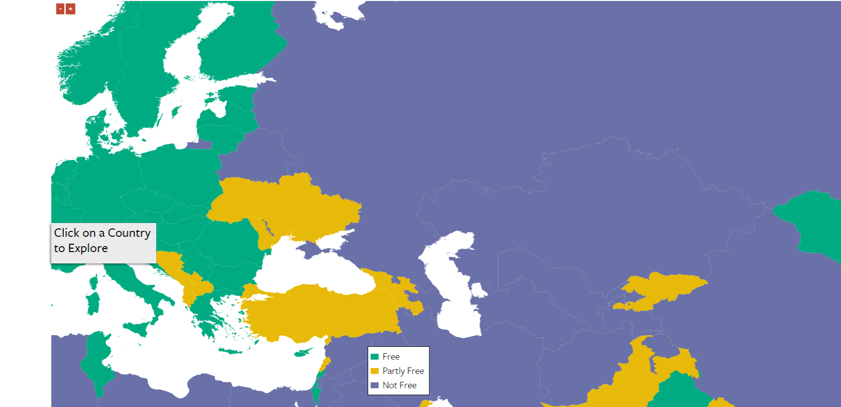
Eurasia (FH 2016)
Predominance of non-democratic regimes in the West-Asia
Problems of state stability in this area (as well as in the MENA)
Difficult consolidation of rule of law

Slide 3
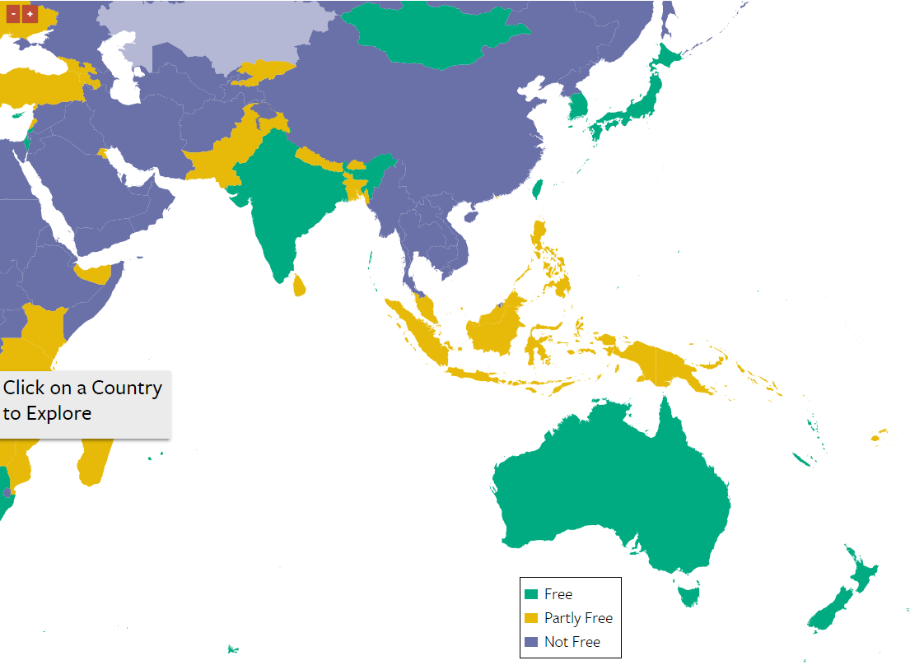
Asia-Pacific (FH, 2016)
More compound situation in Asia-Pacific
Long-established democratic polities
Post-colonial democratic regimes
Recent wave of democratization
Persistence of examples of purely authoritarian regimes

Slide 4
The East-Asian Sphere
Liberal Democracy (FH: 1-2) | Electoral Democracy (FH> 2) | Electoral Authoritarianism | Politically closed authoritarianism
Japan | Mongolia | Malaysia | Brunei
S. Korea | Indonesia | Singapore | Vietnam
 | Philippines | Cambodia | China
 | Timor-Leste |  | Laos
 | Thailand |  | Burma
 |  |  | North Korea

Slide 5
Japan
Imperial heritage
1945: The big loss
An American constitution
Debate on neutrality and external action

Slide 6
The Classic party System and the new era
Centrality of LDP (liberal-democratic party)
Traditional left opposition (Jsp - Jcp)
Other traditional streams (Democratic party, Komeito)
LdP defeat in 1995 and the alternance (after the introduction of a mixed-majoritarian electoral system)
A new LdP era? Yes, but grounded on coalition governments

Slide 7
Form of government
Classic parliamentarism. Asymmetric bicameralism. Role of interest groups
Centrality of National institution. Relative impact of local politics
Growing role of executive leaders (presidentialization of politics?)

Slide 8
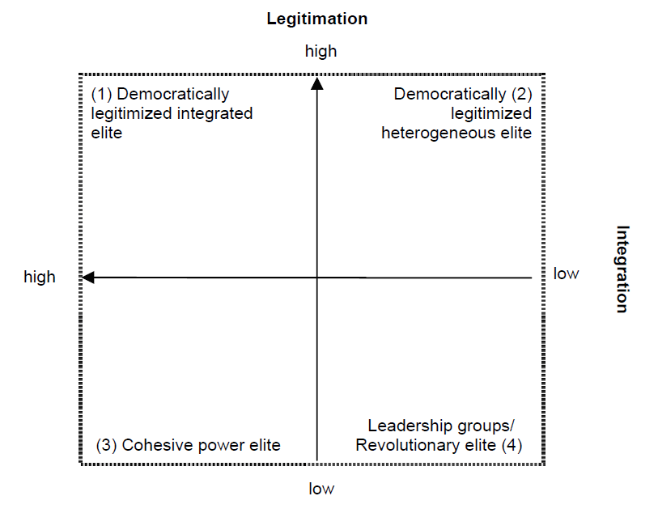
An elite approach to the study of Japanese political system (Schmidt 2005)
A study on the elite structure and interactions based on Giddens.
Political + social elite
Interviews and career profile
Legitimation
Integration

Slide 9
Implications from this study
Japan as a stable elite system. Elite configurations reflect social, structural, cultural and political structures of Japanese society
Importance of Dynasties
no group clearly dominates within the establishment (interlocking directorates of elite groups)
high degree of sectorial variation
Importance of economic elite in politics
Not a monopolistic elite

