Slide 1
Lesson 9 Politics for cultural heritage management in a comparative approach: the «military culture» of United States
Aims and Topics
To examine the different experience developed in United States
To consider the main elements of the american experience, especially from a juridicial point of view;
To try to compare the american experience with respect to the european experiences, and in particular to the british one

Slide 2
A different juridical system
Constitution of United States of America: Supreme Law of the Land
Federal Laws and International Treaties
Constitutions of the States
Acts and Decrees of local administrations
Federal Laws are exceptional with respect to the Laws of the States; and the States can produce acts also towards the subjects reserved to the Federal Law

Slide 3
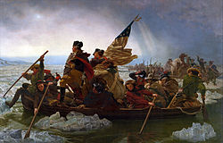
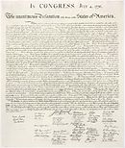
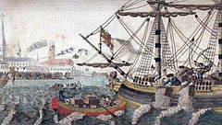
Who made America? A matter of identity
The independence and the legacy of «fatherland»
Boston Tea Party
Declaration of Independence
Emanuel Leutze – Washington crosses
the river Delaware - 1851

Slide 4
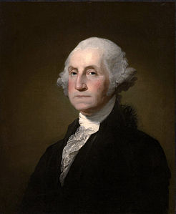
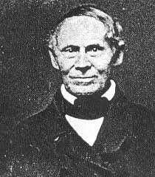
The memory of the independence Some examples
Robert Mills (1781-1855)
Washington Monument
George Washington (1732-1799)

Slide 5
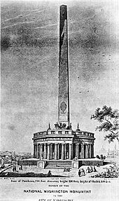
Washington Monument building
(1860 ca.)
The «Washington National Monument
Society» was created in 1833 – It raised more
than 28.000 dollars and the building began
in 1848;
It was interrupted in 1855 and continued
since 1876 under the direction of a Congress Committee;
It was finally completed in 1884
The original project - 1836

Slide 6
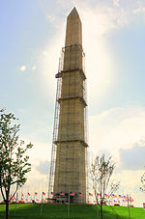
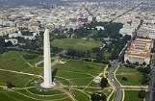
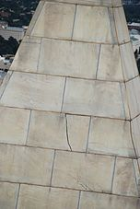
The aluminium apex
The aluminium apex
P.H. McLaughlin – T.L. Casey
Crack in a stone at the
top after the 2011 earthquake

Slide 7
Monuments to Washington Other examples…
Copy (ca. 1815)
after Bust of Washington
by Giuseppe Ceracchi (1795)
Equestrian statue of Washington
by Clarck Mills (1859) –
Washington Circle
Copy (1909)
After the statue of Washington
by Jean-Antoine Houdon
(1791)
George Washington
National Heritage Museum
Lexington
George Washington as Master Mason

Slide 8
Monuments to Washington Some examples
Washington Park – Denver - 1899
Washington Park - Springfield
Washington
on the Mount Rushmore
Washington Oak
Audubon Park –
New Orleans

Slide 9
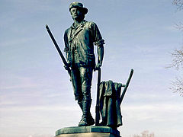
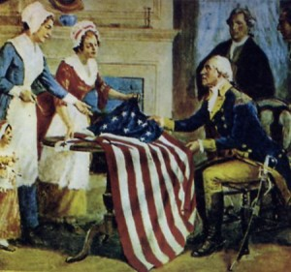
The war for independence Other examples of monuments
The Lexington
Minuteman
The Concorde Minuteman – Daniel Chester French

Slide 10
Monuments to the war of independence abroad

Slide 11
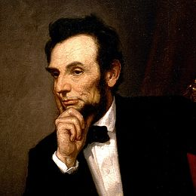
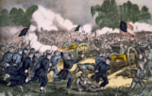
The Civil War (1861-1865)
Abraham Lincoln (1809-1865)
Battle of Gettysburg – July 1863

Slide 12
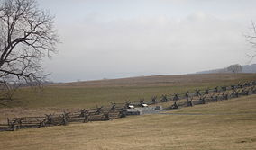
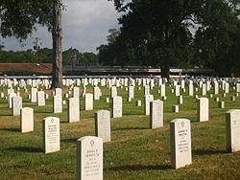
A «military nation»: memory and identity of the war
In 1862 a first federal law was introduced, through which the Congress recognized as cultural asset national military parks, battlefields, monuments and historical sites, and assigned their management to the Ministry of the War.
An Act – 17 July 1862 – empowered President Lincoln «to purchase cemetery grounds and cause them to be securely enclosed, to be used as a national cemetery for the soldiers who shall die in the service of the country».
Bloody Lane – Antietam National Cemetery
Alexandria National Cemetery
Alexandria - Louisiana

Slide 13
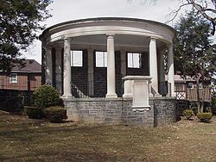
The first national cemeteries and battlefields recognized
Alexandria National Cemetery – Alexandria;
Annapolis National Cemetery – Annapolis;
Antietam National Cemetery – Sharpsburg;
Camp Butler National Cemetery – Springfield;
Cyprus Hills National Cemetery – Brooklyn;
Danville National Cemetery – Danville;
Fort Leavenworth National Cemetery – Fort Leavenworth;
Fort Scott National Cemetery – Fort Scott;
Keokuk National Cemetery – Keokuk;
Loudon Park National Cemetery – Baltimore;
Mill Springs National Cemetery – Nancy;
New Albany National Cemetery – New Albany;
Philadelphia National Cemetery – Philadelphia;
Soldier’s Home National Cemetery – New York
Philadelphia National Cemetery – The Gate

Slide 14
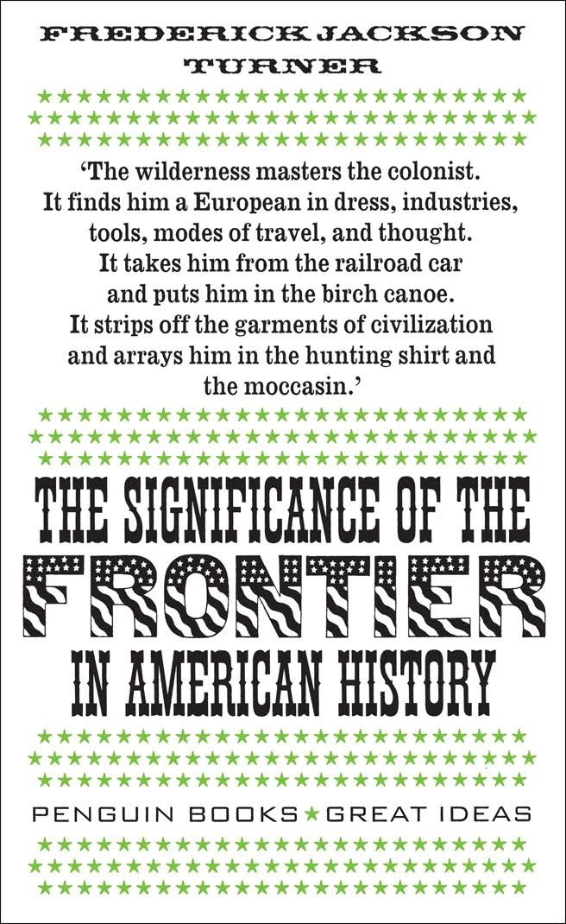
Wilderness, nature, landscape, pioneers The conquest of the West and the myth of the Frontier
Frederick Jackson Turner
(1861-1932)

Slide 15
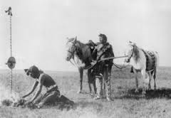
The Frontier

Slide 16
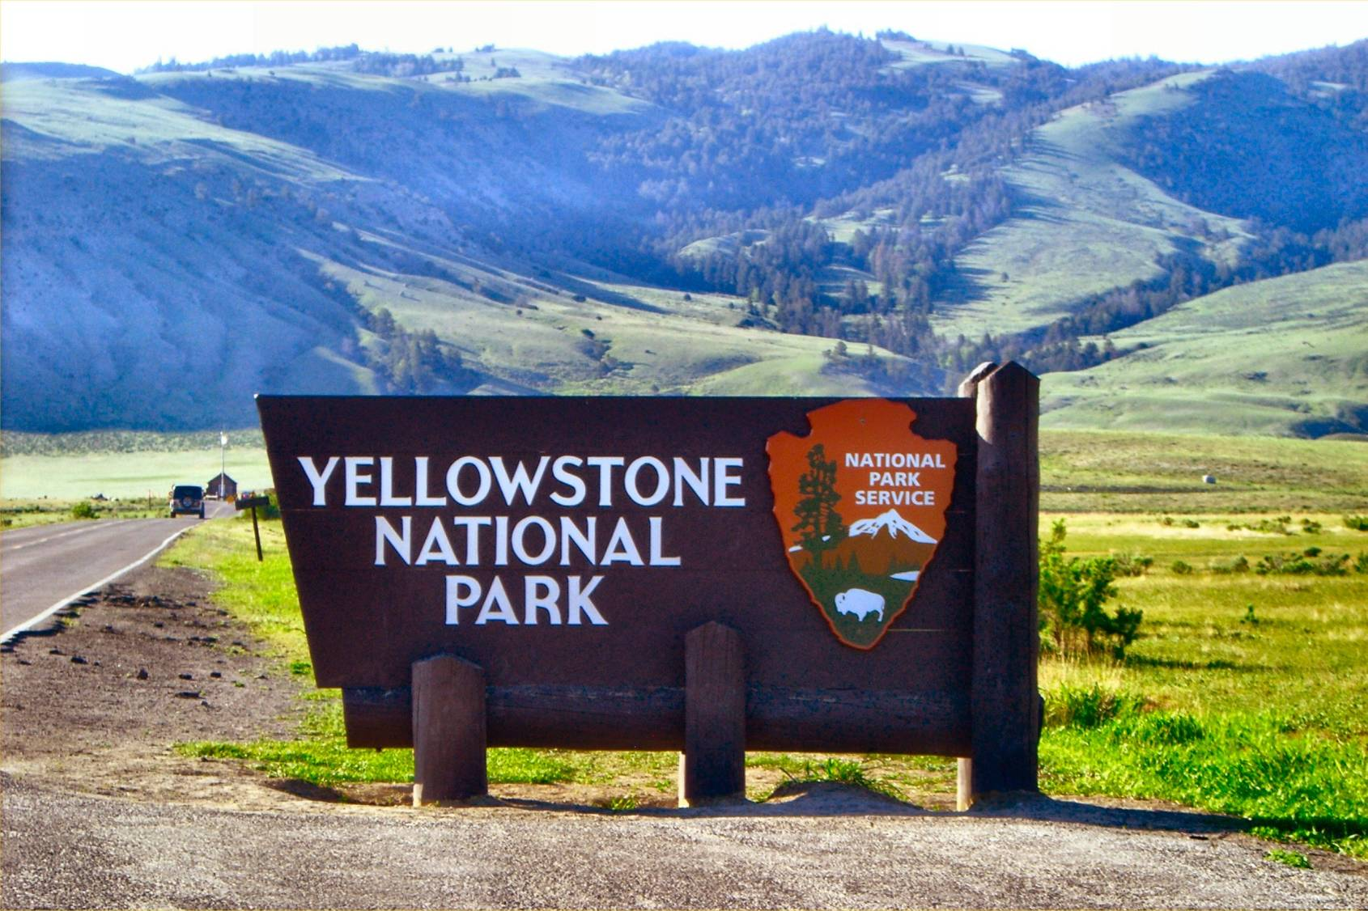
Protection of nature and wilderness

Slide 17
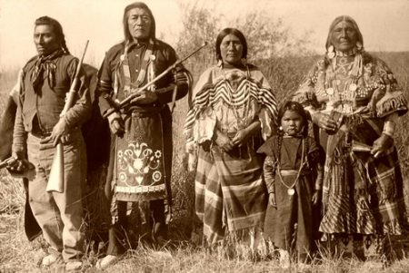
The matter of the Natives

Slide 18
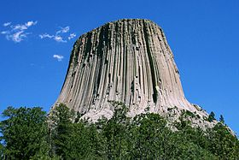
The «Antiquities Act» June, 8, 1906
It empowered the President of USA to declare as «national monuments» sites and buildings, both historical and prehistorical, and other goods of the same historic and scientific interest, placed on the territory owned or controlled by the Union;
Archaeological excavations needed an administrative permission, given by Ministers who were competent on the territory where the archaeological treasures were placed: Minister of Interior, Minister of Agricolture, Minister of War;
The permission was given to institutions – academic or scientitic – considered relevant in the activity of study and research and with the purpose of conservation, study research and management.
Devils Tower – the first national monument protected
along the rules of the «Antiquities Act»

Slide 19
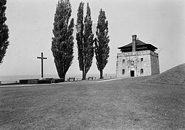
Papahanaumokuakea Marine National Monument
The largest monument protected
Father Millet Cross
Memorial
The smallest monument
protected

Slide 20
The National Park Service
National Park Service
was created on June 25
1916 through the
National Park Service
Organic Act, as an agency of the
Ministry of the Interior with
the dual duty to manage and
protect parks, sites, monuments
and make them accessible
to the public

Slide 21
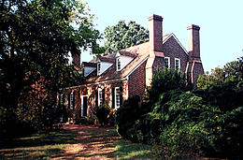
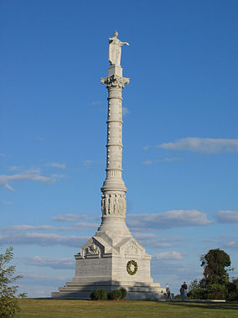
The evolution of the National Park Service
In 1930 the National Park Service was involved also in the protection of sites of historical relevance;
During the further years the National Park Service was opened to other and more general competencies by the President Roosvelt.
Franklin
Delano
Roosvelt
(1882-1945)
George Washington’s birthplace
Recognized in 1930
Yorktown Victory Monument
Virginia

Slide 22
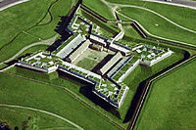
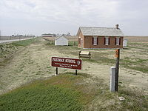
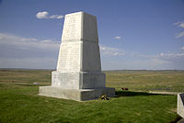
The action of Roosvelt
They were recognized 10 National Monuments, 10 battlefields and 11 national military parks.
Fort Federica – Georgia –
Recognized in 1935
Fort Stanwix – New York –
Reognized in 1935
Daniel Freeman’s Homestead – Nebraska
Recognized in 1936
Little BigHorn Battlefield – Montana
Recognized in 1940

Slide 23
The Law of 1935
It was approved on August 21 1935 with the title Historic Sites, Buildings and Antiquities Act
It defined as one of the aims of the federal policy the conservation – for the public use and benefit – Historic Sites, Buildings and Objects of National Value
The National Park Service obtained the power to acquire – through donations or other instruments, and after a financial allocation defined by the Congress – immobile objects of national and historic value
The National Park Service was also encharged of dealing inquiries on archaelogical sites and historic buildings and objects to indicate those one of exceptional commemorative value for the american history, and recollecting images and photos, maps, plants or other informations related to the same objects
The National Park Service obtained the power to establish contracts or cooperative agreements with States, Cities or Associations for the preservation of a monument or a site, or create specific associations for the protection of a singular object, monument or area if considered too expensive
For the public information around cultural asset, a program of education was included in the law

Slide 24
The competent bodies
Advisory Board on National Parks, Historic Sites, Buildings and Monuments – composed of 16 members indicated by the Minister of Interior
National Park Service Advisory Council – composed of members who concluded their service in the Advisory Board, with the aim of supporting the Board itself

Slide 25
An American National Trust
It was created in 1949 along the example
of the British National Trust, with the aim
of protecting sites and historical monuments.
Organized in the form of a charity, it was
directed by a Council composed of the Minister
of Interior, the Minister for the Justice, the Director
of the National Gallery of Arts and at least six
general administrators

Slide 26
The new protectionist sensibility in the 60s
National Trust
National Park Service
Cultural Heritage Management
American Institute of Architects
Library of the Congress

Slide 27
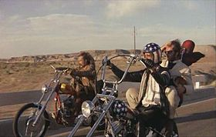
The new protectionist sensibility in the 60s
Jack Kerouac
(1922-1969)

Slide 28
New Laws for New Phenomena…
Institution of a Ministry for Transports – 1966 – within its duties, it is recognized also the protection of historic sites
Law around the metropolitan development
Law around the national policy for the environment – 1969 – I recognizes the duty of the Federal Government, and of States and local administration, to protect environment and ensure a good environmental quality to American people
Law around the aesthetic management of the highways – 1965 – It recognizes the power to acquire areas surrounding highways to manage them
1968 – it is recognized to the Ministry of Transports the power to examine projects having effects towards historic sites or monuments
1961 – Construction Act
1966 – Demonstratio Cities and metropolitan development Act – it recognizes the duty of assistance of federal or local bodies to protect, conserve and enlarge free areas, and to acquire, improve and restore areas, sites and structures of historic or achitectonic value

Slide 29
The National Historic Preservation Act – October 15 1966
It represented the general law of the American system, establishing the duty for the Government to «give the best encouragement to individual and collective initiatives for the conservation, managed with private instruments», and create the conditions of equilibrium between the development and the protection of ancient traces.
It attributed to single States the duty to realize the «National Program of Conservation», indicating the functionaries encharged.
It attributed to the National Park Service the duty to support the functionaries and to the National Trust to promote the development of public sensibility.

Slide 30
New instruments of protection
Advisory Council on Historic Preservation: it is the only federal body encharged in the protection of historic buildings and objects, with the aim of recomposing the different interests of different subjects involved (experts, art merchants, specialists, etc.): it is composed of the Minister of the Interior, the Minister of Houses and Urban Development, the Minister of Transports, the Minister of Commerce, the Minister of the Treasury, the General Attorney, the General Affairs Admnistrator, the Director of the National Trust, the Secretary of the Smithsonian Foundation. The Director of the National Park Service is the Executive Director of the Council.
The «Section 106»: it establishes some particular procedural rules around the building, restoration and management of historic buildings. The competent federal body – to authorize a proposal of «undertaking» (that is a project which could involve changes on a historic building) – has to consider the consequences on sites, structures and objects included in the «National Register».
N.B. The Section 106 is applied only on sites, buildings and objects included in the «National Register», created in 1960 by the National Park Service and comprising barrels, sites, buildings, strutures and objects considered as relevant for the histor, the architecture, the archaeology, the technology the culture of USA, included those monuments declared as National Monuments by the Ministry of the Interior along with issues of the Law of 1935.
Relics
Fragments of american history

Slide 31
The Law of 1966: further development
1971 – President Richard Nixon introduced the Act for the «Protection and Development of cultural environment», attributing to all the federal bodies the duty to manage cultural assets in favour of future generations
1976 – The Congress applied the «Section 106» to all the objects potentially deserving to be filled in the National Register and recognized the autonomy of the Advisory Council
1986: a new amendement to the «Section 106» recognized as subjects interested in the conservation: local administrations, bodies requiring federal authorization and financial supports, competent functionaries, owners of sites involved in the federal action, all the citizens
1992 – a new amendement attributed a more important role in the action of conservation to the American Natives and the Hawaian Natives

Slide 32
Legislative and administrative action at a Federal level
It was the Law of 1966 to give the States an effective power: in particular each State determined our own functionaries encharged in the management of cultural objects and sites and introduced some own rules
The systems adopted in the different States are very different: some States gave their administrative offices the main responsibilities in the management; some other involved private associations; some other created foundations or advisory councils, mostly to involve private subjects in the management
The powers used are referred to the main federal powers: expropriation, police, taxation

Slide 33
The power of expropriation
It is perhaps the main relevant power to be used by the States: they can acquire the property of a site, linking it to the public use
In 1896 the Supreme Court recognized as linked to a «public use» the institution of historical parks and battlefields. The sentence United StatesvS Gettysburg Elect. Ry. recognized the power of expropriation with regard to the institution of military park of Gettysburg
In 1954 it was established to apply the power of expropriation also to the conservation and protection of buildings and sites because of their «aesthetic beauty». The sentence BermanvSParker – set on the opposition of the inhabitants of the District of Columbia against the project of expropriation by the Government, determined the power of the Government to evaluate a city as «beauty and healthy, spacious and clean, equilibrated and attentively managed»

Slide 34
The power of police
The power of police is recognized to the State Government to maintain – adopting specific regulations and rules – hygiene, safety, public morality
It is considered much less liberal, because of the absence of indemnifications for the citizens the rules are applied on. So the Supreme Court developed a much more restricted jurisprudence around the application of this regulations and rules
The application is limited by two constitutional clauses:
The clause of the due process: the application of police regulations has to be linked to a real «public aim and public use»
The clause of the equal protection: the application of police regulations mustn’t determin injustice or inequality

Slide 35
The power of taxation
Each State adopts some fiscal instruments, especially in the category of tax relief for private associations or citizens involved in initiatives of management
A complete tax relief is provided for private areas created as public parks
States are competent also for a very particular category of cultural objects: that one of submerged relics: the Abandoned Shipwreck Act of 1987 encountered the phenomenon of depredation of objects placed in submerged shipwrecks, giving the States the power to manage as own property these relics, and in particular:
Relics stranded in submerged lands of a State
Relics stranded in coral formations protected by a State
Submerged relics deserving to be filled in the National Register

Slide 36
The role of local administrations
The main instrument used by local administration – apart from the power of expropriation, taxation and police – is the creation of Historical Districts
The application of the rules related to historical districts is managed and controlled Commissions composed of architects, historians, lawyers and law scholars, and interested citizens
Consequently, each State created a special Commission to control also these particular rules
The first case was the creation – in 1925 – of a Historical District towards the barrel ov Vieux Carrèe in New Orleans

