Slide 1
Lesson 8 Politics for cultural heritage management: a comparative approach. Ancient and Modern: the experience of Great Britain
Aims and Topics
To examine the main elements characterising the British experience;
To consider actors and actions developed during the history;
To try to point out the main relevant differences with other european experiences.

Slide 2
Some methodological points
In the English experience we can’t find an unified concept of cultural heritage, and the expression itself of «cultural heritage» - developed in the anglo-saxon doctrine – is not often used.
It depends on the flexible nature of the «common law» system present in Great Britain: this determines a spread and elastic conceptualization of cultural objects to protect, based on a juridical system empirically defined.
The flexible nature of the heritage law allows a deep interaction between institutional actors and lobbies, both at a national and at a local level.
The British system of protection is mostly referred to immovable objects: in a liberal perspective, movable are not – apart from some cases – under the protection of the law, that means also the bond of the law. It is particularly evident in the system which rules the matter of export of cultural objects.
The system of protection of ancient immovable objects is deeply linked to – and derives from – the system of urban planning.

Slide 3
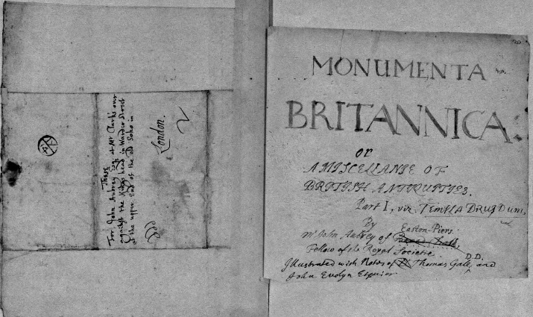
At the origins of a protectionist sensibility
Anthony Wood (1632-1695)
«Historia et Antiquitates Universitatis
Oxoniensis» - 1674
John Aubrey (1626-1697)
Monumenta Britannica
(1663-1697)

Slide 4
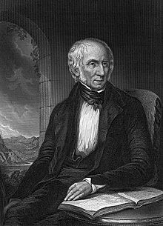
Nature/Technique The turning point of Romantic Age
Samuel Taylor Coleridge
(1772-1834)
Robert Southey
(1774-1843)
Thomas de Quincey
(1785-1859)
The so-called «Lake Poets»
John Ruskin
William Wodsworth (1770-1850)

Slide 5
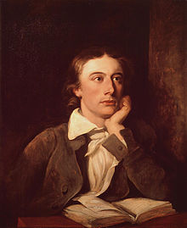
John Keats (1795-1821)
Lord Byron (1788-1824)

Slide 6
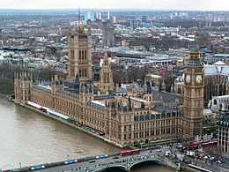
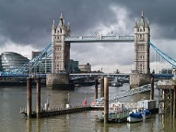
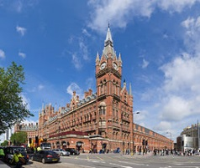
The Victorian vandalism
Fonthill Abbey
Westminster
Tower Bridge
London St. Pancrace

Slide 7
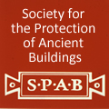
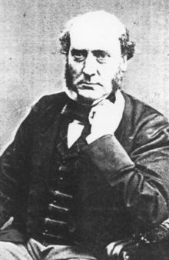
Associations and law
Sir George
Gilbert Scott
(1811-1878)
Society for the protection of ancient buildings – 1877
Inspired by the philosophy defined by John Ruskin,
it was created by William Morris. The main idea was the «restoration» of a monument in any case
to subtract it to the changing times.

Slide 8
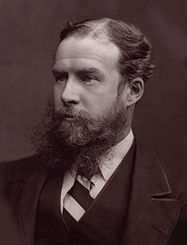
Associations and Law
Ancient Monuments Protection Act - 1882
John Lubbock
Ist Baron of Avebury
(1834-1913)
It focuses exclusively pre-historic monuments
and some of the most known sites in the country

Slide 9
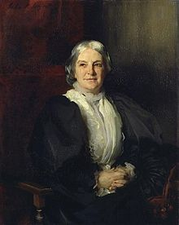
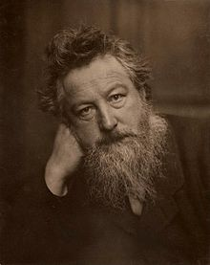
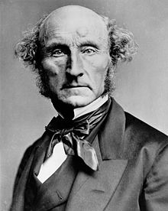
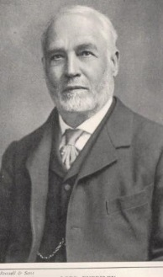
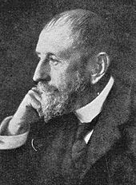
Associations and Law
Octavia Hill (1838-1912)
William Morris (1834-1896)
Commons Preservation Society - 1865
John Stuart Mill (1806-1873)
Lord Eversley (1831-1928)
Robert Hunter
(1844-1913)

Slide 10
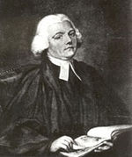
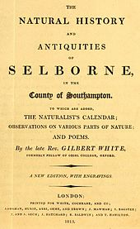
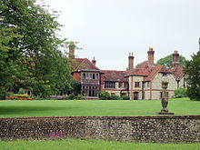
Associations and Law
Selborne Society for the Protection of Birds, Plants and Pleasant Places - 1885
Gilbert White (1720-1793)
White’s House – The Wakes - Museum

Slide 11
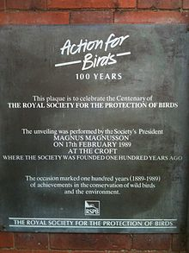
Associations and Law
Royal Society for the Protection of Birds - 1889

Slide 12
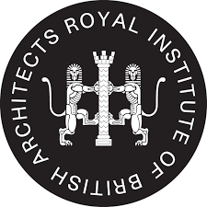
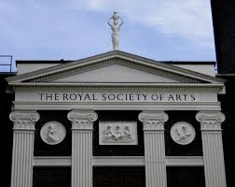
Associations and Law
British Archaeological
Association - 1843
Society of Antiquaries of London - 1751
Royal Commission on the Historical Monuments of England - 1908
Royal Institute of British Architects - 1834
Gerard Baldwin Brown (1849-1932)
Royal Society of Arts - 1754

Slide 13
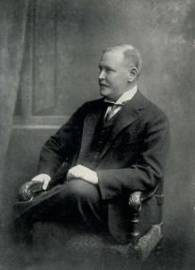
Associations and Law
Society for the Promotion of Nature Reserves - 1912
1957
Charles Rotschild (1877 – 1923)

Slide 14
Associations and Law The National Trust
Founded on 12 January 1895
by Octavia Hill, Robert Hunter,
Hardwicke Rawnsley
Its main purpose is:
«the preservation for the benefit of the Nation
of lands and tenements (including buildings)
of beauty or historic interest and,
as regards lands, for the preservation
of their natural aspects, features
and animal and plants life.
Also the preservation of furniture,
pictures and chattels of any description
having national and artistic of historic interest»
National Trust for Places of Historic Interest or Natural Beauty

Slide 15
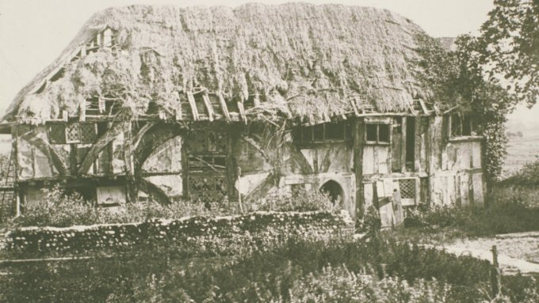
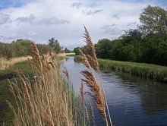
The National Trust Its juridical nature
The National Trust is a charity, that is a private association with public aims;
Its statute is defined by a national law. It is the only case in the english juridical system.
The main purpose – defined in the Act of 1907 – is «the permanent preservation for the benefit of the nation of lands and tenements (including buildings) of beauty or historic interest and as regards lands for the preservation (so far as practicable) of their aspect features and animal and plant life».
For their purposes the National Trust acquires – through different ways – buildings and lands and maintains and manages them for «purposes of public recreation resort or instruction».
Alfriston Clergy House
Bought by the NT in 1896
for 10 pounds – The first
historic building bought
Wicken Fen – First natural reserve bought by the NT in 1899

Slide 16
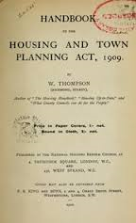
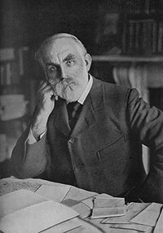
The first juridical Act of protection
Housing and Town Planning Act - 1909
The Housing and Town Planning Act was «an Act to amend the law
relating to the Houses of the Working Classes, to provide for the
making of the House Planning Schemes, and to make further provision
with respect to the appointment and duties of the County Medical
Officers of Health, and to provide for the establishment of
Public Health and Housing Committees of County Council» (Preamble)
It was organized in three parts:
Housing of the Working Classes;
Town plannning;
County Medical Officers and Councils and Town Councils
John Burns
(1858-1943)

Slide 17
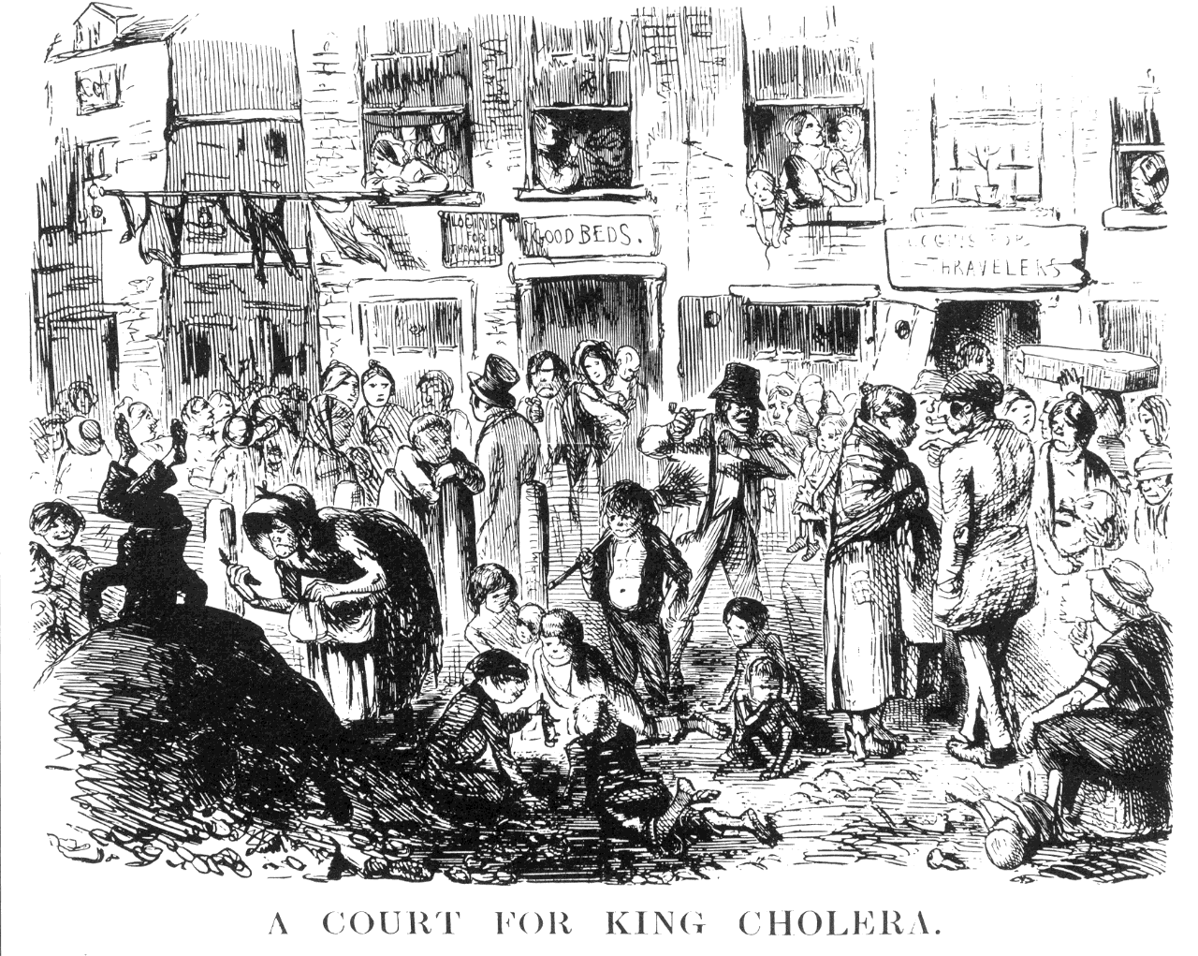
Ancient and Modern The Housing and Town Planning Act as an instrument to protect ancient buildings

Slide 18
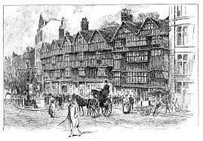

Slide 20
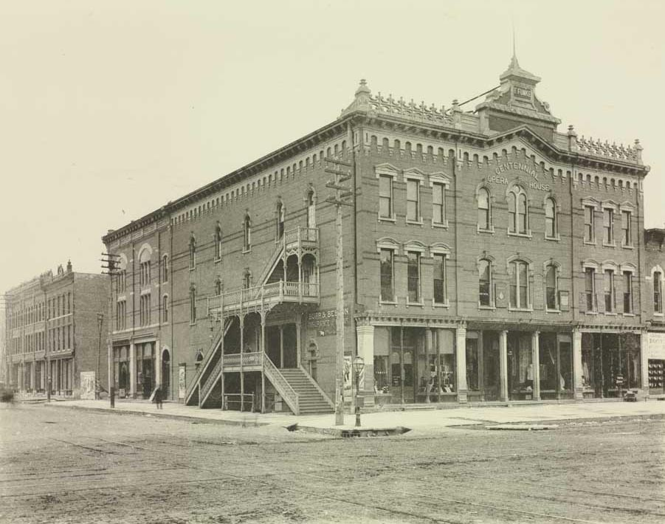
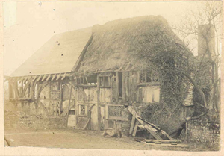
The urban development in England
1800 – 650.000
1900 – 6.500.000
London

Slide 21
After the Second World War
The Town and Country Planning Act – 1944 - introduces the concept of «Lists of Historical Buildings» and gives the Minister of Country Planning the power to fill its lists;
The Town and Country Planning Act – 1947 – introduces the main elements characterising the system of protection till today:
It is created a body for the supervision, composed of architects and experts;
It is prepared a list of building of artistic and historic interest to be protected;
It is created a particular order – the Building Preservation Order – to assure, in some particular cases, an effective protection to some buildings

Slide 22
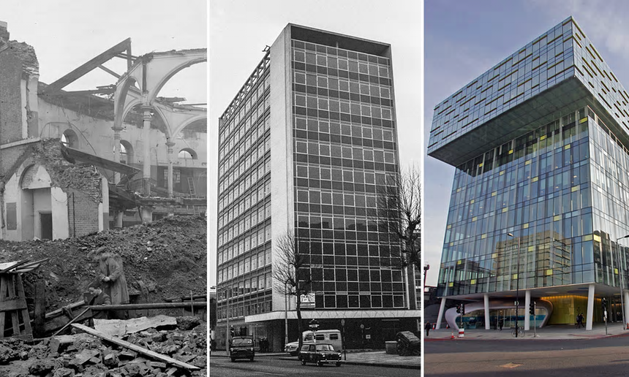
The action of public opinion during the 50s
Bomb-damage map of London

Slide 23
The further evolution
The Town and Country Planning Act – 1968 – einforces the system along three lines:
Transforming the list in a «Blanket Preservation Order» (general order of protection with respect to all the listed buildings);
It is introduced the «listed building consent» to alter or demolish a listed building;
All the «Building Preservation Orders» are abolished
The Town and Country Planning Act – 1971 – is an urbanistic law;
The Town and Country Planning Act – 1972 – pays attention to the matter of national financial funding.

Slide 24
A decentralized system
Department of National Heritage – Department of National Heritage, Media and Sport
District Councils: they manage the planning guidelines in a city;
they give permissions for works on buildings (Planning Departments)
Department of Environment
It proposes laws;
It fills the list;
It directly manages buildings
Office of Arts and Libraries
Department of the Environment
Department of Trade and Industry
Home Office – Department of Education and Science

Slide 25
A decentralized system
Society for the Protection of Ancient Buildings;
National Trust;
Town and Country Planning Association;
Civil Trust;
Amenity Societies
The local level

Slide 26
The Quangos
Chiefs of HBMC are designed by the
DoE. They rule a consultive direction
and an executive one
Historic Buildings and Monuments Commission for England - 1983
National Heritage Memorial Fund
Particular and
direct power around
London
Four regional
structures
It is directed by an administrative Board
It can buy buildings but not directly manage
The board is designed by the DoE and
the Department of Education and Science
Historic Buildings
Council for England
Monuments Commission
for England
An unitarian subject to manage the conservation policy
To deal private sources towards the cultural heritage
To promote restoration and valorization
It gives grants to private subjects
It promotes research around cultural heritage
It promotes cataloguing
Lobby

Slide 27
The role of the Church
It owns 16.700 churches;
Regular ispections of ecclesiastic buildings are managed since 300 years;
Control around demolition is managed since 700 years
The Church owns relevant funds and it spends every year almost 55 million pounds

Slide 28
The national level of the system today
Department of the Environment, Transport and the Regions
Historic Houses Association
Department of Culture, Media and Sport
It manages
planning policy
together with the Planning
Directorate and the Planning
Inspectorate
Arts –Sport – Lottery –
Libraries – Museums – Galleries
It manages – through the Royal
Parks Agency and the Historic
Royal Palaces Agency – the
Royal Buildings

Slide 29
The «conservation areas»
Earl of IveaghvS.Minister of Housing and Local Government - 1964

Slide 30
The Civic Amenities Act - 1967
District Councils have the duty and the power to determine portions of their towns considered as historically and artistically relevant and – consequently – to be protected.
Almost 8.000 conservation areas are now protected
The power is given to the local authorities.

Slide 31
The protection of environment and landscape after the Secondo World War
1949 – National Parks and Access to the Countryside Act defines the typological protected areas:
National Parks;
Areas of Outstanding Natural Beauty;
Sites of Special Scientific Interest;
Nature Reserves
National Parks Commission
Nature Conservation Commission

Slide 32
The protection of environment and landscape The last juridical acts
1968 – Countryside Act
1981 – Wildlife Act
1995 – Environment Act: it establishes a particular purposes for the protection, that is the protection and valorization of the natural beauty, wildlife and cultural heritage, and allow the understanding and enjoyment by the people. If the purpose of the conservation contrasts with the enjoyment, is the first one to prevale. Moreover, protection and valorization of the parks have to consider social and economic health of resident people.
Countryside Commission (1968): it defines parks and protected areas, makes experiments related to different matters (agricoltural activities, car traffic), it has an advisory function for the management
English Nature (1991) – it defines natural reserves and sites of scientific interest and has a scientific and technical advisory function
Independent bodies with a board composed of members designed by local authorities and the competent Minister

Slide 33
Protection of environment and landscape Results of the law of 1995
At the end of the 90s, there were in England and Wales 10 national parks (1.360.000 ha – 300.000 resident people);
At the end of the 90s there were in England and Wales 41 protected areas (more than 2.100.000 ha)
At the end of the 90s there were in England and Wales 45 sea-areas protected and classified as «heritage coast» (1.500 km of coast), managed by the local authorities together with the Countryside Commission and the Countryside Commission for Wales
About monuments and areas and buildings of historical value, the «National Heritage Act» (1983) defined the role of the English Heritage: it defines the areas, has an advisory function for the local authorities, it manages the register of parks and monuments
A similar system does exist in Scotland (Scottish Natural Heritage since 1991) and in North Ireland.

Slide 34
The recent evolution of the National Trust Some quantitative data…
At the beginning the National Trust is a very small organization, with just 720 members in 1920 and 5.300 ha of landscape owned;
It was active only in England and Wales, and – successsively – in North Ireland
The great development is evident after the First World War and the after the Second: in 1940 it had 6.800 members and 27.700 ha owned; in 1965 157.581 members and 133.00 ha; in 2003 3.100.000 members and 250.000 ha owned)
In 1931 it is created the «National Trust for Scotland for Places of Historic Interest or Natural Beauty»: officially recognized with a law of 1935, it has – at the end of 90s – around 250.000 members.
The National Trust recollects the three main perspectives of protection developed in the anglo-saxon system: the purely aesthetic, the perspective of the «heritage», the ecological perspective, developed since the 60s.

Slide 35
The structure of the National Trust Evolution and einforcement
Powers and functions of the NT have been enlarged with different and successive laws: the first one was in 1937 – the power to acquire buildings not only of historical interest, but more generally of «national and architectural interest», and objects of particular value; in particular the National Trust focalised the management and preservation of «country houses»; also, the NT opened its duties to the public access; the second was the Act of 1971 which re-defined the structure and the rules of membership
The National Trust is a charity: a private association (volunteeringly founded) but with recognized public purposes: it uses a 4.500 persons staff, and around 34.000 volunteers: around 137.000 persons are occupied in the management of the different owned sites; it is managed by a Council of 52 members (encharged for 3 years), half elected and half designed by scientific and academic personalities; together with this first body, it does exist a second body: the Executive Committee, composed of members of the Council and of the Regional Committees (32 members): executive functions they have the regional committees;
Finally, the National Trust is directed by a General Director, through a structure divided in three sections: conservation, customer services, human resources and legal services; finance and information system; policy and strategy.

Slide 36
The National Trust Contents and activity
The most relevant activity is acquiring cultural natural assets becoming owner and managing them
The National Trust doesn’t have pre-emption rights and it can’t use the instrument of expropriation (on the contrary the Conservatoire in France has both the first and the second instrument)
Consequently, it operates as a normal «merchant» in the market of arts and landscape
It has some particular rules and uses which favours and allows its action: for example if a person decides to donate a property (a building e.g.), he can remain in the building and express some issues around use and destination

Slide 37
The National Trust Contents and activity
The National Trust has an absolute privilege consisting of the power to declare inalienable its owner, if considered of particularly relevant value.
Consequently, the NT can’t sell its properties or apply real warranties, apart from the case of an Act of the Parliament deciding it.
Sometimes, in particular cases, the NT properties can be the object of a «compulsory acquisition» – a particular way of acquisition by public bodies and institutions; with the «Acquisition of Land Act» (1946) the National Trust can oppose and require a particular procedure to evaluate the request, with a Committee designed by the Parlament.
Consequently, these instruments place the NT properties in a particular juridical area of «inalienable objects and sites», «for the benefit of the Nation»
At the end of the 90s the NT was the owner of 275.000 ha of landscape, 20.000 buildings of different interest and nature, 280 historic buildings, 160 gardens, 75 parks, 40.000 archaelogical sites and 50 villages of historic interest.

Slide 38
The National Trust Contents and activity
The National Trust also uses some «conservation covenants» with private subjects to apply limits to the use of particular buildings or sites;
In other cases, the National Trust can use a form of «lease» for a long period (for example at the moment 500 ha of the Lake District are managed by the Trust through a lease of 500 years) or gives with the same instrument a portion of landscape or a historic building to a different subject (for example environmental associations or the English Nature)
Especially at the beginning the NT acquired portions of the English, Walsh and Irish coast. In particular, we have to mention the so-called «Neptune Enterprise» – started in 1965 – for the protection of the coast, which allowed to recollect 34 million pounds and acquire 665 km of coast.

Slide 39
The National Trust Managing the property
We consider the «National Trust Strategic Plan» (2004-2007), which established the main purposes and strategice lines and the performance-level to reach.
For each property, the NT defines a «statement of significance», describing particular nature and charateristics of the site, consulting local communities and private associations.
The National Trust is developing a particular attention to the role of local communities considering the peculiar and specific nature of the sites and their relations with the entire national system.
Considering the enormously growing number of visitors (around 50 millions a year on the entire property of the NT), the NT established the prevalence of the conservation on the enjoyment, considerd just as an instrument to reach the first aim.
A particular relevance assumes also the agricultural activities developed on the properties of the NT, with more than 2.000 farms.

Slide 46
Historic Buildings/Ancient Monuments
Ancient Monuments, introduced in a schedule (scheduled monuments), that is in register, or considered – by the Minister for Environment – of «national interest for their historic, traditional, artistic or archaeological value»
12.800 ancient buildings at the beginning of the 90s
Historic Buildings, listed in different categories: built before 1700, built between 1700 and 1840, built between 1840 and 1915, and after 1915 till 1939, along different characteristics
6.000 buildings of «exceptional interest» – 20.000 of «particular interest»

Slide 47
The protection of movable objects
The English system doesn’t protect clearly movable objects: the common law supplies with its rules considering movable artistic or historical objects as a normal property, apart from the cases of acts of the parliament.
Some restrictive rules limit the exportation
Some particular rules are applied to the public collections: e.g. the ancient feudal rights are applied on some archives under the control of the «Master of Rolls» (Magister rotulorum), since 1875 President of the Court of Appel
No rules are applied on private archives, apart from the case they are acquired by local authorities or public archives or libraries
Private objects are free in a liberal system.
They belong to the owner

Slide 48
The system of exportation
Till the XX° century, it doesn’t exist a system which rules the matter of exportation.
In 1950 the Chancellor of the Exchequer promotes a Committee (under the direction of Lord Waverley) to establish some rules around the problem. It doesn’t introduce a law, but just some rules: a particular attention has to be payied for the exportation of objects producted since more than 100 years or imported since more than 50 years, and having a value of more than 1.000 pounds. The exportation of objects of particular value needs a licence. This licence is given by the Reviewing Committee on Export of Works of Art.
Objects of particular value need – to be exported – a particular licence: the European Community Export Licence – for the exportation out of the European Community of objects controlled with the European system – and the United Kingdom Export Licence for the exportation in the European Union.
Against the illicit traffic of works of art, the main societies of antiquieties subscribed a sort of code – in 1984 – to respect the Unesco Convention of 1970, and a particular licence is required for the exportation of objects having a value of more than 400 pounds.
A particular rule is appliced on the objects considered as «treasures» along the law of 1997: who discoveres an object of this category has to declare to the coroner for the evaluation and the conservation.

Slide 49
The Museums
The National Museum are managed and directed by a Board of Trustee;
The local Museums are managed and directed by local councils and local authorities
They have financial autonomy and they manage museums with a large level of freedom.

