Slide 1
Lesson 7 Politics for cultural heritage management in a comparative approach. The idealistic approach in Germany
Aims and Topics
Examining the main elements of the German experience
Considering the different ideological approach characterising the German experience
Observing the most recent development of the German system

Slide 2
The uncertain origins of a movement
In some parts of the German territory – especially in the Anseatic-League cities – noble families payied attention to the matter of cultural heritage protection within the constitutional power
In the Eastern part of Germany, cultural heritage management was an instrument to define the politics of conquest on the slavic populations

Slide 3
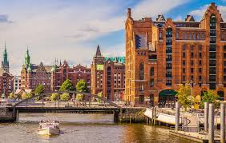
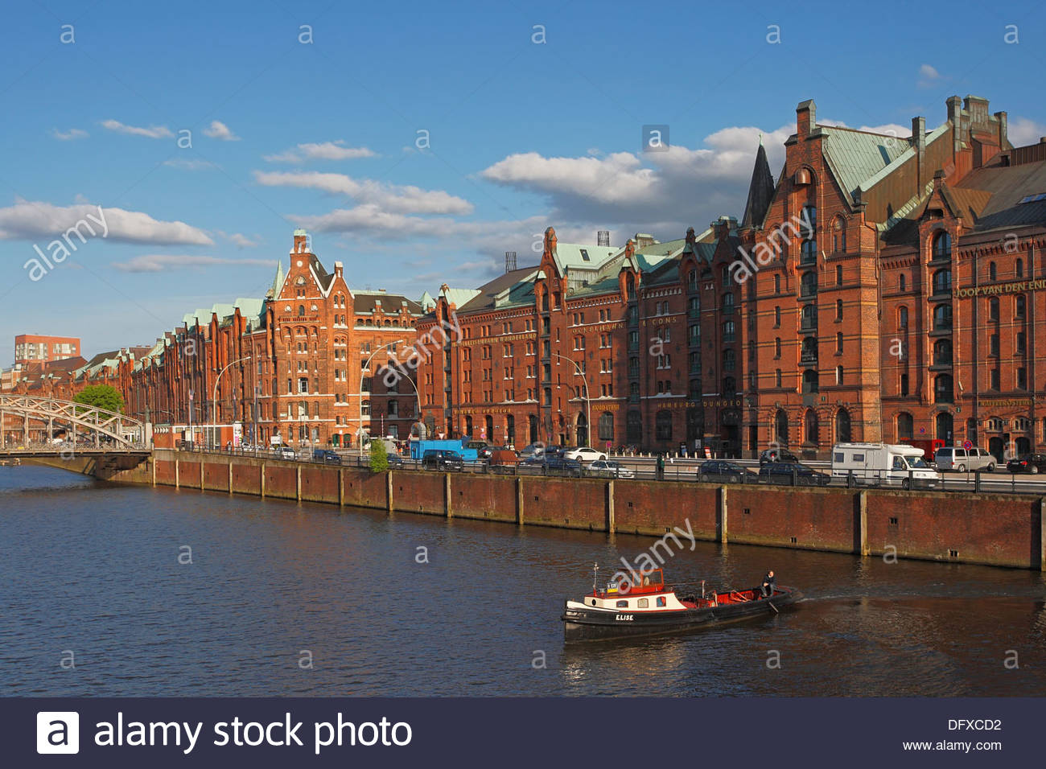
…some examples…

Slide 4
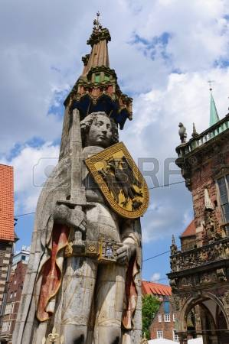
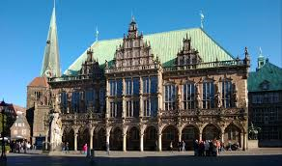
…some examples…

Slide 5
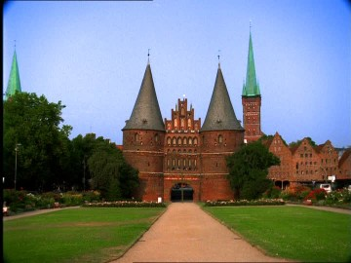
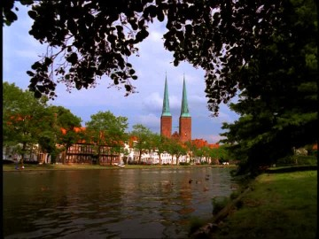
…some examples…

Slide 6
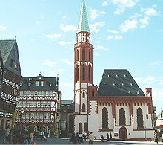
…some examples…

Slide 7
The main elements of the German experience
Cultural Heritage is protected as an expression of the «spirit of the Nation» (Volksgeist)
The protection is especially focalised on landscape as Heimat (homeland)
Cultural Heritage is considered as an expression of the State (State of Culture)

Slide 8
The first German Laws
Regulations of Hessen and Bavaria and the «Museum Fredericianum» – 1780;
Prussian Law introduced by Frederick the Great:
He called for a restrictive regulation on the circulation of assets, «to the degree in which the conservation of an object has a relevant influece on the protection of the common good, the State is legitimized in forbidding its destruction or removal»

Slide 9
After 1815…the Confederation of German States
In a general authoritarian organization, Princess of different States of the Confederation focalised their activity on matters and spaces of freedom: one of this was certainly politics for cultural heritage.
The first juridical acts of protection emerged in this period:
Hessen-Darmstadt;
Bavaria;
Württemberg
After 1815

Slide 10
Two main elements…
An accentuated decentralization:
e.g. introduction of a general inventory of architecture by the Grand Duke Ludwig I in Hessen-Darmstadt – remained till 1870 and directed to all the administrations;
A dialectic relationship between the State and the bourgeoise

Slide 11
Instruments of protection
Konservator der Kunstdenkmäler für den gesamten Bereich der Monarchie – Conservator of the artistic monuments in the entire territory of the Monarchy (1843)
Kommission zur Erforschung und Erhaltung der Kunst denkmäler – Commission for the investigation and conservation of artistic monuments (1853)
Private associations: eg. Verein zur Beförderung des Gartenbaus im Preussischen Staat – Association for the promotion of the institution of gardens in the Prussian State (1822)

Slide 12
The case of Hessen-Darmstadt The «Law around Conservation» – 16 July 1902
A Commission is created in January 1902; it presents a first draft in april and finally the law is approved in july
In September 1899 is created the «Gesamtvereins der deutschen Geschichts un Altertumsvereins – 124 associations

Slide 13
The law for conservation in Hessen Wurttemberg - 1902
The structure
Monuments in possession of legal persons of public right;
Architectural monuments in possession of private persons;
Special rules for single cases;
Excavations and discoveries;
Organisation of cultural heritage protection;
Natural Heritage;
Final provisions

Slide 14
The Law of Hessen-Darmstadt - 1902
a)it protected not only buildings of particular historical relevance, but also “the natural formations of the earth’s surface such as waterways, rocks, trees, whose conservation constitutes public interest for the respect of history, of the history of nature, and the beauty and peculiarity of landscape”
b)protection dressed by the local administrations: “heimat” as “miniature homeland”
c)public monuments protected by law, private monuments protected after classification
d)protection could include the prohibition of installations of advertising

Slide 15
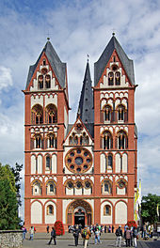
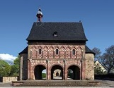

Slide 16
A liberal system…
With respect to the juridical system of Prussia, the law of Hessen-Darmstadt of 1902 was very liberal, and defined an open idea of cultural heritage: buildings with exceptional value, but also popular art and architecture, and the entire heritage having a local or regional value.
This act was the model for other further acts introduced:
In Hamburg – 1920;
In Lippe – 1920;
In Mecklemburg-Schwerin – 1924;
Saxony - 1934

Slide 17
Theoretical, Ideological, Philosophical basis of the German approach
Idealistic origins of the protectionist movement in Germany: cultural heritage as expression of «the spirit of Nation» (Volksgeist) – Fichte – Hegel – the German romanticism
A particular attention is payied to the problem of landscape, protected as part of national spirit – Heimat - Homeland

Slide 18
«Fathers» of German protectionist movement
Alexander von Humboldt – Kosmos – 1843-1859
Ernst Haeckel – Ecology
Carl Georg Schillings – protection of animals and plants
Associations and groups

Slide 19
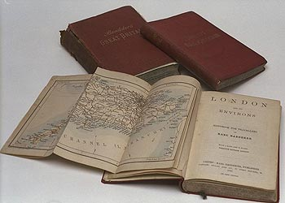
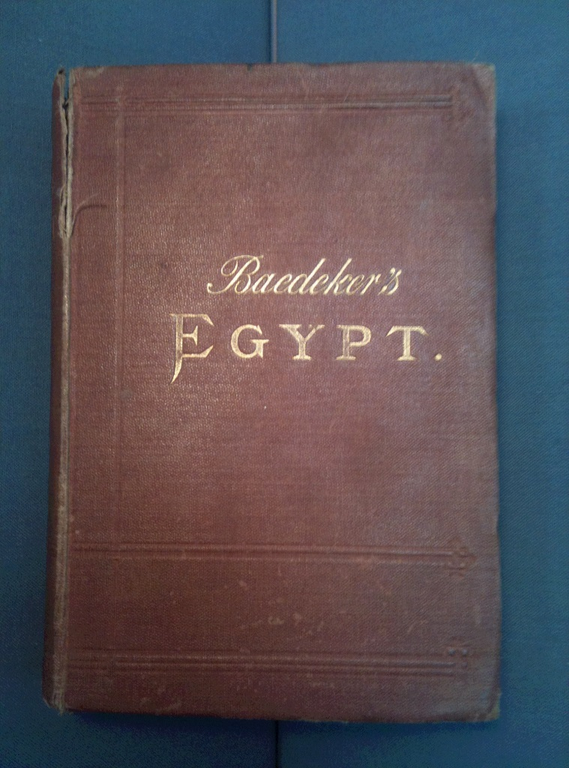
The role of the Touring Club

Slide 20
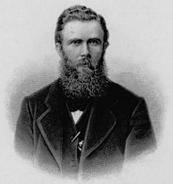
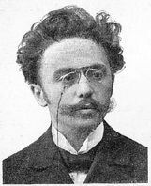
The idea of Heimat
Heimat is the idea of a cultural identity founded on the traditional community and its territory: it is an idea which contrasts the process of modernization, mixed with the movements of Lebensreform and of Völkish.
Ernst Rudorff
(1840-1916)
Friedrich Lienhard
(1865-1929)

Slide 21
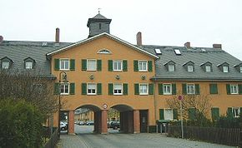
The idea of Heimat
Heimatschutzsarkitektur - Heimatschutzstil
Paul Schultze-Naumburg
(1869-1949)
Raylways-workers houses - Frankfurt

Slide 22
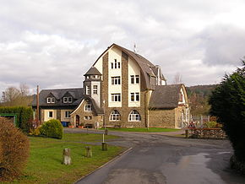
Wiehl – Town Hall
Raylway station
Braunfels-Oberndorf

Slide 23
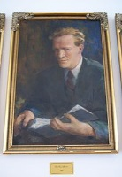
Theodor Fischer
(1862-1938)
Karl Gruber
(1909-1995)

Slide 24
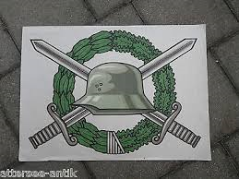
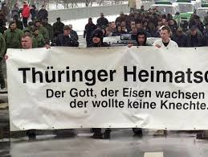

Slide 26
The Weimar Constitution - 1919
Historical monuments, works of art, natural beauties, landscape
are protected and tutelated by the Reich.
the Reich has the duty to forbidd the exportation abroad
of works of art of its own property – art. 150

Slide 27
Under the Nazism
It was extended the protection also to the rural landscape, apart from cultural asset
Instead, it was much less considered the urban landscape
Art was considered as one of the most relevant instruments of propaganda

Slide 29
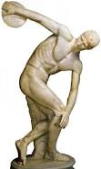
Rodolfo Siviero
(1911-1983)

Slide 30
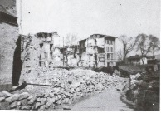
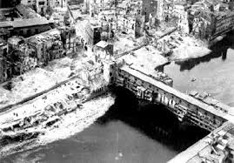

Slide 31
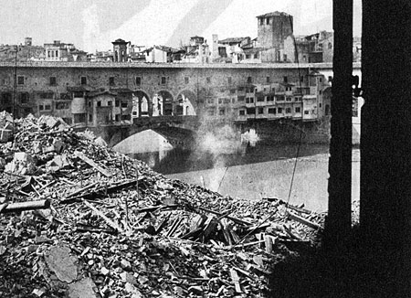

Slide 32
After the War – Germany divided
No rules are stated for the tutelage:
because they continue to refer to article
150 of the Weimar Constitution and because
all the actions are focalised on the matter
of restoration and reconstruction.
Just at the beginning of the 60s a protectionist
consciousness emerges.

Slide 33
The last development – after the re-unification A decentralized system
The German Constitution – the Fundamental Law or Grundgesetz –
establishes the power of the different Länder to introduce acts
around cultural heritage if this powers are not established within
the competence of the Bund.
As the Grundgesetz doesn’t establish this power as an exclusive one
for the Federation, neither in the other – parallel – juridical systems –
neither in the general system of the Federation, the Länder are the
Exclusively competent bodies on this matter.
Consequently, we have in Germany a typical decentralised system

Slide 34
The examples of the Länder
The Länder are the exclusively competent bodies on the matter of cultural heritage protection. They are competent also towards the matter of exportation of works of art abroad.
Some other laws establish and confirm this system: in particular some rules introduced in the Criminal Law, which punishes damage of public monuments and objects of art conserved in public collections – art. 304 – and the Civil Law, which defines the acquisition of treasures of art.
Some other rules define federal powers around cultural heritage:
Rules of protection of cultural heritage in the goverment of landscape;
Rules of protection of cultural heritage in the government of federal roads;
Rules of protection of cultural heritage in the government of federal raylways;
Rules of protection of cultural heritage in the law around the federal river traffic;
Rules of protection of cultural heritage in the law around the agricoltural properties;
Rules of protection of cultural heritage in the law around landscape and environment management.

Slide 35
The Laws of the Länder
Baden-Württemberg: Gesetz zum Schutz der Kulturdenkmale – 25 Ma 1971;
Bayern: Gesetz zum Schutz und zur Pflege der Denkmäler – 25 Juni 1973;
Berlin: Gesetz zum Schutz dem Denkmalen in Berlin – 22 Dezember 1977;
Bremen: Gesetz zum Pflege und zum Schutz der Kulturdenkmäler – 27 Mai 1975;
Brandenburg: Gesetz uber den Schutz und die Pflege der Denkmale und Bodendenkmale in Land Brandenburg – 22 Juli 1991;
Hamburg: Denkmalschutzgesetz – 30 Mai 1978;
Hessen: Gesetz zum Schutze der Kulturdenkmäler – 23 September 1974;
Mecklemburg-Vorpommern: Gesetz zum Schutz und zum Pflege von Denkmäler im Land Mecklemburg-Vorpommern – 30 November 1993;
Niedersachsen: Niedersachsisches Denkmalschutzgesetz – 30 Mai 1978;
Nordrhein-Westfalen: Gesetz zur Schutz und zur Pflege der Denkmäler im Lande Nordrhein-Westfalen – 11 Marz 1980;
Rheinland-Pfalz: Landgesetz zum Schutz und zur Pflege der Kulturdenkmäler – 23 Marz 1978;
Saarland: Gesetz nr. 1067 zum Schutz und zur Pflege der Kulturdenkmäler im Saarland – 12 Oktober 1977;
Sachsen: Gesetz zum Schutz und zur Pflege der Kulturdenkmale im Freistaat Sachsen – 3 Marz 1993;
Schleswig-Holstein: Gesetz zum Schutze der Kulturdenkmale – 7 Juli 1958;
Thüringen: Gesetz zur Pflege und zum Schutz der Kulturdenkmale in Land Thüringen – 7 Januar 1992

Slide 36
The Competent Bodies
Technical offices specialized in the conservation of the monuments, which are the «scientific instruments» of the conservation – Denkmalfachbehörde
Administrations for the protection of the monuments, with powers of police-offices – Denkmalschutzbehörde
Advisory Commissions
Untere Denkmalschutzbehörden
Mittlere
Obere
Oberste

Slide 37
The Competent Bodies Some more details Functions and Powers
Consultation, proposal and cooperation around the protection of monuments;
Study and collection of monuments;
Management of specialized libraries and archives;
Development of public awareness campaigns;
Management and restoration of monuments belonging to the State;
Advisory and consultant activity to private owners;
Establishment of relationships;
Technical advisory reports;
Works of restoration and conservation of monuments, research and tutelage of archaeological excavations;
Issuance of tax certificates;
Apponting charge fees.

Slide 38
Competent Bodies Some more details
They have different names and, above all, they are not hyerarchically organized with respect to the administrations. They have a specialistic and scientific character and, consequently, they are autonomous
They are composed of non specialized personnell and they work together with local associations – They are hyerarchically organized: in the big Lander we found four levels (cities, groups of cities, Regions and Land); in the small Lander we found three levels (absent the Regional one), the «State-cities» have just one level

Slide 39
The tutelage
The most relevant action of tutelage is the inscription of an object (typically an immovable object) in the Inventory, an administrative act which is considered as real, as it determines some consequences on the object. In particular:
The inscription needs an owner’s audition;
It needs also the audition of the local communities, as the inscription limits their power of local space development and building;
The inscription has to be communicated to the owners because it limits their rights of ownership; the inventory can be consulted by public;
Communication to owners doesn’t imply communication to a future purchaser;
The Inventory can be modified if the object is not considered more as an object of interest;
Particularly menaced buildings can be placed under a temporary protection.

Slide 40
The tutelage Inscription through information
In this case the object is automatically protected without being necessary an act of public authority;
This act is not considered as an administrative act, and consequentely:
It doesn’t need an owner’s audition;
Only in some Lander local communities have an advisory role
In three cases it is used a mixed system – Schleswig-Holstein, Baden-Württember, Brandenburg – where the inscription as an administrative act is used only for the immovable objects of particular cultural interest.

Slide 41
The protected objects: their management
The most general and important duty for the owner of an object listed in the inventory is its conservation: it means management with a particular care, a good level of conservation, restoration;
It is forbidden to produce alteration of a protected object: the owner can’t – without the permission of the administration of monuments – operate to modify substance or external features of a monument, neither destroy it;
The owner has the duty of allowing the access to the monument for the public, along rules and manners established together with the administration of monuments; the personnell of the administration can access the monument to acquire informations.

Slide 42
First refusal and expropriation
The German system contains the institute of the first refusal, belonging – in different cases – to the Land or the local authority;
Expropriation is allowed in any case when the protection can be assured in different manners, and the possible institutions can be the Land itself, the local community, an administrative authority, or public or private Foundations;
In the German system, moreover, also the recognition of the historical-cultural value corresponds to the expropriation, determining an indemnification for the owner.

Slide 43
Descovery of cultural objects
Each Land has its rules to define the matter of descovery of cultural objects;
Each Land establishes also some financial supports for the descovery and management: both direct and undirect supports:
Direct are subsidies and loans to the owner;
Undirect are tax breaks.

