Slide 1
Lesson 6 Politics for cultural heritage Different experiences in the world The case of France and the legacy of the Enlightmenment
Aims and Topics
To examine the experience of politics for cultural heritage managament in France through XIX° and XX° century;
To consider the most relevant elements of the French experience;
To evaluate the relevance of the experience
Literature+legislative action (Unesco website)

Slide 2
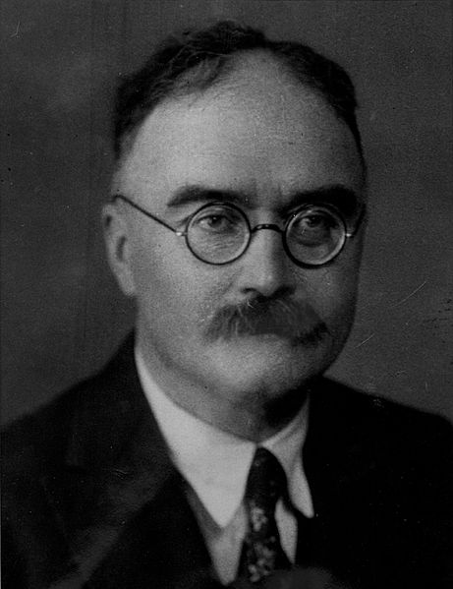
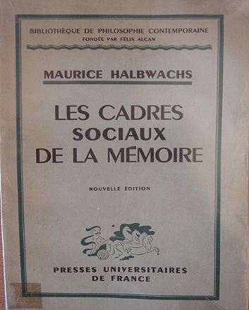
Cultural asset and spirit of the Nation The role of cultural objects and the nation building process
Aesthetic and Politics
Cultural objects as elements
of the symbolic stage of the
Nation
Perceptibility
Specificity
Singularity
Jean-Claude Passeron
«Le raisonnament
sociologique. L’espace
non-poppérien du
raisonnament naturel»,
Paris, 1991
Maurice Halbwachs
(1877-1945)
Jacques-Louis David, «The oath of Orazi» – 1784 - Louvre

Slide 3
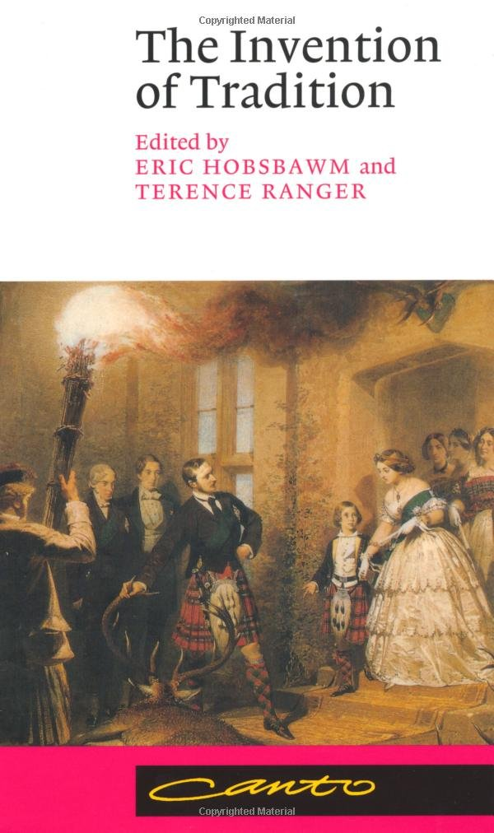
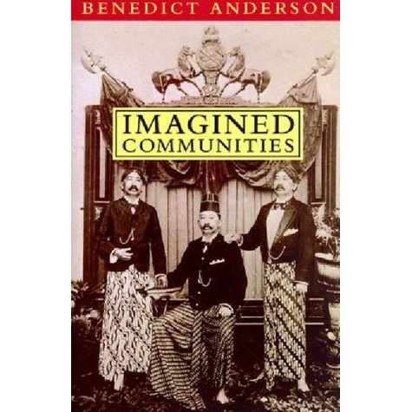
The Nation Building Process The role of cultural heritage
Eric Hobsbawm (1917 – 2012)
Benedict Anderson (1936 – 2015)

Slide 4
The Nation Building Process Threshold and Capitalization
Roland Barthes (1915 – 1980)
«Essais critiques» – 1964
Capitalization: an experience of
recognition of the past through
its signs, with a process of authentication
Victor Turner (1920 – 1983)
Threshold: the limit between a community which
has been destroyed and a new community which
is being rebuilt. Here the symbolic role of the past
takes its place, becoming «cultural asset»
Private owner
Nation

Slide 5
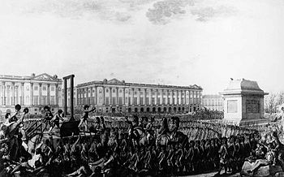
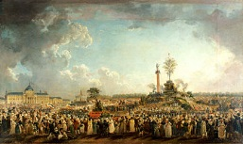
The Nation Building Process The Revolution
Charles Thévenin (1764 – 1838)
«La prise de la Bastille» - 1793
Louis XVI executed
Pierre-Antoine Demachy (1723 – 1807)
Féte de l’Être Suprême - 1794

Slide 6
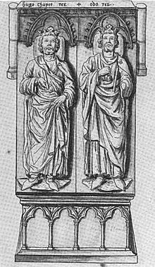
…before the Revolution…
Nicolas-Claude Fabri de Pieresc (1580-1637)
François-Roger de Gaignieres (1642-1715)

Slide 7
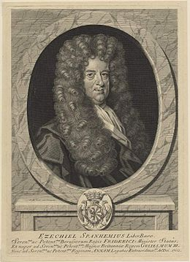
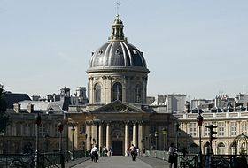
…before the Revolution… The foundation of some «sciences of memory»
Petite Académie – Académie des Inscriptions et
des Belles-Lettres (1716)
Jean Mabillon (1632-1707)
Diplomacy
Ezechiel Spanheim
(1629-1710)
Numismatics

Slide 8
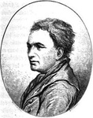
…before the Revolution… Enlightenment and Erudition
Etienne Maurice Falconet
(1716 – 1791)
History is erudition: seeking the origins and the original structure
of an institution, without a completely defined sense of aesthetic
hierarchy
Voltaire (1694 – 1778)

Slide 9
The Revolution
«public instruction lights the spirit,
National education builds the heart»
History as authority of tradition/History as authority established by reason and politics: only what is considered important in the new «national narration» has to be preserved and considered as historically important. Against the tradition, the contract
Jean-Paul Rabaut Saint-Etienne
(1743-1793)

Slide 10
The Revolution Decontextualization - Recontextualization
Objects considered as important in the new «historical narration» od the Nation, must be decontextualized from their territorial and historical origins. This processes gives them an universal value;
The value is considered from the point of view of the new historical narration and from the point of view of the beauty: this process gives them a value of universal beauty, as a vehicle of cosmopolitism and universal language;
This process is promoted and obtained through the invention of new «belonging places»: museums, Pantheons, parks of memory, cemeteries: here the nation defines its new memory, its new past, its new history;
These new places give the past – designed and narrated in the objects (monuments, peintures, sculptures, etc.) a new national value. Objects are recollected from the whole national territory and distributed all over the national territory.
The past – in its organization, location, management – is defined by the most universal and national instrument: the law.

Slide 11
The Revolution The Museum
The Museum represents the crucial institution in the new theory of cultural asset defined by the Revolution and after the Revolution. It is the place where the beauty – represented in the monuments, in the peintures, in the sculptures – is recollected, managed and showed, for the purpose of the national consciousness building. To build the «new citizen» means giving examples of the national history: these examples – together with the study of history and literature – are found in the cultural objects recollected in the museum.

Slide 12
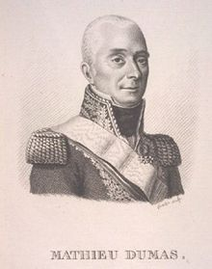
The Revolution The debate around the idea of «beauty»
Historical Beauty
is defined by the reason.
The Museum will be created
in the new «Republic»
Tradition
Antoine Chrysostome Quatremere-de Quincy
(1755-1849)
Historical Beauty is something unrepeatable,
linked to the specific historic conditions of an age
The example of museum is «the city of Rome»
Reason
Mathieu Dumas (1753-1837)

Slide 13
A theory for the conservation
Development of institutions and associations devoted to the conservation:
Societies of erudition and historical studies (1815 – 1830-’40);
Société de l’Histoire de France – 1835;
Société française pour la conservation des monuments – Institut des Provinces – 1830;
Congrès scientifiques régionaux de la France
Inspector for the monument: in the words of François Guizot «he establishes direct relationships with authorities and people who study the history of each place of the country, gives the owners informations related to the importance of their historical properties, deals and stimulates the different institutions devoted to the management of historical monuments».

Slide 14
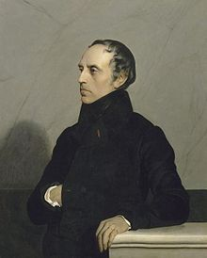
The relevance of archaeology
Archaeology becomes the most relevant science because of its power to re-discover and design the past, and the history of a nation. The archaeology is developed on an erudistic basis, but it acquires a scientific and political value, it recollects national energies and deals them towards a purpose of government, showing the power within a long process of historic development. This power is defined within the sovereignity of the reason, justice and rights, against the power and prevalence of tradition and superstition.
François Guizot (1787-1874)

Slide 15
Politics for cultural heritage management in France The main elements
The Enlightement root of the concept of heritage;
The «historical decontextualiation» of heritage;
The change in artistic production;
The role of Paris;
Heritage as an «ambassador of French culture»

Slide 16
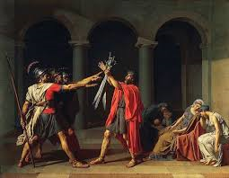
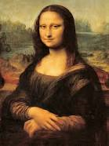
The Enlightment root of the concept of cultural heritage
The beauty represents the history of the nation, but it is to be enjoyed for its universal value, as a universal language and universal vehicle of knowledge

Slide 17
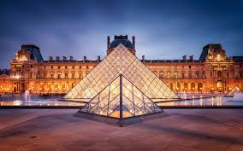
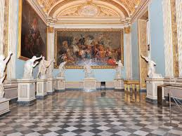
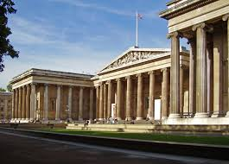
The «historical decontextualization» of the heritage
The «decontextualized» asset is positioned in a place where it «lives» as such: it is the modern Museum.

Slide 18
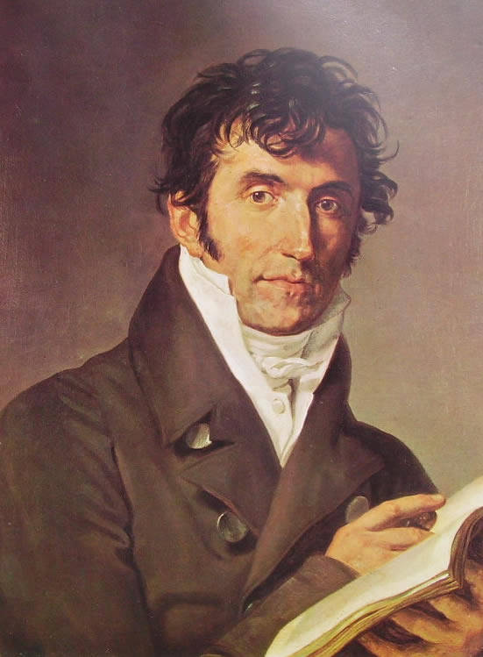
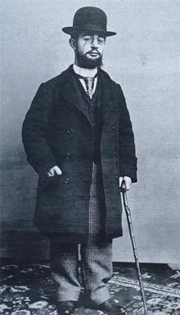
The change in artistic production
From the private commitment, artist is linked to the public commitment: he produces for an artistic market, but he also produces for the nation.
Henry de Toulouse-Lautrec
(1864-1901)

Slide 19
The role of Paris

Slide 20
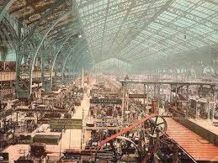
Cultural Heritage as «ambassador of the French culture»

Slide 21
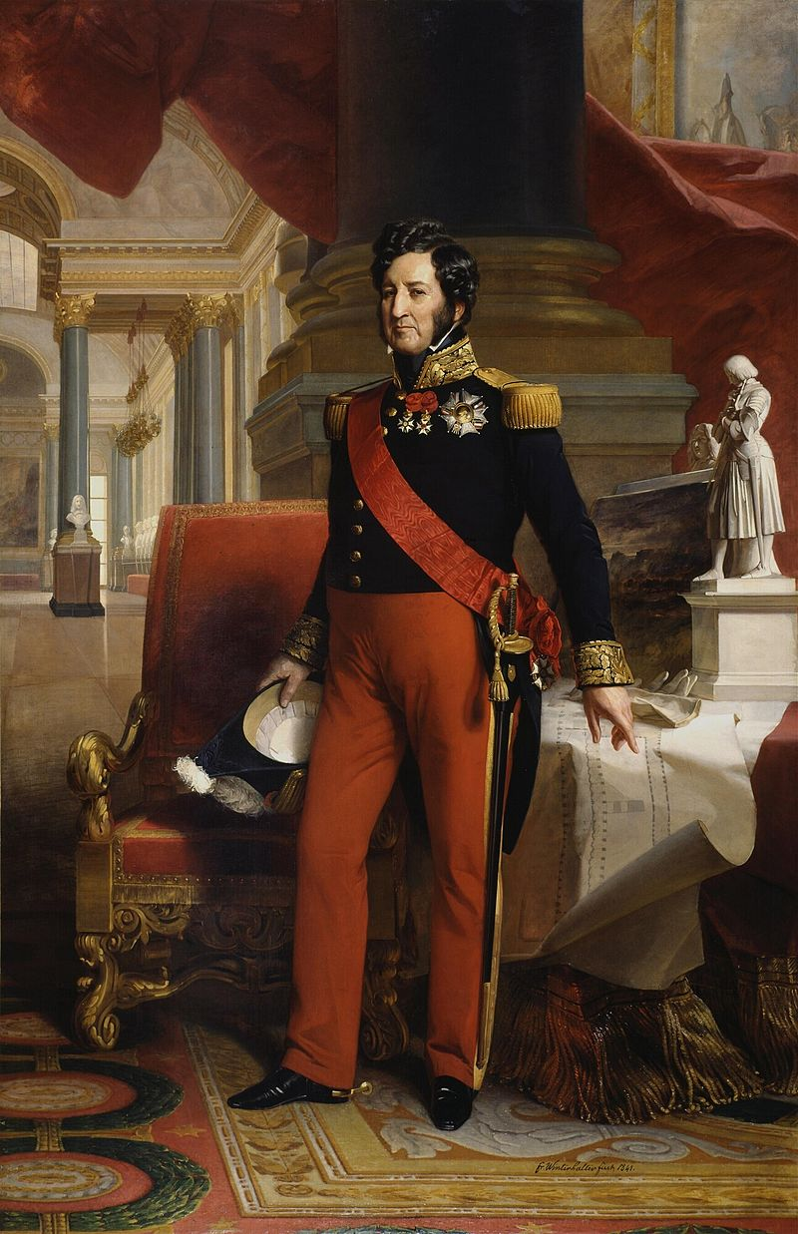
Politics for cultural heritage managemente in France. The historical evolution till 1913
The legacy of «The Monarchy of July»
It was a period of gigantic development of the history as a science,
linked to the purpose of the nation building process.
In this context, also the history of monuments and cultural objects became
a crucial instrument, showing the history of France in the relics.

Slide 22
Politics for cultural heritage management in France. The «Monarchy of July»
A Commission for the historic monuments is created in 1837 for the purpose of «defining the budget and examining the projects of restoration»;
A specific inspector – the Inspector for the historic monuments – is created in 1830;
A complete budget for the management of monuments is created in 1830 (200.000 French francs).
The protectionist sensibility
emerges at an administrative and not
juridical level.
It is the State
the subject which assumes
the control.
The role of private
associations is
completely reduced.

Slide 23
The administrative control during the «Monarchy of July»
National Service for the Historical Monuments
Ministry of Public Education
Inspector for the Historical Monuments: he fills reports for the Commission around monuments, budget, restoration etc; gives his opinion around projects of restoration (generally defined by architects). Progressively it is created a National Inspectorate,
National Commission for the Historical Monuments – just an advisory function, and not a juridical one, but of course very relevant

Slide 24
The administrative control during the «Monarchy of July». Other instruments and bodies
For the management of objects of art, the Commission creates a network of experts, corresponding, with reports and notes, from all the Departments of the nation;
The National Service for the civic buildings depends on the Ministry of Public Works, and has an its own body of architects; it is encharged of the management of buildings holding public offices or State bodies;
The National Service for the Residence of the King or Emperor manages the «real estate»: Versailles, Saint Cloud, Fointainbleau). After the Second Empire these two services (civic buildings and real estate) are unified in the National Service for the civic buildings and the national palaces. This explains why – till the beginning of the XX° century – the Service for the Monuments won’t manage this kind of national property;
The National Service for Religious Affairs depends on the Ministry of Interior and manages all the religious buildings. It has an its own body of architect but sometimes other particularly relevant and famous architects can be encharged.

Slide 25
A liberal/illiberal system
The system defined under the «Monarchy of July» is a liberal one: no one legal servitude can be imposed without an act of expropriation for public utility;
The State used very seldom the power of expropriation; so its action was directed mostly towards public buildings;
The action of the State is directed towards Ministers, Prefects or local communities;
The management is financed if and when a monument or an objects is classified, that is «listed» in the national list of monuments and objects deserving to be protected; but the Service finances only actions of restoration and conservation; the maintenance belonges to the owner;
This action is much less effcient with regard to the movable properties; much slow is the classification and less the financing action;
The criminal law punishes acts of vandalism.

Slide 26
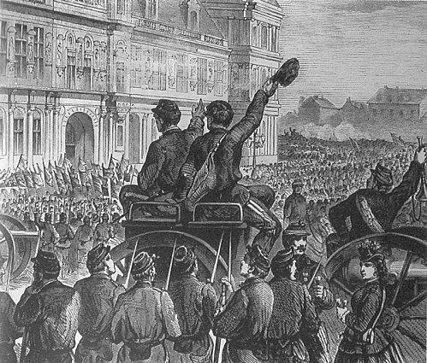
The law of 1887
The French-Prussian War (1870)
La Commune - 1871

Slide 27
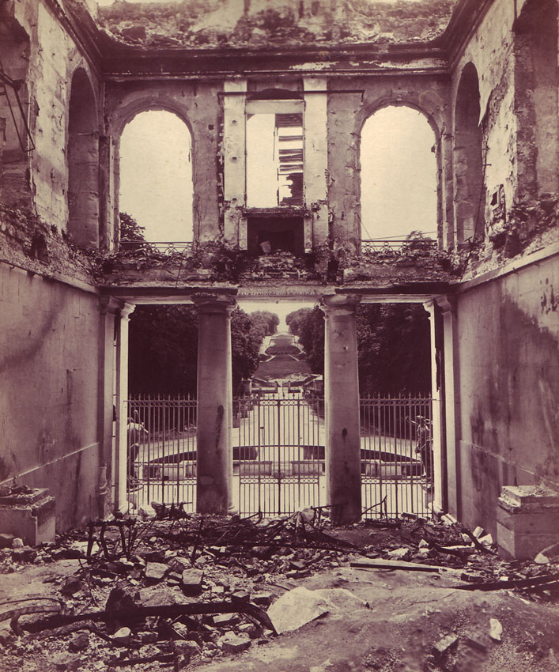
…consequencens and destructions…
Meudon
Saint Cloud

Slide 28
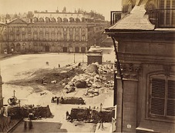
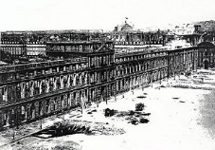
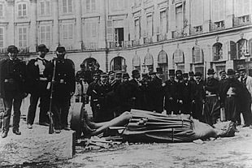
Les Tuileries
Vendôme

Slide 29
The law 30 March 1887 for the conservation of monuments and objects of art, of historic and artistic value
The introduction of the «juridical classification»
Till the law, objects classified were just the objects filled in the list to receive a financing support for their management;
With the law, the classificatiion becomes an administrative act – promoted by the Minister after the advisory opinion of the National Commission – which gives the object or the monument the quality of «historic monument»;
The most relevant criterion for the classification is the «national interest».

Slide 30
The concept of «national interest» in the law of 1887
From a juridical point of view, it introduces a preventive action, against the repressive regime;
It recognizes a prevalent role of the State in the evaluation and selection of the objects which deserve tutelage, and consequentely a function of designing the national history through them;
It guarantees the private owner: only a few number of objects are considered really important and listed;
From the point of view of the history of art it introduces some elements quite close to the idea of «typical monument», that is a monument evaluated in an objective, right and scientific way, considering nature, features, region, age.

Slide 31
The classification – Action and method
For a public object, the National Service can always impose classification, also passing over the opponent owner applying a more formal act (a decree)
For a private object, if it is a movable object classification is impossible; if it is an immovable one classification needs the consensus from the owner, or – if he denyis it – the State can proceed through an expropriation

Slide 32
The law of 1887 An evaluation
It was important, discussed and problematic: the discussion last since 1871 to 1887;
It introduced not so relevant elements of innovation, apart from the institut of expropriation;
It introduced the prevalence of the national interest and the role of the State in the management of cultural and artistic objects, and consequently gave a definition to the emerging consciousness of the importance of beauty and antiquity. The State became, at last, the subject encharged of a politics for the management.

Slide 33
Between two laws: the evolution of the politics for the management of cultural heritage in France (1887-1913)
The administrative structure of the protection
The administrative structure is developed along three main directions:
Development;
Professionalization;
Statization.
The «General Inspectorate» is composed of seven «general inspectors», competent on seven Departments which divide the country; they are encharged of the «high control» and are responsible in front of the Commission;
The peripheral body of the administration is composed of architects: «architects in chief» (40) who are encharged of the direction of the management, with the assistance of some «ordinary architects»; there are also some other figures, at a lower level: accounting auditors and custodians.
For the movable objects, in 1907 some departmental officers are introduced, directed by one of the seven general inspectors.

Slide 34
…towards the law of 1913…
The emergence of a new consciousness of the political relevance of the management of cultural objects, among political forces and figures, intellectuals, magazines and newspapers;
The debate around the idea of private property and the new idea of a «social function of the property»;
The law of 1905 which separates Churches and Religious Affairs from the State: the State – both at the centre and at the peripheral level – acquires the power of management of religious buildings, applying new – and more efficient – measures of protection.

Slide 35
The law 31 December 1913 The main elements
The relationhip with the law of 1887: innovation and continuity
The law of 1913 uses the same concepts of the law of 1887: monuments, classification, expropriation, conservation: it still remains within the context of the already defined system of management present in France.
But on the other side it introduces an innovation in a much deeper action through a much more intensive use of the instruments of tutelage, and a clearly more general conceptualization.

Slide 36
The law of 31 December 1913 The main elements
The prevalent «public interest»
The most relevant innovation is the introduction of the prevalent «public interest» in the conservation. It is possible to classify a private object also without the consensus of the owner.
On the other side, the amount of private objets which can be managed and listed is more limited and the action of listing is much more difficult from a procedural point of view.

Slide 37
The law of 31 December 1913 The main elements
Movable and Immovable Objects
The category of movable objects considered as important for their «national interest» is much more limited than that one of the immovable: it is difficult to know all the movable objects present in the country and, above all, there is a resistance opposed by the art merchants. The relationship between the recognition of a public interest and the protection of the private ownership will remain as one of the most relevant also in future.

Slide 38
The law 31 December 1913 The main elements
Ambiguity in the purposes
The law declares the purpose of the management is the conservation, but it dosen’t define exactly what does this conservation mean. Consequently the law gives some very detailed informations around the regime of management, but not the same elements and informations around the purposes.

Slide 39
The law 31 December 1913 The main elements
The absolutely prevalent power of the State
It is the State the only subject legitimate to promote and deal an action of tutelage and conservation, or actions of restoration and management. The law declares the prevalent and unique «national interest» in the way of the prevalent and unique «national power».

Slide 40
The law of 1913 Some more detailed elements around the classification
The criteria
Objects can be classified both immovable and movable; if movable can be naturally movable or movable «for the destination», that is «incorporated» to an immovable;
The law doesn’t define the protection of collections, and this is a very profound element of weakness in the structure of the entire act;
The law doesn’t define a terminus a quo, neither a terminus ad quem, just speaking of «history»;
The main relevant criterion is the «public interest» – and not the «national interest» – «from the point of view of art and history».
The catalogue is both a descriptive instrument, and a juridical one. The law 23 July 1927 will define exactly the juridical relevance of the list.

Slide 41
The law of 1913 Some more detailed elements around the classification
Classification of immovable objects is the same of the law of 1887. If movable, objects can be listed whith the consensus of the private owner. If not, the classification requires an ad hoc law
Classification of private objects determines four important consequences:
Each action to manage or modify the object has to be declared and authorised by the Minister;
The national administration can promote – in certain cases – a particular action of intervention;
The national administration has the power – in certain cases – to promote a forced acquisition of the object;
Intervention of management on classified objects are financed.

Slide 42
The main characters of the system (1913)
The system of protection of cultural heritage exactly reflects the administrative structure of the French State: a vertical structure, like a pyramid, descending from the top (Ministry of Public Instruction) to the bottom (offices, inspectors, supervisors, departments);
The French State appears – from a certain point of view – as «protector», but on the other side as a «police officer»: it guarantess the protection of a certain level of private property, but it applies high punishments against vandalism; it keeps artworks on site with reserve for public access, develops public collections, but it protects art commerce;
The French State appears as the main subject in a not decentralized system, but on the other side it recognizes a certain role to local communities to fill the inventory;
The law of 1941, promoted by Jérôme Carcopino, Minister of Public Instruction under the regime of Vichy, regulated the archaeological exacavations and defined more efficient instruments against the illicit traffict;
The entire system is applied also in the colonies

Slide 43
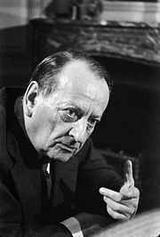
After the Second World War The Ministry for Cultural Affairs
Charles De Gaulle
(1890-1970)
André Malraux
(1901 – 1976)

Slide 44
The system of protection
Direction of Architecture
General Direction of Arts
Direction of Archives
Sub-Direction of Historical Monuments and Sites
Sub-Direction of Civic Buildings
Direction of Museums of France
Direction of Buildings of France

Slide 45
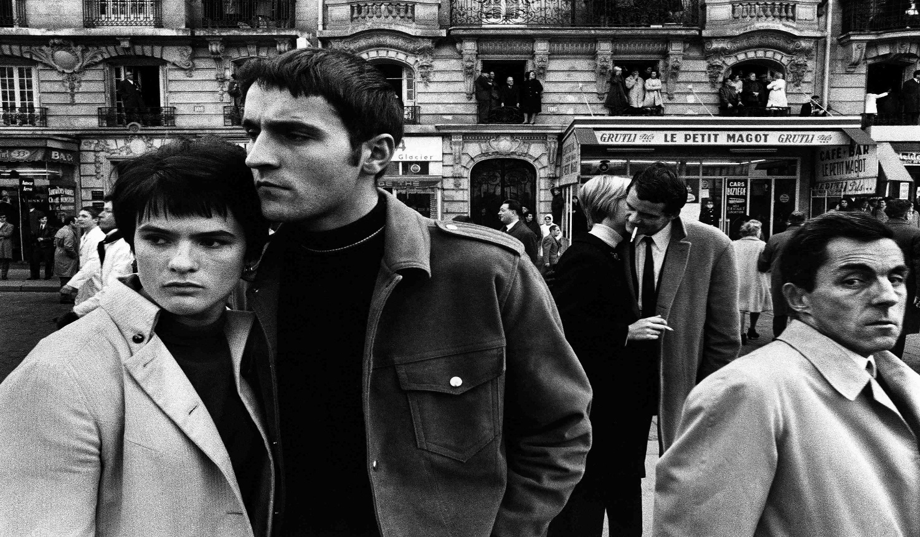
Elements of innovation
…to link the historical art to the contemporary and «living art»…

Slide 46
Elements of innovation
Law for the «protected sectors» – 4 August 1962 - Created by the Ministry for Cultural Affairs together with the Ministry of Building, it applyes a protection to particular areas of towns of historic and artistic interest (especially the historical centres).
General Inventory of Monuments and artistic richnesses of France – 1964 – National Commission of the Inventory – It has the aim to recollect all the artistic richness of France, also out of Paris. It defines a more general and complete idea of the «history of art», passing over a certain sectorialization, and involves lots of local volunteers.
A particular attention payied to the architecture and in particular to the work of Le Corbusier. Some works (Unité de Marseille, Ville Savoye) are listed and it is created a «Commission for the modern monuments» with the aim to consider and protect some particular and basical trends of modern architecture.

Slide 47
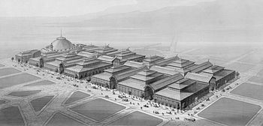
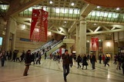
The 70s: a turning point
A rapid urbanization;
Desacralization of the main institutions: the State, the Church, Public Instruction;
A new political relevance of culture;
Development of the associations for the tutelage of cultural heritage;
A new idea and methodological point of view in historical science
A particular event: the destruction – in 1971 – of the Halles projected by Victor Baltard.
The Pavillions Baltard in 1863
The market at «Les Halles» in 1920
Place Carrée

Slide 48
A new program for a new concept of culture
Association of the Conservatives of public collections: National Conference – 1969 – Cultural heritage and public collections: «Cultural Heritage is the amount of all the objects, both natural and created by man. It represents the object of culture»;
This new idea is introduced in the program of the Socialist Party under the new and young leadership (François Mitterrand): Changing life. Cultural heritage is considered now not only the amount of the fine arts, but also the amount of the testifies of social and popular life and of the technical development. They are also considered testifies of our age».
François Mitterrand
(1916 – 1996)

Slide 49
…some examples…
The Festival of Autumn;
It is created a Direction for Cultural Heritage in 1978;
It is created an «Year of Cultural Heritage» in 1980;
It is created a Council of Ethnological Heritage in 1980;
It is approved a Charter of Eco-Museums in 1981;
A progressive decentralization is promoted at a regional level.

Slide 50
The last evolution
The Code for Cultural Heritage – 2004 – recollects all the trends developed in a new concept of cultural heritage and above all passing over the idea of a prevalence of the State and the nation: cultural heritage belongs to everyone

Slide 51
The landscape The so-called «Conservatoire de l’Espace Littoral»
The «Conservatoire de l’Espace Littoral» has been created with the law 10 July 1975 n° 75-602. It was an aswer to the problem of a growing pressure on the French coast, determined by the increasing urban development after the Second World War.
It was introduced on the basis of the so-called «Report Piquard»: Piquard was the president of a study committee instituted by the Government to answer the requirement of the Delegation for the landscape and regional action (DATAR – Délégation à l’àmeènagement du territoire et à l’action regional). The Report proposed a series of measures to protect landscape and coast. Among these measures, the «Conservatoire» was certainly the most relevant.
Some critical observations were developed during the debate:
The status of inalienability of the portions of landscape acquired by the Conservatorie: it was considered too much with respect to other portions;
The relevant financial effort of the Government;
The role of local communnities (they were created some regional bodies – Conservatoires regionaux d’espace naturels (CREN) – separated from the Conservatoire itself.

Slide 52
The Conservatoire – Its juridical nature
It is a public body: it depends on the Ministry for the Environment and is composed of members selected from the Parliament, members selected from the Government, and members selected from associations for the tutelage of environemnt, from the regions and from the local communities;
It is supported by a budget established and given by the State. It can also use financial suppport from private people or other public structures;
It acquires portions of landscape which become «its own demanial property»: these portions can be sold but a very complicated procedure; so they actually become inalienable.

Slide 53
The Conservatoire – Its purpose
The purpose is the management of coasts, landscapes and natural sites, respecting ecological equilibrium;
The main relevant instrument to proceed is the acquisition of the portions considered important and relevant;
The Conservatoire can acquire portions of landscape through different measures:
First refusal;
Expropriation;
Friendly transaction.

Slide 54
The Conservatoire – Its management
The Conservatoire manages directly actions of maintenance, restoration and valorization;
In other cases, the Conservatoire proceeds through conventions with different subjects: public bodies, foundations, specialized associations;
It is managed by a Board of Administration and deals the so-called «Conseils de Rivages» – linked to the «Association de Rivages de France», introduced inn 1983;
It has an annual budget by the State, apart from private financial supports;
It has developed an active politics of suggestion, advertisement, study and research.

