Slide 1
Lesson 5 Other recent perspectives on cultural heritage
Aims and Topics
To consider and examine the most recent development of juridical doctrine about
cultural heritage;
To define the other categories of cultural heritage considered in the most recent
legislative production;
To examine the different meaning acquired by the concept of cultural heritage

Slide 2
An opening conceptualization Other instruments of tutelage and the enlargement of the notion
Tangible cultural heritage
Intangible cultural heritage
Natural cultural heritage
Underwater cultural heritage

Slide 3
Some introductive lines Natural Heritage
Originally considered as an isolated element to protect, natural heritage has been linked to the cultural heritage in the Unesco Convention of 1972.
Art. 1 – Unesco World Heritage Convention – 1972:
«For the purposes of this Convention the following shall be considered as ‘cultural heritage’:
Monuments: architectural works, works of monumental sculpture and paintings, elements or structures of an archaelogical nature, inscriptions, cave dwellings and combinations of features, which are of outstanding universal value from the point of view of history, art or science;
Groups of buildings: groups of separate or connected buildings which, because of their architecture, their homogeneity, or their place in the landscape, are of outstanding universal value from the point of view of histoy, art or science;
Sites: works of man or the combined works of nature and man, and areas including archaelogical sites which are of outstanding universal value from the historical, aesthetic, ethnological or archaelogical point of view

Slide 4
The Search for an Expanded Notion of Cultural Heritage
At the beginning, the value considered to list a monument or a site in the World Heritage List of Unesco was an «iconic» value: «the best of the best», or «the most outstanding in the world», «representative of the best» in a cultural area, region, theme or period.
Iconic – in the words of Christina Cameron (Keynote speech Evolution of the application of ‘outstanding universal value’ for cultural and natural heritage – Special Experts Meeting of the World Heritage Convention – Kazan – 6-9 April 2005) – means «sites that transcend cultural affiliation, sites that are unique and widely known».

Slide 5
Some examples of «iconic sites and monuments»

Slide 6
The steps to open the concept of Cultural Heritage
The first group of sites and monuments, after the Convention of 1972, was inscribed on the World Heritage List in 1978.
Successively, the Committe worked to open the List, first with respect to representation of cultural and natural heritage, and then with regard to the imbalanced represenation of different categories of cultural heritage.
In the session of 1980 the revision of the cultural heritage criteria in the Guidelines appeared to give primacy to a «monumentalist» approach that favoured nominations from Europe over less materialistic heritage values from other parts of the world. «the List reflects a framework which is not really appropriate for the kinds of heritage most common in regions where cultural energies have been concentrated in other forms of expression such as artifacts, dance or oral traditions» (Report of the World Commission on Culture and Development – 1996²).
The expert group noted the following gaps and imbalances in the List:
Europe was over-represented in relation to the rest of the world;
Histori towns and religious buildings were over-represented in relation to other types of prpoperty;
Christianity was over represented in relation to other religions and beliefs;
Historical periods were over-represented in relation to prehistory and twentieth century;
«Elitist» architecture was over-represented in relation to vernacular architeccture

Slide 7
World Heritage List Gaps and imbalances
The 1980 revision excluded living traditions from the List. «In more general terms, all living cultures – and especially the ‘traditional’ ones – with their depth, their wealth, their complexity, and their diverse relationships with their environment, figured very little on the List» (Report of the Experts Meeting on the ‘Global Strategy’ and Thematic Studies for a representative World Heritage List – 1994)
The limited number of States Parties to the Convention created imbalances and gaps in the properties included in the List in this period.
In 1987, the Committed created an expert group to study the concept of a global study and a functional typology to guide the Committe in its decision making. It was created a new system consisting of a typological approach, already criticized in the session of 1991 – and consequently abandoned – because mostly based on historical and aesthetic criteria which did not consider adequately the matter of traditions and living cultures.
Finally, in 1992 it was created a Gobal Strategy for a Balanced, Representative and Credible World Heritage List, preferring the term global strategy to the term global study, this latter considered as to rigid, unique and definitive.

Slide 8
World Heritage List A Global Strategy
Human coexistence with the land:
Movement of peoples (nomadian, migration);
Settlements;
Modes of subsistence;
Technological evolution
Human beings in society:
Human interaction;
Cultural coexistence;
Spirituality and creative expression

Slide 9
World Heritage List A Global Strategy Elements of innovation
The revision led to conceptual shifts in the scope and application of the notion of cultural heritage under the Convention;
The revision allowed for a process of rectification of imbalances and identification of gaps, in the List with respect to types of property, regions of the world, cultures, and periods by opening it up to heritage that was not yet represented in it or was previously rejected by the Committee, such as cultural landscapes, seascapes, industrial heritage, routes for people and goods, modes of occupation of land and space, water management, modern architecture, railways, traditional settlements and their environments, sites of spiritual significance whether monumental or not, waterways, and properties associated with events and living traditions;
It constituted a clear move away from a purely monumental view of cultural heritage of humanity towards a more anthropological, comprehensive and diversified conception of the wealth and diversity of human cultures (the idea of «cultural heritage as testify of civilization);
It resulted in a shift from an iconic, «wonders of the world» approach towards a representative and comparative «selection of the best» approach in the establishment of the List and the appllication of the concept of cultural heritage under the Convention.

Slide 10
After the Convention of 1972 Other instruments…new categories…
Convention for the Safeguarding of the Intangible Cultural Heritage – 2003;
In 1992 the Unesco Committed decided to recognize three categories of cultural landscapes for inscription in the List as «manifestations of the interaction between humankind and its natural environment»:
Clearly defined landscapes designed and created intentionally for humans;
Organically evolved landscape;
Associative cultural landscape
Convention on Underwater Cultural Heritage – 2001 – defining underwater cultural heritage to be protected as follows:
All traces of human existence having a cultural, historical, or archaeological character which have been partially or totally under water, periodically or continuously, for at least 100 years, such as:
Sites, structures, buildings, artifacts, and human remains, together with their archaeological and natural context;
Vessels, aircraft, other vehicles or any part thereof, their cargo or other contents, together with their archaeological and natural context;
Objects of prehistoric character

Slide 11
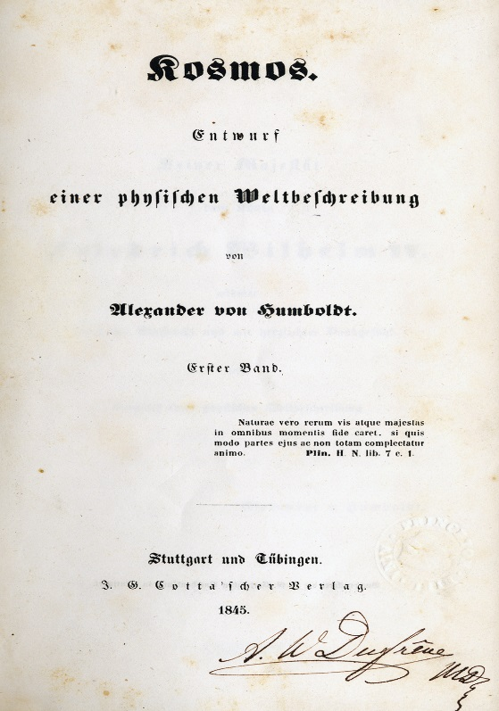
Natural Heritage and its protection A historic evolution
Naturphilosophie
Goethe - Kant
The search for structural
relationships between
elements of nature in a
vision of harmony
of the world
Kosmos – Project of a physical
description of the world - 1845
Alexander Von Humboldt (1769 – 1859)

Slide 12
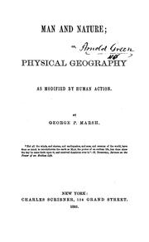
Natural Heritage and its protection A historic evolution
Nature as harmony
Man as disturbing agent
Man and Nature
Physical geography
as modified by human action - 1864
George Perkins Marsh (1801 – 1882)

Slide 13
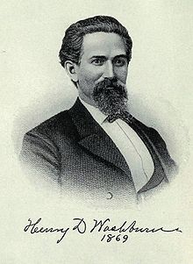
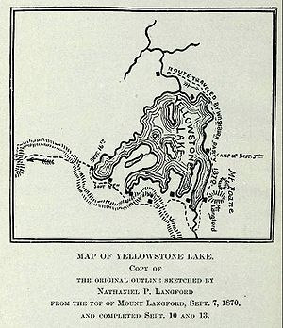
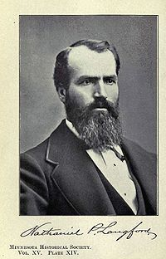
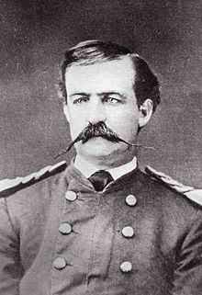
Natural Heritage and its protection A historic evolution
Henry Washburne
(1832-1871)
Yellowstone Park - 1872
Nathaniel Langford
(1832-1911)
Washburne-Langford-Doane expedition
Wilderness
Gustavus Doane (1840-1892)

Slide 14
Natural Heritage and its protection A historic evolution
Ecology
Ernst Haeckel (1834 – 1919)

Slide 15
Natural Heritage and its protection A historic evolution
From Germany
Naturphilosophie - Ecology
From United States
Wilderness
From Great Britain
Romanticism – Emergence of Industrial Revolution
and urban development

Slide 16
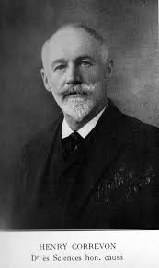
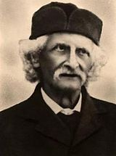
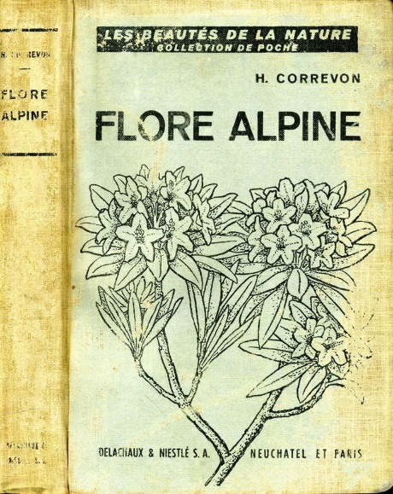
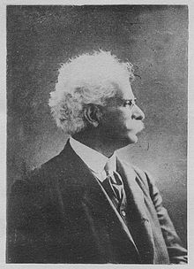
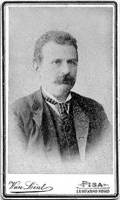
Natural Heritage and its protection A historic evolution
Federico Delpino
(1833-1905)
Henri Correvon
(1854-1939)
To protect flora and fauna: the role of private association
Association pour la protection des plantes – Geneve – Henry Correvon
Scientific congresses all over the Europe: «Società Botanica Italiana» – 1888 – to protect natural monuments
Antonino Borzì
(1852-1921)
Oreste Mattirolo
(1856-1947)
Giovanni Arcangeli
1840-1921)

Slide 17
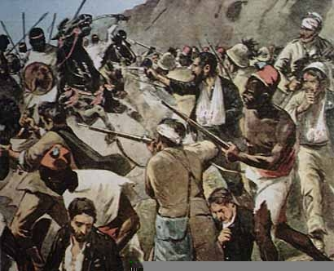
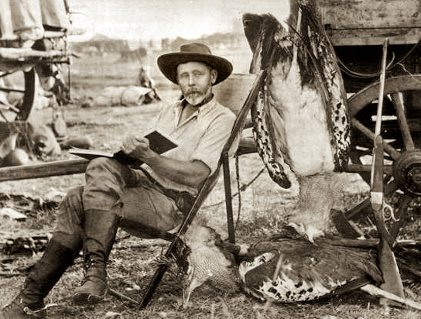
Natural Heritage and its protection A historic evolution
…against hunting…
1867: East Riding Association for the Protection of Seabirds;
1869: first english act of protection of birds;
1870: Association for the Protection of British Birds;
1885: Plumage League – Selborne League
1886: Selborne Society

Slide 18
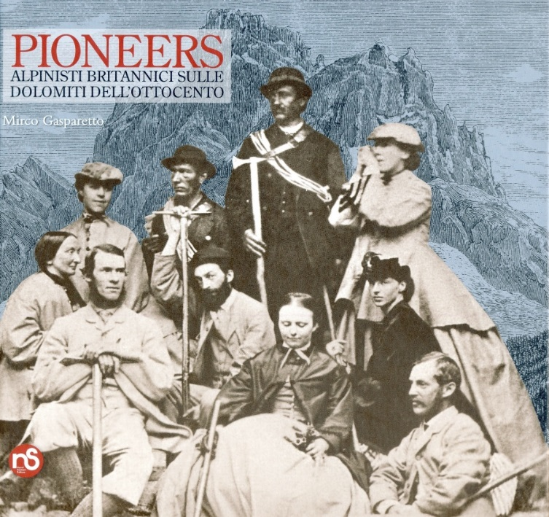
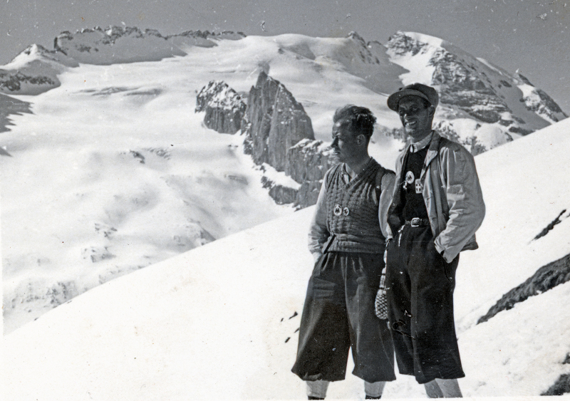
Natural Heritage and its protection A historic evolution
…exploration trip and nature…
Alpin Club – England – 1857 – Ashley Hotel;
Osterreichischer Alpenverein – 1862;
Club Alpino Italiano – Schweizer Alpenclub – 1863;
Deutscher Alpeverein – 1869;
Club alpin français – 1874.

Slide 19
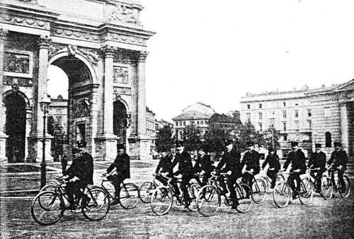
Natural Heritage and its protection A historic evolution
…to know the landscape and the country: the role of the sport…
Cyclists’ Touring Club – United Kingdom – 1878;
Nederlandsche Wielrijders Bond – 1883 (1886 – Toeristenbond for Nederland);
Touring Club Suisse – Osterreichischer Touring Club – 1886;
Touring Club de France – 1890;
Touring Club Italiano – 1894;
Touring Club de Belgique – 1895;
Deutscher Touring Club - 1900

Slide 20
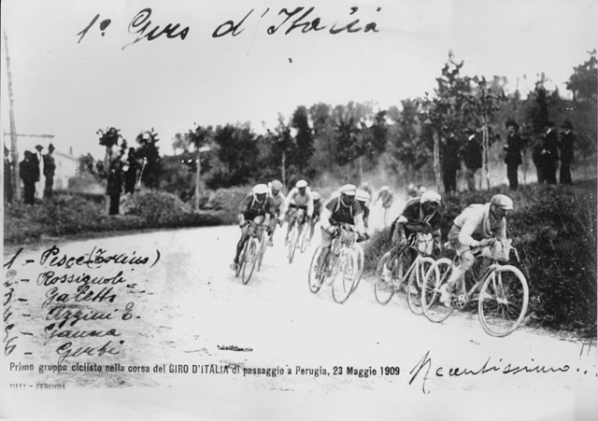

Slide 21
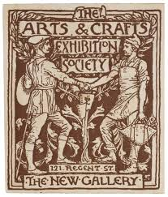
Natural Heritage and its protection A historic evolution
Art and nature
Against the restoration
of Monuments
John Ruskin
(1819-1900)
Arts and Crafts

Slide 22
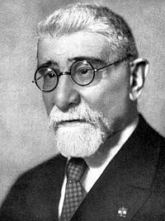
Natural Heritage and its protection A historic evolution
Different meanings at the origins…
In Italy landscape is considered in an aesthetic meaning, as part of the national history, as element of national culture
Luigi Rava
(1860 – 1938)

Slide 23
Natural Heritage and its protection A historic evolution
In France, sites and landscape are tutelated as «natural and historical monuments», also as part of national history, but in a meaning more linked to the new concept of Nation created by the Revolution of 1789.
In Germany, natural heritage is linked to the concept of Heimat – Homeland – and so to a patriotic interpretation.
In England, landscape and nature are linked in particular to a Romantic sensibility, and against industrial revolution.
In USA, it is linked to the idea of wilderness and to the myth of the frontier.

Slide 24
Natural Heritage and its protection A historic evolution
National Trust - 1895
Pro Montibus
et Sylvis - 1899

Slide 26
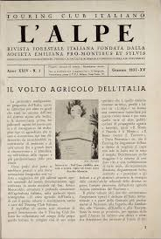
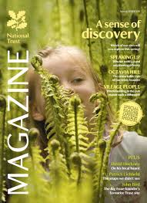
Natural Heritage and its protection A historic evolution
Magazines and newspapers

Slide 27
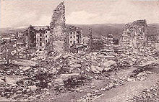
Natural Heritage and its protection Other elements of discovery
The war
Destruction of Asiago – Strafexpedition – Italy - 1917

Slide 28
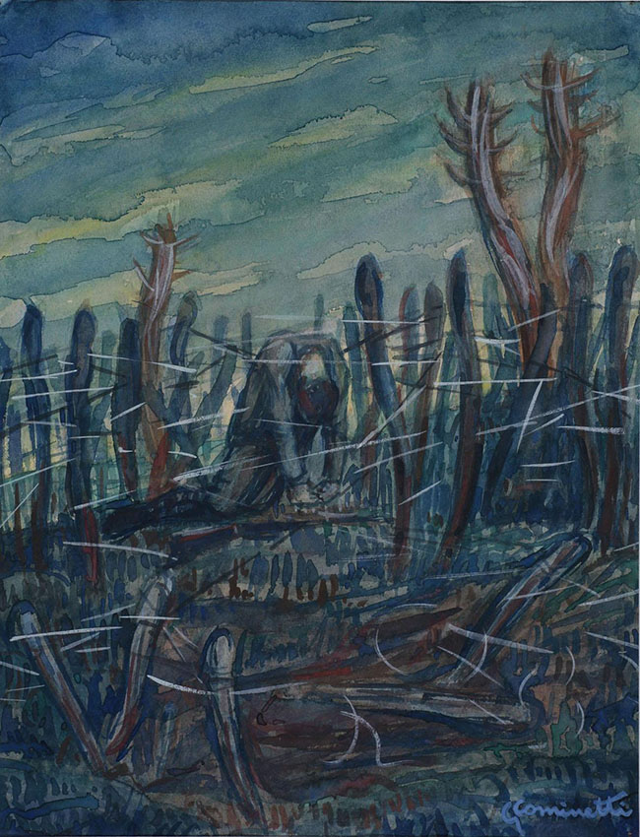
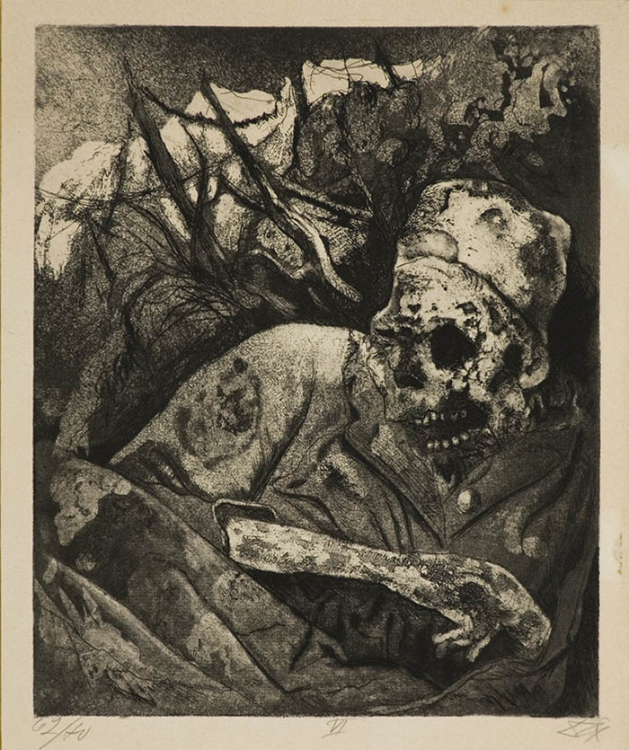
Natural Heritage and its protection Other elements of discovery
The War and the art
Giuseppe Cominetti
«Fra i reticolati» - 1918
Otto Dix
«Soldato sul filo spinato»
1924

Slide 29
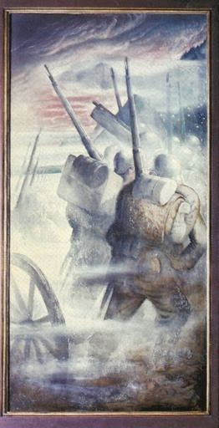
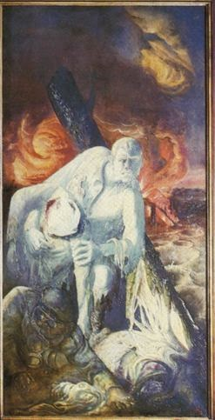
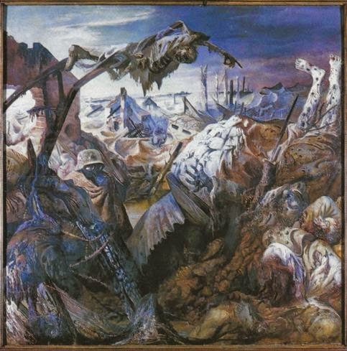
Natural Heritage and its protection Other elements of discovery
The War

Slide 30
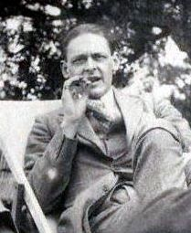
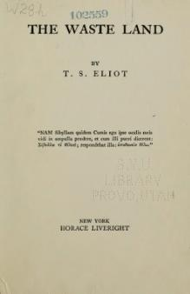
Natural Heritage and its protection Other elements of discovery
The Waste Land
The Waste Land
1922
Thomas Stearn Eliot
(1888 – 1965)

Slide 31
Natural Heritage and its protection Other elements of discovery

Slide 32
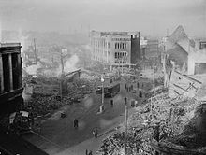
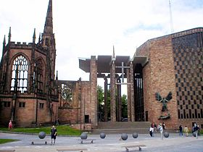
Natural Heritage and its protection Other elements of discovery
The matter of aerial bombardments
Coventry – aerial bombardment 14-15 November 1940

Slide 33
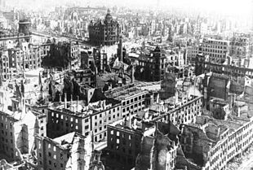
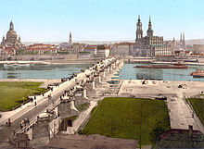
Natural Heritage and its protection Other elements of discovery
Apocalypse in Dresda…14-15 February 1945
The AltStadt
Ruins…

Slide 34
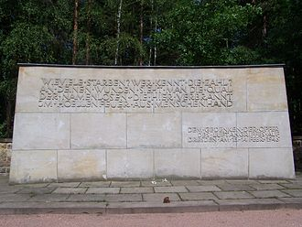
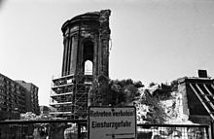
Cemetery of Heidefriedhof
Memorial
«Wieviele starben?
Wer kennt die Zahl?
An deinen Wunden sieht man
die Qual: der Namenlosen
die hier verbrannt;
im Höllenfeuer
aus Menschenhand»
From the RathausTurm
Ruins of the
Frauenkirche - 1991

Slide 35
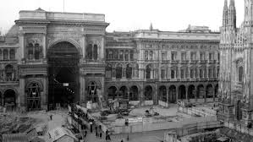
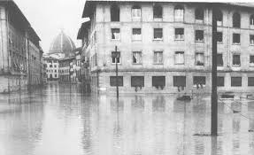
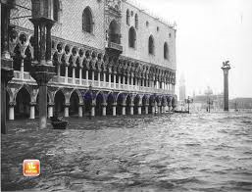
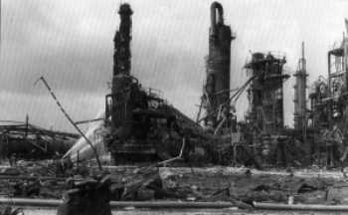
Natural Heritage and its protection Other elements of discovery
Urban development, emergencies, ecology…

Slide 36
Natural Heritage and its protection The Convention of 1972
The innovation of the World Heritage Convention of 1972 was to bring the natural environment under the wider category of «world heritage» and to express the intergenerational obligation of conservation and transmmission.
Emergence of the concept
of common heritage of humankind
Definition of the concept of
«universal heritage» and
«common heritage of humanity»

Slide 37
Natural Heritage and its protection The Convention of 1972
The origins of the introduction of «natural heritage» within the elements o the Convention take place in the proposals by United States from the mid-60s for a «World Heritage Trust», where identified natural and scenic areas and historic sites would be preserved for the future generations.
In 1965 the USA Committee for the Conservation and Development of Natural Resources proposed to establish a Trust for the World Heritage «that would be responsible to the world community for the stimulation of international cooperative efforts to identify, establish, develop and manage the world’s superb natural and scenic areas and historic sites for the present and future benefits of the entire world citizenry».

Slide 38
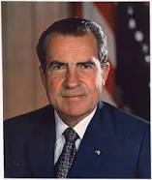
Natural Heritage and its protection The Convention of 1972
Richard Nixon
(1913-1994)
President of United States
Russell Train
(1920-2012)
Chair of the United States
Council of Environmental Quality - 1970

Slide 39
Natural Heritage and its protection The Convention of 1972
Unesco draft for the International Protection of Monuments, Groups of Buildings and Sites of Universal Value - 1971
International Union for the Conservation of Nature – Draft Convention for the Conservation of the World’s Heritage - 1972
Stockholm Declaration of the UN Conference on the Human Environment: «man has a special responsibility to safeguard and wisely manage the heritage of wildlife and its habitat» - 1972

Slide 40
Natural Heritage and its protection The Convention – Contents, aims, instruments
What is natural heritage to be protected?
Natural features consisting of physical and biological formations or groups of such formations, which are of outstanding universal value from the aesthetic or scientific point of view;
Geological and physiographical formations and precisely delineated areas which constitute the habit of threatened species of animals and plants of outstanding universal value from the point of view of science or conservation;
Natural sistes or precisely delineated areas of outstanding universal value from the point of view of science, conservation or natural beauty.

Slide 41
Natural Heritage and its protection The Convention of 1972
What is «outstanding value»?
In the words of the «Guidelines» (1977), the concept of «outstanding value» represents:
«cultural and/or natural significance which is so exceptional and so transcends national boundaries and to be of common importance for present and future generations of all humanity. As such, the permanent protection of this heritage is of the highest importance to the international community as a whole. The Committe defines the criteria for inscriptions of properties on the World Heritage List»

Slide 42
Natural Heritage and its protection The criteria (Guidelines par. 77)
Contain superlative natural phenomena or areas of exceptional natural beauty and aesthetic importance;
Be outstanding examples representing major stages of earth’s history, including the record of life, significant on-going geological processes in the development of landforms, or significant geomorphic or physiographic features;
Be outstanding examples representing significant on-going ecological and biological processes in the evolution and development of terrestrial, fresh water, coastal and marine ecosystems and communities of plants and animals;
Contain the most important and significant habitats for in-situ conservation of biological diversity, including those containing threatened species of outstanding universal value from the point of view of science or conservation.
Integrity

Slide 43
Underwater Cultural Heritage
…some problems…
The relationship between private property and public property, and the concept of «common goods»;
The fact that historic or artistic objects can be found in areas far from the states and private persons to whom these objects belonged;
Other legal persons, such as the finders of historic objects and states enjoying sovereign rights over these marine areas, may claim rights over the objects themselves.

Slide 44
Underwater Cultural Heritage The State of Origin
It is the first subject which can claim the rights. For the purposes of this concept the State of Origin is defined as «the state where a historic object was produced and was used before it disappeared into the sea. (in this way the 1970 Unesco Convention on the Means of Prohibiting and Preventing the Illicit Import, Export and Transfer of Ownership of Cultural Property; and the 2004 Italian Code on Cultural Properties and the Landscape).
It may happen a judge doesn’t recognize the right of the «State of origin», as – for example – in the case of the «Lisippo bronze», found in the Adriatic Sea, then exported, disappeared, and the reappeared in the Getty Museum. The judge established that if the Italian organs had been informed of the finding of the statue at the time of the discovery, as required by Italian law, Italy could have exercised its right of pre-emption.

