Slide 1
Lesson 3 Cultural Heritage management at an international level: bodies and organizations
Aims and Topics
To examine the matter of cultural heritage management at international level, considering the role of the most relevant institutions and organizations encharged. To try to answer the question: who manage cultural heritage? What kind of institutions are involved in this matter? When and why did the problem emerge at an international level?
To focalize the relationship between the new historical situation and the idea to build some specifical institutions encharged in the management of cultural heritage after the II World War. To try to answer the question: why do national governments put attention to the matter of cultural heritage after the II World War at an international level?
To try to describe the most relevant results of their action

Slide 2
The institutions

Slide 3
Some general considerations to introduce…
The creation of the United Nations system with its specialized
agencies was an endeavor to provide an institutional framwork
for organized international cooperation. The need for it derived
in general from the growing interdependence of nations, and in
particular from the human suffering and the material destruction
caused by World War II.
With this motivation was combined a new realization, based
on the experience of inter-Allied cooperation during the war, that
it was practical to organize international relations on a clear and
more logical basis.

Slide 4
The Organization of United Nations: a hope of peace and progress
Such wartime experiments in international collaboration as the Raw Materials Control Board, the Inter-Allied Commodities Control Board, the Inter-Allied Shipping Board, and the combined Chiefs of Staff, had gone far beyond inter-Allied cooperation in the first World War and anything attempted under the League of Nations. These experiments had indicated that, when survival was at stake, concepts of national sovereignty could in some cases be modified and the emotions associated with nationalism disciplined to permit effective cooperation among sovereign states.
The United Nations system (24 October 1945) represented an effort to apply the liberal democratic doctrines underlying a number of national governments to world-wide institutions of international cooperation. The role of force in the maintenance of peace was not disregarded, but increased recognition was given to the significant role of persuasion and agreement.
The background of the development of the United Nations system is to be found in the long history of liberalism and democracy. It was intended as a hope for peace and an instrument having a place in the power structure of postwar international relations.
man
truth
peace
education
science
culture
Notes:
Having a placce in the

Slide 5
The Unesco
The United Nations Educational, Scientific and Cultural Organization was created during the Inter-allied Conference of the Ministries of Education, held in London in November 1945, and signed on 16 November 1945 by twenty nations: Saudi-Arabia, Australia, Brasil, Canada, Chetcoslovachia, China, Denmark, Egypt, France, Greece, India, Lebanon, Mexico, Norway, New Zealand, United Kingdom, Dominicanan Republic, United States, South Africa, Turkey.
It was built in a sense of practical application of the long tradition of human speculation concerning the relation of education, science and culture to politics. In the words of Leon Blum: «steering Unesco’s future activities in the direction of that ‘ideology’ of democracy and progress which is the psychoogical condition, the psuchological basis of international solidarity and peace».
It was built in a current mood of hope and faith.
Against propaganda and the operations of the Fascist systems which had led in the capturing of men’s minds both within the dictatorships, and in the occupied territories. To restore the freedom of thought as a condition for a lasting peace.
It was built in a mood of general expectation that the world was to be blessed by a prolonged period of peace: a positive peace and not only the absence of war.

Slide 6
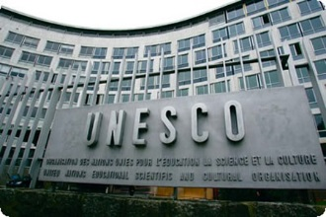
The Unesco – A new building for peace and culture

Slide 7
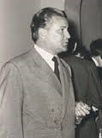
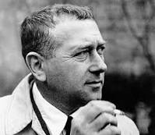
The Unesco A new building for peace: the project
Bernard Zehrfuss (1911-1996)
Marcel Breuer (1902-1981)
Pier Luigi Nervi (1891-1979)

Slide 8
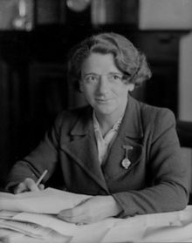
Creating the Unesco The Conference of London – November 1945
Clement Attlee (1883-1967)
Prime Minister of Great Britain
Ellen Wilkinson (1891-1947)
Minister of Education of Great Britain

Slide 9
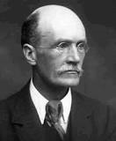
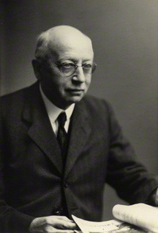
Creating the Unesco The Conference of London – November 1945
Leon Blum (1872-1950)
Former Prime Minister of France
Hu Shih (1891-1962)
Chinese poet and intellectual
Archibald McLeish
(1892-1982)
Poet and scholar
Former Librarian of Congress
Assistant Secretary of State
United States
Alfred Zimmern
(1879-1957)
intellectual
Gilber Murray (1866-1957) - intellectual

Slide 10
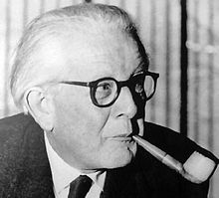
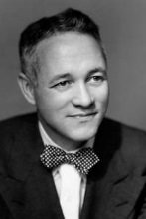
Creating the Unesco The Conference of London – November 1945
Jean Piaget (1896-1980)
Former Director of the
International Bureau of Education
Geneva
Lieutenant Colonel
John W. Taylor (1906-2001)
United States
Unesco Deputy Director General
from 1951 to 1952
Acting Director General
from 1952 to 1953
Henri Bonnet (1888-1978)
Former Director of Institute
of Intellectual Cooperation Paris
French Ambassador in the USA

Slide 11
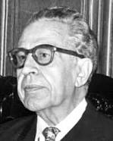
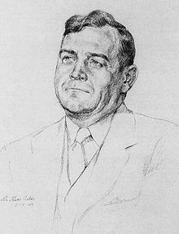
Creating the Unesco The Conference of London – November 1945
Julian Huxley (1887-1975)
Director General of Unesco
1946-1948
Jaime Torres Bodet (1902-1974)
Director General of Unesco
1948-1952
Luther Evans (1902-1981)
Former Librarian of Congress
Director General of Unesco
1953-1958

Slide 12
Creating the Unesco The Needs to meet
Reconstruction
Building for Peace through Understanding
Exchange of Useful Knowledge
Aid to Economically Less Developed Countries
N.B. Of the fifty-one states signing the United Nations Charter at San Francisco (October 1945) all were represented at the London Conference except seven: Ethiopia, Costa Rica, Honduras, Paraguay, USSR, Byelorussia, Ukraine

Slide 13
Creating the Unesco Reconstruction
Reconstruction of war-damaged countries: especially Poland, Greece, China, the Philippines
School and university buildings had to be repaired or rebuilt; text-books and furnishing replaced; libraries and laboratories restocked and equipped;
Educational methods and programs needed revision and improvement
Reconstruction of cultural and moral values destroyed by nazism and fascism through propaganda and war

Slide 14
Creating the Unesco Building for Peace through Understanding
Against Nazism, chief enemy, for peace against the war, for internationalism against nationalism, against racism, for human rights
Attlee said in 1930s «wars begin in the mind of men, and we are to live in a world of democracies, where the mind of the common man will be all important». In the Unesco Constitution – Preamble – it was introduced the sentence «since wars begin in the minds of men, it is in the minds of men that the defenses of peace must be constructed»
Leon Blum asked Unesco to «establish the spirit of peace in the world». As the French philosopher Etienne Gilson stated: «the Charter signed in San Francisco created the United Nations; now Unesco has to give it a soul».

Slide 15
Creating the Unesco Exchange of Useful Knowledge
Open channels for all peoples to the wolrd’s body of knowledge
Some delegates – especially the French – asked to limit this international exchange to elites and intellectuals
Some others – the Norwegian, for example – pretended to extend this exchange both to elites and to masses.
Attlee asked what the organisation would do tor the man in the street and «the children in the street», answering that every country could learn from efforts of other countries to fit education to the needs of a changing world

Slide 16
Creating the Unesco Aid to Economically Less Developed Countries
Help the less developed countries
The Egyptian delegate asked a campaign against illiteracy
Other delegates confirmed this request

Slide 17
Creating the Unesco The past experience
Private International Organizations
International Congress of Anthropology and Pre-History – 1866
Congress of Orientalists – 1873
International Congress of Psychology – 1899
Congress of Historical Sciences – 1898
International Research Council – 1919
International Academic Union
National Academy of Sciences – National Research Council – American Council of Learned Societies (United States of America)
The National Education Association of the United States promoted the constitution of the World Federation of Education Associations, established in 1923, followed – after the Second World War – by the World Organization of the Teaching Profession
European or Norh-American
membership
Private and not government
organizations
Not based on intergovernmental
agreements nor they received financial support from government
Notes:
Ot

Slide 18
Creating the Unesco The past experiences – Under the League of Nations
September 1914: on the initiative of Fannie Fern Andrews – United States – an International Conference on Education was to meet at The Hague. It failed because of the outbreak of the Great War
At the beginning, the League of Nations was silent about intellectual matters, considered as «the exclusive province of each government or of private initiative»; the League could have nothing to do with them
After the second assembly in September 1921, a report was presented by the French delegate Léon Bourgeois and an International Committee on Intellectual Cooperation was approved

Slide 19
Creating the Unesco The Committee on Intellectual Cooperation
First chairman was Henri Bergson
Among the members: Marie Curie, Gilbert Murray, Robert Millikan
An International
Institute of Intellectual
cooperation was established
in Paris, becoming the Secretariat
of the Committee
National Committees
created in some forty
countries

Slide 20
Creating the Unesco The Committee on Intellectual Cooperation Tasks and results
It sponsored collaboration among intellectual leaders on problems of common concern
It provided a kind of clearing house for government departments dealing with intellectual matters and for its own National Committees, as well as for such organizations as learned societies and organizations of educators or writers
It furnished a number of technical services
It exchanged information on museums and archives
It published lists of translations and bibliographies
It studied problems of copywright
It issued reports on emplyment of intellectuals
It focalised the problem of education, especially the matter of textbooks revision and teaching history (1931) and the reorganization of Chinese school system
It was the effort of individuals within the League of Nations
It was limited to small groups of individuals

Slide 21
Creating the Unesco The International Bureau of Education at Geneva
It was founded in 1925 as a private agency for exchange of information and research in education, chiefly at the primary and secondary level
In 1929 it received a quasi-official status, with governments, public institutions, and international organizations eligible ffor membership
In 1946 its membership included fifteen governments and two nongovermental organizations, but – it is important to remind – neither United Kingdom nor the United States were members
It was at the beginning a centre of information but later it gave attention also to methods of education for international understanding and cooperation
In 1917 a section of education was established also by the PanAmerican Union

Slide 22
Creating the Unesco National Cultural Relations Programs
France was the first modern nation to embark on an official program of cultural relations, focalised on the Middle-East and Asia, following the experience of catholic educational missionaries, supported by the French government
1906: it was created the
Alliance Française: a private
agency enjoying governmental
subsidy, to spread language and
Culture from France abroad
The French program
of «intellectual expansion»
was enlarged after
the First World War

Slide 23
Creating the Unesco National Cultural Relations Programs
The official German cultural program recognized the importance of the German schools set up by emigrant German communities in Asia, South Africa, Latin America
Some schools, supported
by private contributions,
began to receive government
subsidies in 1875
After the defeat
in the First World War
the program of cultural
relations took new importance
to try to «win by a friendly
cultural offensive in the
outside world»

Slide 24
Creating the Unesco Nationa Cultural Relations Programs
Soviet Union began some cultural programs with other countries after the abandon of immediate efforts for world revolution. In 1925 there was established the All Union Society for Cultural Relations with Foreign Countries (VOKS),
with propaganda for the Soviet system as its object
The VicePresident of Voks
E. Lerner stated in 1931:
«These societies must create
a ring of trust, sympathy and
friendship around the USSR,
through which all plans
of intervention will be unable to
penetrate»
Seeking «the world
union of intellectual forces
for the triumph of genuine
world culture», demonstrating
«to foreign countries a general
outilne of Soviet culture
in its totality», calling intellectuals
«to fight the war danger, agitate for peace»

Slide 25
Creating the Unesco National Cultural Relations Programs
United Kingdom created in 1934 the British Council for Relations with Other Countries: an agency of «national interpretation» abroad, initially with the expectation of financial support from private agencies, then, rapidly, supported by the Foreign Office
United States was one of the last of the major powers to create programs of cultural exchange. In 1938 was created an Inter-Departmental Committee on Scientific and Cultural Cooperation with the other American Republics, and, together, in the Department of State, a Divisionn of Cultural Relations

Slide 26
Creating the Unesco National Cultural Relations Programs
Some common elements…
The programs were concerned with «exchanges of persons»
They encouraged contacts between members of a national community and those of another
They promoted exhchanges of books and periodicals
They promoted lectures, concerts, theatrical productions, art and science exhibits, broadcasts and motion pictures
They encouraged «cultural institutes» to foster knowledge of the language, literature, life of the sponsoring country
They all were based on a national aim: promoting friendship and interest around the national culture

Slide 27
Creating the Unesco The immediate origins
1942: Conference of Allied Ministers of Education (CAME) took place in London, promoted by the British Council, the British Foreign Office, and R.A. Butler, President of the Board of Education. It was attended by Ministers of Education of Governments in exile in London (Belgium, Czechoslovakia, Greece, Holland, Luxembourg, Norway, Poland, Yugoslavia, the French National Committee of Liberation, and it considered «what help would be needed, and coulld be given to the occupied countries of Europe in the restoration of their educational systems». It grow up during the further years, with the attendance of different delegates, and having a particular help from United States.
San Francisco Conference (May 1945), that provided that «the United Nations shall promote…international cultural and educational cooperation»

Slide 28
The Unesco Characters and action
Five issues
Unesco’s program: its content and range;
Unesco’s purpose: single or multiple;
Unesco’s character: governmental or nongovernmental
Unesco’s relation to the United Nations
Unesco’s role: how should the organization be used?

Slide 29
The Unesco Characters and action
Program: Content and Range
Unesco didn’t have the typical functions of a sovereign State. It was not to intervene in member states on matters «essentially within their domestic jurisdiction». Indirect references to this particular role were in some words of the first articles of its Constitutions: «encouraging», recommending», «suggesting». The aims were indicated in very general and open manner: «all branches of intellectual activity»: education for adults as well as for children, books, works of art, monuments, press, radio and film. It was clear that Unesco would have a far more difficult task in developing a coherent and integrated program than such sister agencies as the Food and Agriculture Organization and the World Health Organization which dealt with more limited areas and more tangible activities.

Slide 30
The Unesco Characters and action
Program: Content and Range
The matter of Education
France presented a draft making a specific reference to educational and cultural reconstruction, asking for an organization with more long-term aims
The United States delegation pointed out that the new organization could not become a relief agency, receiving and distributing relief funds – a task for which the UNRRA already had responsibility
Study of problems

Slide 31
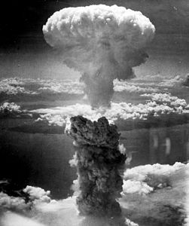
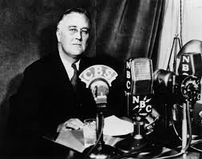
The Unesco Content and Range
The London Conference restricted Unesco’s activities in educational reconstrucction to collection and circulation of information. But it greatly broadened the role of the organization by incorporating science and mass communication in its program.

Slide 32
The Unesco Characters and action
Purpose: Single or Multiple?
Unesco’s purpose is to contribute directly to peace and security. Each activity has to be choosen consciounsly in terms of direct contribution to peace. This approach appears influenced by the immediacy of threats to peace and the need to mobilize every resuorce to strengthen peace
Unesco’s approach to peace has to be indirect by furthering the welfare of mankind through education, science, culture. It is a long-range approach arguing that strengthening education, science and culture will promote human welfare and that this is the surest and soundest approach to peace. It assumes that maintaining peace in contemporary international relations is a task for the United Nations Security Council and the United Nations General Assembly and Unesco’s task is to lay foundation for future peace

Slide 33
The Unesco Characters and action
A compromise…
The Constitution of Unesco listed five purposes:
Maintenance of international peace and security
Promotion of universal respect for and observance of human rights and fundamental freedoms
Development of sciences and arts
Diffusion of knowledge and culture to all peoples for the service of human needs
Preservation of the word’s inheritance and monuments of history

Slide 34
The Unesco Characters and action
Governmental or Nongovernmental?
The French draft for the Constitution proposed that the annual conference should be a tripartite body of governments, National Commissions, leading nongovernmental «world associations». The London Conference resolved that only governments could be members of the organization with a right to vote in the annual conference.
The CAME and the French draft provided for election to the Executive Board of persons (not states) from among delegates to the General Conference. The Conference agreed that members of the Board should be chosen by the General Conference from among the government delegates in that body. After eletion these members should serve, not as representatives of their respective governments, but on behalf of Conference as a whole. In relation to their own governments the members were to function as free individuals, relying upon their own wisdom and responsible to no one but the General Conference.
The matter of national cooperating bodies or of National Commissions also involved the role of governments and that of private bodies. A compromise was worked. National Commissions were to include representatives of both governments and private bodies. They were not to be represented per se in the General Conference, but national delegations were to be chosen after consultation with National Commissions.

Slide 35
The Unesco Characters and action
Unesco was created as an autonomous agency, close to United Nations. The United States delegation asked for a more closely action, integrated with the United Nations, against the French delegation, that invoked a more autonomous role. The solution was again a compromise: Unesco has to present an annual report to the Economic and Social Council of the United Nations (ECOSOC), but it decides autonomously its action and also – above all – its financial budget, as the United Nations examine the decision, with the power and right to make some points of remark.
Another point of discussion was that one relative to the use: should Unesco be just a «house of discussion», or should it be used as an active agency. Unesco became a sort of international agency with some powers and rights, but in a balance with the States competencies.

Slide 36
The Unesco The evolution of the program
The Unesco program is usually presented by chapters or departments, and by a series of resolutions approved by the General Conference, the Director General carries out specified activities wich together constitute the program.
The chapters are now six:
education: fundamental education, extension of primary education, education for international understanding
Natural sciences: international scientific cooperation, encouragement of research for the improvement of the economic and social conditions of mankind (arid zone project), teaching about science
Social sciences: international development of social sciences, their application to social tensions, human rights, international understanding
Cultural activities: international contacts in the arts, better understanding of the cultural history of mankind, international cooperation in the humanities and philosophy, services rendered by libraries and museums
Mass communication: use of press, radio, film, television for international understanding
Technical assistance: reduction of obstacles to the free flow of information among nations

Slide 37
The Unesco The program – The 1947-49 Period
At the beginning, in 1946, the proposals were so numerous and different, to be listed along some different criteria:
Projects which should be attacked immediately;
Projects which should be considered by the First Session of the General Conference for operation in 1947-’48;
Projects to be studied for action later.
The Commission also adopted a three-fold classification of program activities:
Programs which would promote peace and security directly;
Programs which would advance human welfare directly;
Programs which would indirectly serve these objectives by developing the resources of education, science and culture

Slide 38
The Unesco The Unesco «philosophy»
Julian Huxley (1887-1975)
Unesco: Its Purpose and Its Philosophy (1946)
A «world scientific humanism»
Respect for diversity, a conscious pluralism

Slide 39
The Unesco The further periods
After a period of weakness (1950-52), especially linked to the emergence of the Cold-War and the failure of Unesco’s programs, a new trend was introduced in 1953 by the italian member of the Executive Board Vittorino Veronese, who proposed to follow in particular four points of discussion:
Unesco’s failure to obtain the full support of member states, creative thinkers and peoples;
Greater use of a regional approach in Unesco activities;
Need for more effective National Commissions;
Means of further concentrating the program

Slide 40
The International Centre for the Study of the Preservation and Conservation of Cultural Property ICCROM
The main phases
The origins take place in the aftermath of the Second World War, by decision of the General Conference of Unesco in New Delhi in 1956.
Subsequently the Italian Government invited the new organization to establish its headquarters in Rome, already the headquarters of the Italian Central Institute of Restoration: it became the Rome Centre.
In 1971 the name was changed to International Centre for Conservation.
In 1977 it was again changed to ICCROM

Slide 41
The historical context
…till the foundation of ICCROM…the protectionist sensibility and the concept of cultural heritage…
The idea of a common heritage of humanity emerged firstly in the idea of the «grand tour»: in Italy, in Greece, in the Near East;
After the first contributions (Emerich De Vettel), it was during the Elightment that this concept was reflected. Giambattista Vico (1668-1744) and Johan Gottfried Herder (1744-1803) recognized the meaning of truth in specific historical and cultural contexts and the significance of heritage in response to cultural diversity;
The French Revolution developed the sense of heritage as part of a cultural and national identity (Quatremère de Quincy stressed the importance to mantain cultural objects in situ).

Slide 42
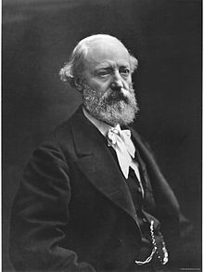
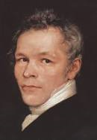
The historical context The «restoration fury»
The rediscovery of classical heritage during the Romanticism, determined an attention to the matter of the restoration of historic buildings, making them available for contemporary users.
Eugène Emanuel Viollet-Le Duc
(1814-1879)
Karl Friedrich Schinkel (1811-1841)
Gilbert Scott (1811-1878)

Slide 43
The historical context Restoration/Conservation
Latin World
Anglo-Saxon World
Restoration
Conservation
ICCROM
Restoration+Conservation

Slide 44
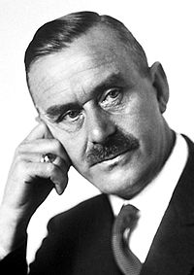
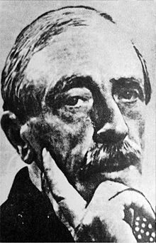
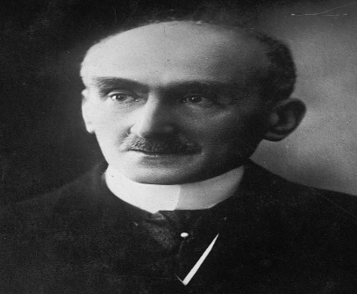
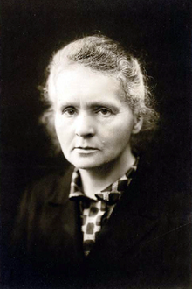
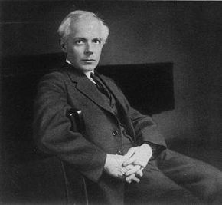
The historical context Around the First World War
Paul Valery
(1871-1945)
Thomas Mann
(1875-1955)
Under the direction of the League of Nations, the International Committee of Intellectual Cooperation (1922-1945) formed special committees of experts, such as the International Committee on Intellectual Cooperation, the International Commission on Historical Monuments, the Committee of Scientific Advisors and the Committee of Architectural Experts.
Henri Bergson (1859-1941)
Albert Einstein (1879-1955)
Marie Curie (1867-1934)
Béla Bartòk (1881 – 1945)

Slide 45
The historical context The International Museums Office
Created in 1922, it was the direct predecessor of the International Council of Museums, created under the direction of Unesco in 1946.
It promoted two important conferences:
The conference of Rome (1930), devoted to the study of scientific methods for the examination and preservation of works of art;
The Conference of Athens (1931), devoted to the conservation of architectural monuments, approving an important document (the so-called «Charter of Athens», around the relationship between preservation and restoration.
Gustavo Giovannoni (1873-1947)

Slide 46
The historical context The International Congress of Modern Architecture
It was created in Switzerland in 1928 (last in 1959), and represented the large movement of renovation in the architecture, linked to the new artistic expressions emerged around the First World War, such as the Manifesto of Futurismo (1909) or the «De Stijl Movement» in the Netherlands, or the Bauhaus in Germany.
The Congress of Athens in 1933 produced another important document (the so-called «Charte d’Athènes», following the conclusions get in the Conference of 1931. The general Secretary was Siegfried Giedion, and one the most active members Le Corbusier.

Slide 47
Under the Unesco
International Council of Museums, created in 1946 (President was Chauncey Hamlin – 1946-1953 – then Georges Salles – 1953-1959 – then Philip Hendy – 1959-1965 – then Arthur Van Schendel – 1965-1971.
International Committe for Monuments, created in 1948 at the Unesco Conferencce of Beirut.
The International Union for the Conservation of Nature, created in 1948 at the Unesco Conference of Fointainbleau.

Slide 48
The ICCROM
The ICCROM was created under the direction, and within the initiatives of Unesco, looking at the main purposes of the organization. In particular the matter of conservation and restoration of cultural property – following the Hague Convention of 1954 – was stressed by some intellectuals and operators, active members of the International Council of Museums: Guglielmo De Angelis d’Ossat, Piero Gazzola and Giorgio Rosi (Italy), Jan Karel van der Haagen (Netherlands), Hiroshi Daifuku (Japan), Frédéric Gysin (Switzerland).

Slide 49
The Centre in Rome
After a series of conferences followed between 1952 and 1955, the ninth session of the Unesco General Conference – meeting in New Delhi in november-december 1956 – established to create the International Centre for the Study of the Preservation and Restoration of Cultural Property. Ir also established to place the centre in Rome, and to get agreements with the Italian Governments and the other italian institutes devoted to the tutelage of cultural property: in particular the «Istituto Centrale del Restauro», the «Istituto di Patologia del Libro», the «Scuola Centrale antincendi», the «Istituto d’Arte per la Ceramica», the «Scuola del Mosaico», the «Istituto per le Pietre Dure».
The Provisional Council was composed of:
Jan Karel van der Haagen – Unesco Chief of the Division of Museums and Historical Monuments;
Guglielmo De Angelis d’Ossat – Italian Government – Director General of Antiquieties and Fine Arts;
Paul Coremans – Director of the «Institut Royal du Patrimoine» – Brussels;
Cesare Brandi – Director of the «Istituto Centrale del Restauro» – Rome;
Frédéric Gysin – Chairman of the Advisory Committee of ICOM and Director of Musés National Suisse - Zurich

Slide 50
The main activities during the 60s
The tutelage of Nubian monuments in the Nile Valley during the excavation of the Aswan dam;
The intervention during the floods in Venice and Florence;
A series of important publications;
The development of an important library;
Conferences, trainings, courses on architecture, restoration, art.

