Slide 1
Politics for cultural heritage management in a comparative approach A proposal of discussion about «transoceanic relations»
Aims and Topisc
To examine the main elements of the Spanish experience
To consider and examine the cultural relations between the Spanish heritage and the development of South-American culture;
A divided history/a different culture?

Slide 2
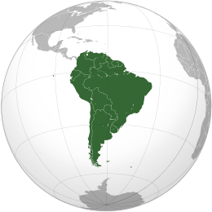
Our space of analysis

Slide 3
A history of conquest?
The descovery, exploration and conquest of South America
began with the descovery of America by Colombo (1492)
In 1513 Vasco Nunez de Balboa crossed the isthmus of Panama
In 1519 Hernan Cortes conquered the Aztec Empire
In 1531 Francisco Pizarro conquered the Inca Empire, founding
the city of Lima

Slide 4
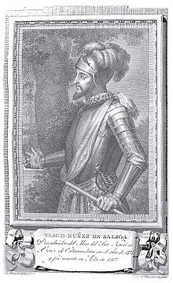
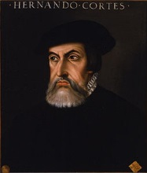
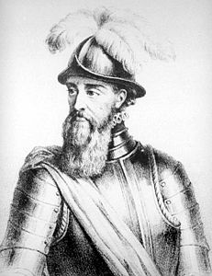
Explorers and Conquerors
Hernan Cortes
(1485-1547)
Cristoforo Colombo
(1451 – 1506)
Francisco Pizarro
(1475-1541)
Vasco Nunez de Balboa

Slide 5
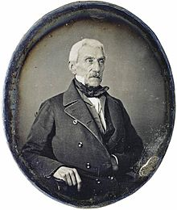
A history of independence
It was the series of wars occurred between 1808 and 1833 to give independence to the different south-american countries
Josè Antonio Torres
(Mexico)
Josè Antonio de San Martin
(Argentina – Chile – Perù)
Simon Bolivar
(Colombia)

Slide 6
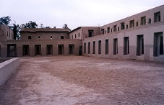
Descovering a cultural heritage?
Machu Picchu
Temple of Pachamac

Slide 7
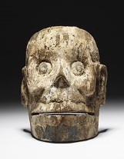
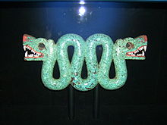
Descovering a cultural heritage?
Santa Cecilia Acatitlan

Slide 8
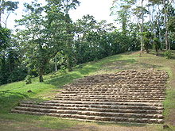
Descovering a cultural heritage?
El Castillo – Chichen Itza
Takalik Abaj

Slide 9
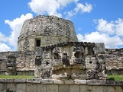
Descovering a cultural heritage?
Calakmul
Mayapan

Slide 10
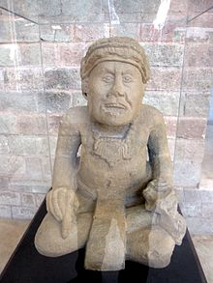
Descovering a cultural heritage?

Slide 11
Some elements around the Spanish system of protection The first laws
At the beginning of the protectionist movement in Spain we find two main institutions encharged of the protection:
a)The Academy of History: found in 1738 by Phiilip V, it had general powers of inspection and inventory of monuments;
b) The Academy of Fine Arts: founded in 1752 by Ferdinand VI, it had specific competencies for works of architecture;

Slide 12
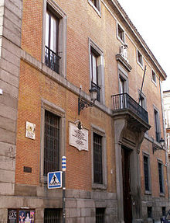
Real Cédula – 1738
It defines the first Statute of the
Academy of History
The Academy of History today

Slide 13
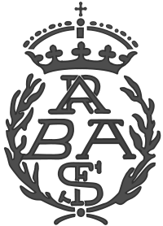
Palacio de Goyeneche – Calle de Alcalà – Madrid
Academia des Bellas Artes de San Fernando
The symbol

Slide 14
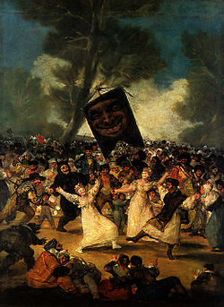
Some examples…
El sueño del caballero – Antonio de Pereda
El entierro de la sardina - Goya

Slide 15
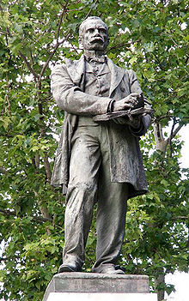
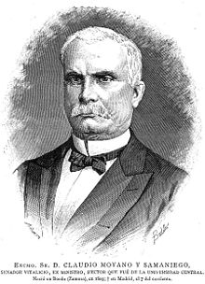
A progressive centralization
In 1844 it was created a Central Commission for Monuments, with Commissions at a provincial level
In 1857 it was introduced a general law around educational system, referred also to the problem of protection of cultural objects.
Claudio Moyano
(1809 – 1890)

Slide 16
La Ley Moyano Some more details
It was introduced on September 9 1857 and remained as General Law of Education till 1970;
It established three levels of education:
primary: obligatory from 6 to 12 years of age;
Secundary: till 18 years of age;
University
It introduced a series of rules for the education and the study of art and history of art;
At the beginning of the XX° Century it was, finally, introduced a Ministry for the Public Education and a General Direction for the Fine Arts.

Slide 17
The experience of the Republic and the Constitution of 1931
It recollected the results of previous laws (1911, 1915, 1926), which introduced the idea of an Archeological National Treasure;
It introduced the idea of a National Treasure put under the protection of the State;
Art. 45: «all the artistic richness of the country constitutes the National Treasure of the Nation and will be under the protection of the State. The State will protect also the the sites recognized for their natural beauty or for their artistic or historical value»;
The Constitutional basis was applied through a specific law promoted and introduced in 1933 wich remained also after the Civil War

Slide 18
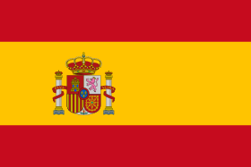
Under the Regime

Slide 19
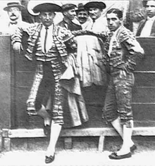
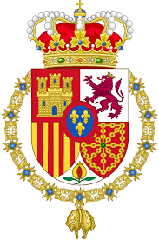
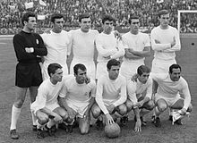
An authoritarian and conservative regime
The Church
The Monarchy
National Tradition

Slide 20
An opening system?
Law 22 July 1958 creating a system of protection for national, provincial and local monuments;
Law 20 November 1964 – introducing a system of rules to protect movable objects;
Law for the protection of natural spaces and sites – 1975;
Three administrative structures:
Supervisor of Fine Arts;
Supervisor for devasted areas;
Supervisor of Architectur

Slide 21
The system today
At the basis of the system it is the Constitution introduced in 1978 (6 December), the foundamental law of the State;
It determined the transition of Spain from an authoritative regime to a constitutional and representative system;
It allowed the process of development and modernization of Spain.

Slide 22
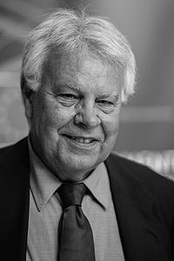
Adolfo Suarez Gonzalez
(1932 – 2014)
Felipe Gonzales Marquez (1942-)

Slide 23
Centralization/Decentralization
The Constitution establishes the unity of the State, but the art.2 recognizes the original character of spanish nationalities and of their territorial context;
National character of spanish territorial autonomies is also recognized by the art. 143: it introduces the power of establishing «autonomous Communities» for Provinces having historical, cultural and economic defined characteristics, or having a so-defined «entidad regional historica»;
Among the powers recognized to autonomous communities are also powers of management of cultural asset.

Slide 24
Nation/Autonomies
To avoid risks related to the unity of the State, the Constitution and the laws reognize the difference between culture as a value and competencies recognized to the autonomies around cultural heritage;
Some autonomous communities introduced in their Statutes some exclusive competencies around cultural heritage: so it is in the case of Paìs Vasco, Galicia, Andalucìa;
The Constitutional Judge established cultural value has a general meaning, so the competencies are divided between State and autonomous communities in a very defined manner

Slide 25
The State
The State is exclusively competent around the management and protection of:
General legislation for the protection of environment;
Protection of cultural, artistic, monumental asset of Spain against exportation;
Museums, libraries and archives which are ownership of the State

Slide 26
The autonomous communities
Autonomous communities are exclusively competent around:
Museums, libraries, musical institutes, onsidered as relevant for the local communities;
Monuments of interest for the local communities;
Development of the culture of the local communities

Slide 27
The last result
The Law for the Historical Spanish Asset (1985) defines a new system of rules balancing competencies of the State and autonomous communities;
Two other laws – 1991 and 1994 – completed the system the same way;
Consejo del Patrimonio Historico
It is composed by one member of each autonomous community and one member of the administration of the State, who is the President of the body

Slide 28
The role of the local communities
They have competencies around the museums and musical institutes;
It has been created a particular system – Systemas Espanoles de Archivos, Museos y Bibliotecas – representing an alternative system for the development of the protection of cultural heritage and also for the development of the culture;
The basis of the role of local communities is given by the Constitution, by the General Law of 1985, and by some other particular laws around specific categories of cultural objects.

Slide 30
A South-American cultural heritage?
The first matter to consider is that one of the so-called «patrimonio cultural exiliado»: the amount of cultural objects stolen and trasnported from Spain to South-America;
In Spain the law for artistic national treasure – Ley relativa al patrimonio artistico nacional – introduced established that «artist treasur is bound to our national history»

Slide 31
A Soouth-American heritage after the independence
Two main issues
Building an independent identity against the former colonial identity: eliminating each trace of former colonia identity;
Building a sort of «purity» in «new countries identity» linked to the pre-colombian past

Slide 32
The example of Colombia
Law n.34 – May 29 1881 – constitution of the National Museum and general law to protect “objects with a value for the national memory and for the development of science”
Law n.59 – June 11 1881 – introduction of a Committee for the study and development of natural sciences

Slide 33
…other examples
Dominican Republic – 1870 – protection of the national monument “Alcazar de Colon”
Honduras – 1870 – protection of the Valley of Copán
1891 – National Museum – with the cooperation of the Peabody Museum
Costa Rica – 1881 – National Archive
Nicaragua – 1870 – National Archive
Nicaragua – 1897 – Industrial, Commercial, Scientific National Museum
San Salvador – 1870 – National Museum
Bolivia – 1906 – protection of the natural and archaeological site of Tihuanaco

Slide 34
Palacio Virreynal – Alcazar de Colon

Slide 35
Valley of Copan - Honduras

Slide 36
Valley of Copan

Slide 37
Tihuanaco - Bolivia

Slide 38
Tihuanaco

Slide 39
Tihuanaco

