Slide 1
Lesson 13 Some general considerations around the italian case after the Second World War
Rupture and continuity after the end of the war
The last results at a juridical level

Slide 2
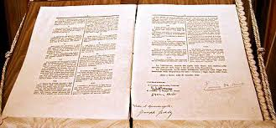
The Constitutional Charter and the recognition of a constitutional right to the «beauty»

Slide 3
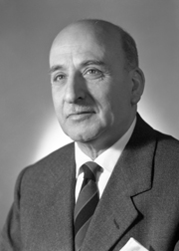
The art. 9
It was discussed by the First Sub-Commission, devoted to «Duties and Rights of citizens», whose President was Umberto Tupini (Christian-Democrat Deputy)
Umberto Tupini (1889 – 1973)

Slide 4
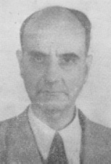
The art. 9 About the discussion
Liberal perspectivevSsocial perspective
Vittorio Emanuele Orlando
(1860 – 1952)
Costantino Mortati
(1891 – 1985)

Slide 5
The art. 9 The results
The text: «Republic promotes the development of culture and scientific and technological research. It protects landscape and historical and artistic asset of the Nation»
The recognition of a social right
The State with its bodies and different levels has the prevalent role
It follows the model of the «social Constitutions»

Slide 6
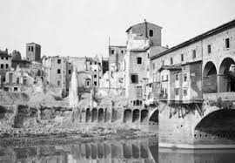
Rebuilding destroyed cities…

Slide 7
Rebuilding destroyed cities…

Slide 8
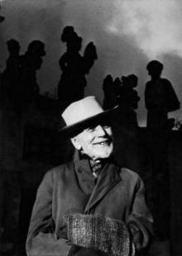
Voices of the culture…
Ranuccio Bianchi Bandinelli
(1900 – 1975)
Bernard Berenson
(1865 – 1959)
Rebuilding after an attentive study
following the original
Rebuilding adapting to
the new conditions

Slide 9
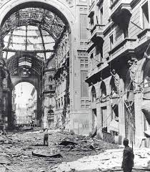
Other examples…

Slide 10
Some other examples…

Slide 11
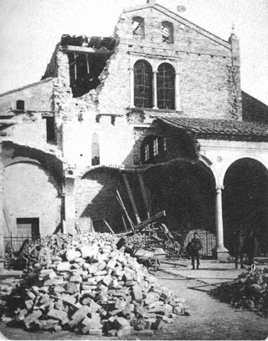
Ravenna

Slide 12
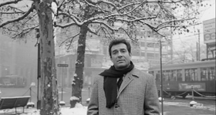
The «italian boom»
La dolce vita – Federico Fellini - 1960
La vita agra – Carlo Lizzzani - 1964

Slide 13
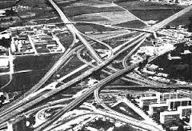
The «italian boom»

Slide 14
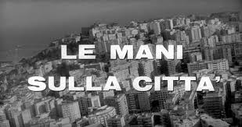
The «italian boom»
A great urbanization
A great migration South-North
A massive building speculation
Francesco Rosi
1963

Slide 15
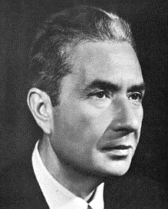
A government for the modernization The experience of «centre-left»
Aldo Moro (1916 – 1978)
Amintore Fanfani (1908 – 1999)

Slide 16
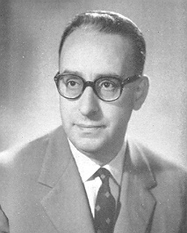
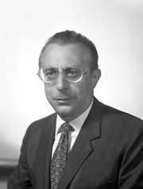
The effort for the urban planning reform
Fiorentino Sullo (1921 – 2000)
Giacomo Mancini (1916 – 2002)
Giovanni Pieraccini (1918 - )

Slide 17
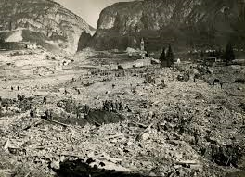
Natural disasters and emergencies
Collapse of the Vajont Dam
9 October 1963

Slide 18
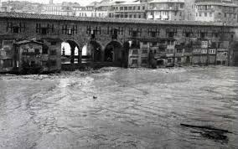
Natural disasters and emergencies
Flood of Florence – 4 November 1966

Slide 19
Natural disasters and emergencies
Landslide – Agrigento - 1967

Slide 20
Natural disasters and emergencies

Slide 21
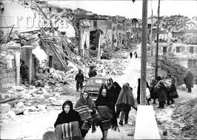
Natural disasters and emergencies
Earthquake – Belice - 1968

Slide 22
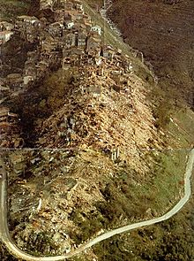
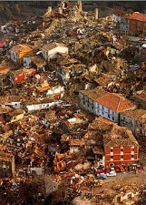
Natural disasters and emergencies
Earthquake – Friuli Venezia-Giulia - 1976
Earthquake – Irpinia - 1980

Slide 23
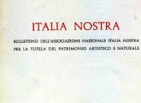
Private associations and tutelage
Created in 1955 by a group of intellectuals,
it is till today the most relevant association devoted
to the problem of cultural heritage protection and
management

Slide 24
Contents, issues, basis…
It was an association created by a group of experts, intellectuals, interested in the tutelage and art;
It was created with an elitistic approach to the tutelage, against the modern development, especially the urban development;
It is an association – today a not lucrative association – with sources obtained from private citizens but also from the State;
It has today more than 200 sections and offices in Italy
The main aim is «the protection of cultural and natural asset in Italy»

Slide 25
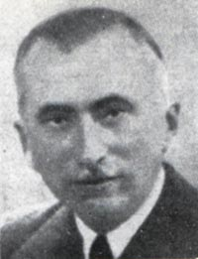
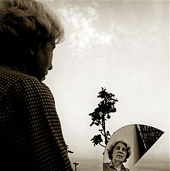
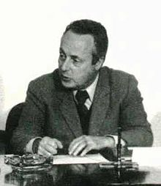
The founders…
Pietro Paolo Trompeo
(1886 – 1958)
Elena Croce (1915 – 1994)
Umberto Zanotti Bianco (1889-1963)
Giorgio Bassani (1916 – 2000)

Slide 26
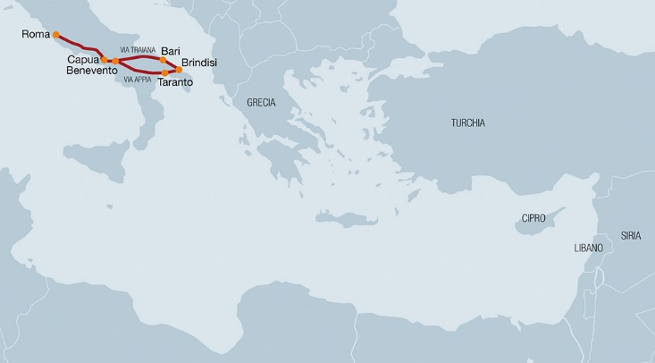
Protecting the «Appia Antica»…
At the Age of Roman Empire
Quaedulig – Excavations on the «Appia Antica» - 1860

Slide 27
In 1960 a first project was proposed,
to create an archaeological park;
The project was consolidated in 1965;
In 1979 Argan accepted to introduce
the project in the «agenda for Rome»
Antonio Cederna (1921 – 1996)

Slide 28
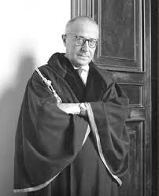
Restoration: two opposite perspectives
Roberto Pane (1887 – 1987)
Balancing ancient and new
Cederna – against destruction
and modernization

Slide 29
A Commission for the study of cultural asset
The Commission «For the tutelage of cultural and environmental heritage» was created by the Parliament in 1964, with a group of Deputies and experts;
It was organized in different groups:
Archaeological objects;
Artistic objects;
Environmental sites (also historical centres);
Libraries;
Archives

Slide 30
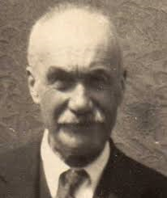
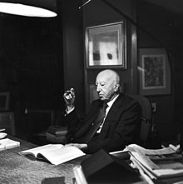
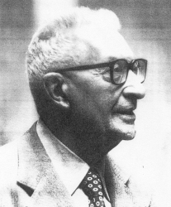
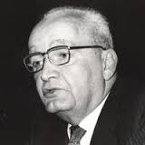
Some figures…
Giovanni Astengo
(1915 – 1990)
Alfredo Barbacci
(1896 – 1989)
Feliciano Benvenuti (1916 – 1999)
Augusto Campana
(1906 – 1995)
Massimo Severo Giannini (1915 – 2000)

Slide 31
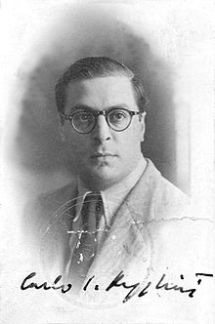
Mino Maccari (1898 – 1989)
Ettore Onorato (1899 – 1971)
Carlo Ludovico Ragghianti
(1910 – 1987)

Slide 32
The result: a new concept of cultural asset
84 General Declarations:
It recognizes cultural asset as composed of every object having
value of testify of civilization

Slide 33
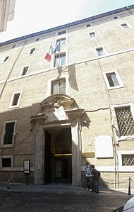
The last step: a Ministry for cultural and environmental heritage
Created with the
Decree n° 674/1974
Giovanni Spadolini
(1925 – 1994)

Slide 34
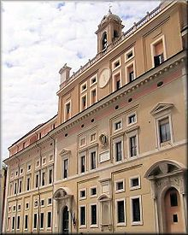
Aims and structure
It was created as a Ministry for and not of cultural and environemtal heritage, to represent the technical approach to the matter;
It was created as a general ministry, both for the cultural and the environmental heritage;
It acquired also the control and management of the archives, originally linked to the Ministry for Interior with an inspective role

Slide 35
The structure
Office for the communication
Cabinet Office
The Ministry
Secretary of the Minister
Legislative Office
Offices of the Sub-Secretaries

Slide 36
The structure
General Secretary
Office I – International Relations - Unesco
Office II - National and Communitarian Strategy
Office III – Inspective Service

Slide 37
The Structure
General Direction for Archaeology, Fine Arts, Landscape
General Direction for Archives
General Direction for Libraries and Cultural Institutes
General Direction for Museums
General Direction for Organization
General Direction for Economic Management

Slide 38
The role of the Regions
Created in 1970, the Regions acquired immediately a series of competencies around cultural heritage and landscape;
They were in particular related to the management of schools, libraries, buildings for public education, museums, at a local level;
Above all, they acquired a great power around the urban planning policy, consequently around the landscape management and environment, becoming the real actor of the tutelage and of an idea of «democratic access to culture»

Slide 39
The last codification
It was the Decree n° 42 – 22 January 2004 (the so-called «Codice Urbani») to recollect all the results of the debate and redefine the general lines of management

Slide 40
The tourism

