Slide 1
Lesson 12 Politics for cultural heritage management in a comparative approach: some notes about the Italian case
Aims and Topics
To analyse the theoretical basis of the italian politics for cultural heritage
To consider the historical context and the historical reasons of the emergence of a protectionist movement
To examine the most relevant characters of the italian case

Slide 2
A great cultural asset…

Slide 5
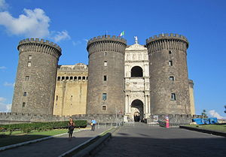

Slide 6
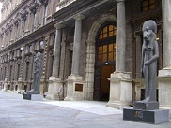

Slide 7
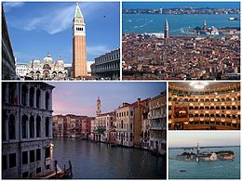
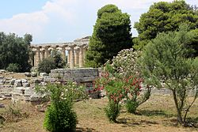

Slide 8
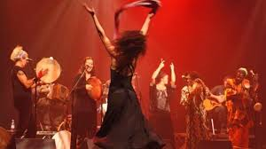

Slide 9
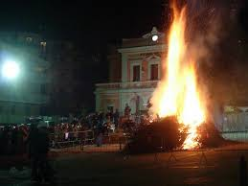

Slide 11
The result of a long historical development
The emergence of a protectionist sensibility in Italy is the result of a very long historical process
The emergence of an attention to the «beauty» takes places in an universal dimension, setting in the atmosphere of the «Reinassance»
The main step is exactly linked to the origins of the Italian State
Italian protectionist movement is linked to the international sensibility emerging in Europe between XIX° annd XX° century
An international process
An Italian specificity

Slide 12
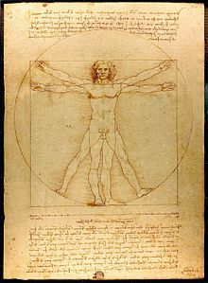
The relevance of the Reinassance

Slide 13
The man and the beauty
Reinassance is the re-discovery of reason after the dark period of Medieval tradition and superstition
Reinassance is the new concept of the «man as protagonist of the world»: the man is considered as homo faber
Reinassance is the re-discovery of the history after the Medieval Christian conceptualization of apocalypse
Reinassance is the re-discovery of Greek and Latin culture after the decline of the Medieval Age
Reinassance is re-discovery of the «beauty» as expression of the man

Slide 14
The first efforts to protect the «beauty»
The decree promoted in 1425 – Etsi de cunctarum –
introduces in Rome some particular police officers –
Magistri Viarum – against damages and vandalism,
especially to avoid acts of vandalism against buildings
Pope Martino V°
Oddone Colonna
(1417 – 1431)

Slide 15
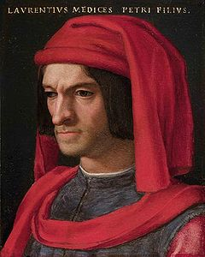
Reinassance and Baroque
The symbol of the Medici family
Lorenzo (1449 – 1492)

Slide 16
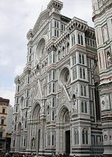
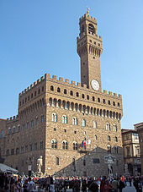
…some examples…
San Tommaso Church
Fabio Borbottoni (1820 – 1902)
Santa Maria del Fiore

Slide 17
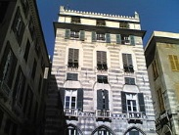
Renaissance and Baroque
Andrea Doria (1466 – 1560)
Doria Palace - Genova

Slide 18
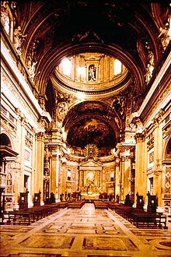
The power of the Church

Slide 19
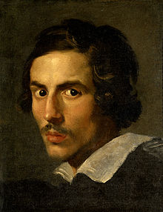
Gian Lorenzo Bernini (1598 – 1680)

Slide 20
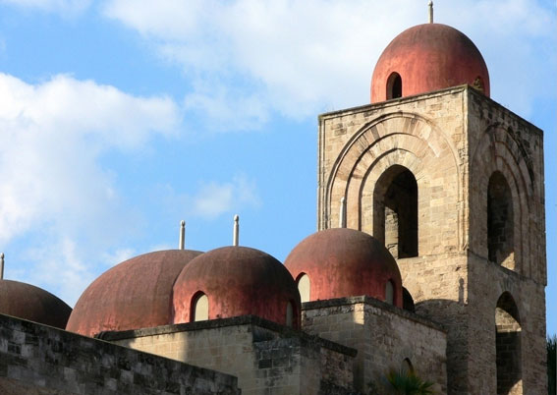
The Arab influence
Listed in the World Heritage List

Slide 21
Before 1861
Different systems
in different States

Slide 22
Two examples
Decree 7 april 1820 –
It introduced some instruments of protection
and considered absolutely not liberal.
against it, the lobbies of art merchants promoted
actions
Bartolomeo Pacca (1756 – 1844)

Slide 23
Two examples
Decree of 1774 – It introduced rules for the protection
in a mostly preventive way. Considered a very liberal decree
Antonio Maria Zanetti (1706 – 1778)

Slide 24
The organization of the system till the beginning of the XX° century
The juridical and administrative system introduced after 1861
followed the system introduced by Napoleon: a very centralistic one,
with a strong control by the State.
The most important role was played by the Prefect: nominated
by the King, responsible to the Ministry of Interio, «man of the State»
on the peripheral level of the territory.
He controlled the public order, the police, but also, infrastructures,
services, hygiene, healthy.

Slide 25
The organization of the system till the beginnning of the XX° century
The system of protection followed the model of the administrative system;
Encharged of the protection they were General Inspectors with a territorial competency exactly similar to the Prefects;
In some particular cases, Inspectors were created with specific competencies with regard to the protection and management of particular sites: for example Rome, Pompei, or some particulary relevant national museums;
Some projects were promoted to decentralise the system at a regional level, immediately abandoned.

Slide 26
A look to the system
General Inspectors at a peripheral level, following the model of the Prefects
At the top of the system the competent body is the Ministry of Public Instruction, where it is introduced a General Direction for Antiquities and Fine Arts
Archives are managed and controlled by the Ministry of Interior

Slide 27
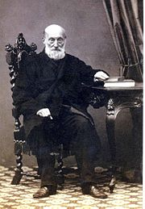
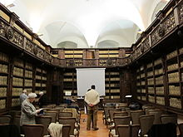
A large debate…few figures…
Gian Pietro Viesseux
(1779 – 1863)
Gabinetto Viesseux

Slide 28
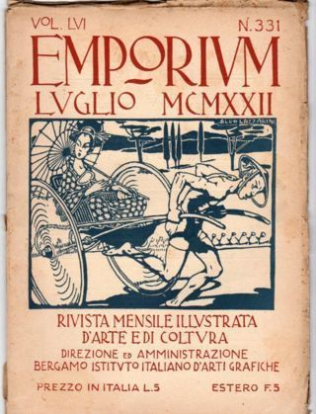
«Il Marzocco» (1896 – 1932)
[…] «We contrast all the artistic
production set out of an idea of
pure beauty» […]
«Emporium» (1895 – 1964)
Published by the Institute of Graphic Arts
Bergamo

Slide 29
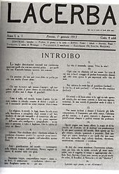
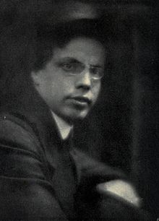
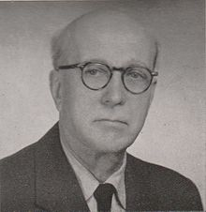
«Il Regno» (1903 – 1906)
«Lacerba» (1913 – 1915)
Giovanni Papini
(1881 – 1956)
Giuseppe Prezzolini (1882 – 1982)

Slide 30
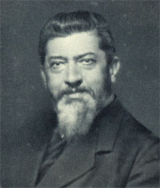
For an elitistic art…against mass society
Filippo Turati
(1857 – 1932)
Giovanni Giolitti (1842 – 1928)

Slide 31
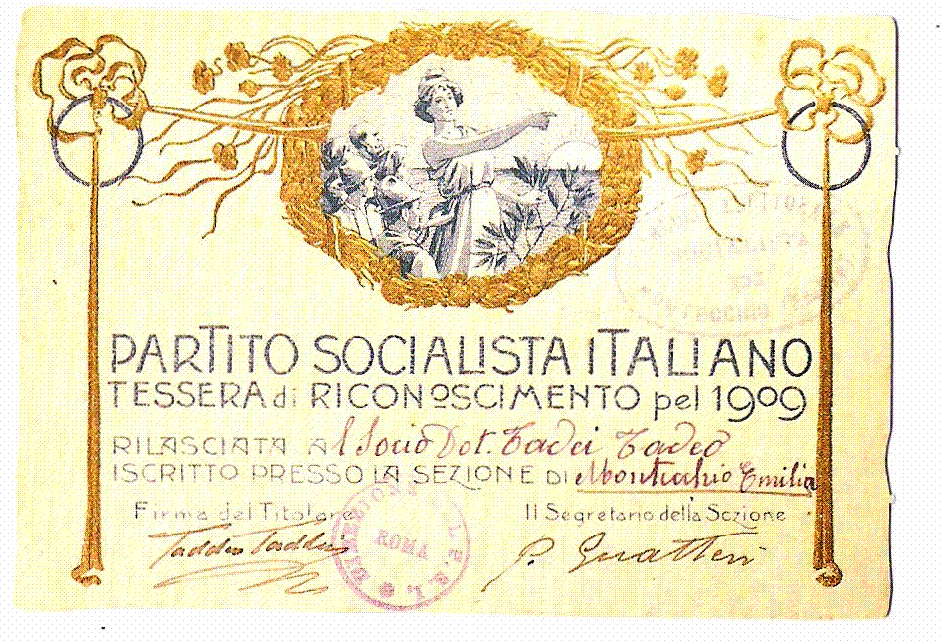
A possible different idea of «beauty»

Slide 32
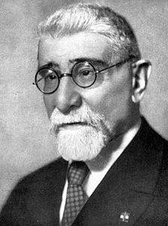
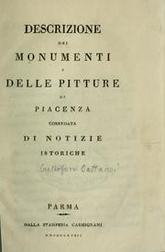
Intellectuals, experts, friends…
The so-called «Monuments Friends’
Brigades were the first private
associations to promote an action
of discovery, tutelage and research
Luigi Rava (1860 – 1938)
Giovanni Rosadi (1862 – 1925)

Slide 33
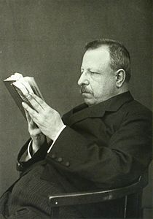
New attention, new sciences… The emergence of archaeology, the recognition of a scientific history of art
Corrado Ricci
(1858 – 1934)
Benedetto Croce (1866 – 1952)

Slide 34
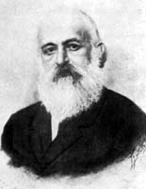
History of art
Giovanni Morelli (1816 – 1891)
Giovanni Battista Cavalcaselle
(1819 – 1897)

Slide 35
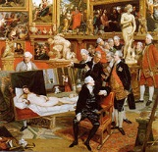
The legitimacy of a new science
Adolfo Venturi
(1856 – 1941)

Slide 36
The legislative development Three important steps
Law 16 July 1905 n° 411 – «For the conservation of the pinewood of Ravenna»
Law 20 June 1909 – n° 364 – «For the Antiquities and Fine Arts» (so-called Law Rosadi-Rava)
Law 11 June 1922 – n° 778 – «For the protection of natural beauties and buildings of particular historical interest»

Slide 37
The main elements
All the laws define the beauty as «element of national history»: both the monuments and, in particular, the landscape, are protected as «memory of national history»;
The Law Rosadi-Rava defines the objects under protection in an aesthetic way: they are «objects of historical, archaeological or artistic interest»;
They are declared unalienable
it gives public administration the power of expropriation of private objects particularly relevant
It introduces some rules related to the control of the exportation of movable objects;
It promotes the development of archaeological research;
It defines a new system of protection through the introduction of the «Superintendents»

Slide 38
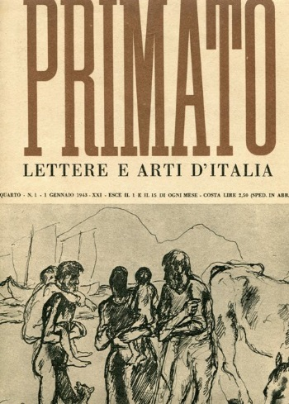
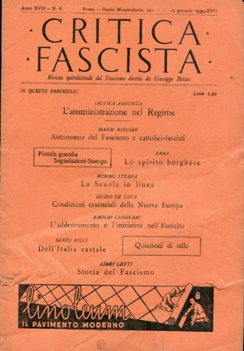
Under the fascism: rupture or continuity?
Giuseppe Bottai
(1895 – 1959)

Slide 39
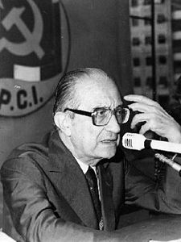
New generations of intellectuals
Cesare Brandi (1906 – 1988)
Giulio Carlo Argan (1909 – 1992)

Slide 40
The legislative results
Law I° June 1939 n° 1089 «Protection of objects of artistic or historical interest» - Law 29 June 1939 n° 1497 – «Protection of natural beauties»;
Both the first and the second defined cultural objects from an aesthetic point of view: the first with regard to «things of art» (exclusively material), the second to «natural beauties»
The structure of the first law moves along some issues:
1)It defines the concept of objects of interest;
2)It introduces the concept of «public enyoiment» of protected objects;
3) It separates the matter of cultural objects from urban planning acts;
4)It introduces the duty of protection, conservation and management also for the private owner;
5) It introduces rules about exportation and alienation

