Slide 1
Lesson 10 Politics for cultural Heritage Management in a comparative approacch: the different system in the Socialist countries
Aims and Topics
To consider the different basis of the socialist system
To examine the different evolution of the system of management for cultural heritage
To consider differences and simliraties with the Western European countries

Slide 3
A dictatorial regime framed by Marxism-Leninism
Collectivisation of means of production and exchange
A cooperative system
The government is identified with one political party

Slide 4
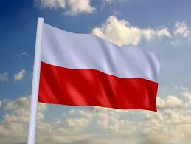
A monolithic system with some differences…
A deep catholic culture
A cooperative system
1948 – expulsion of Jugoslavia from
the Cominform
Consequent detachment from URSS

Slide 5
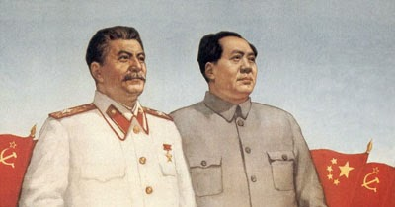
Communism in Asia…
Progressive detachment from URSS
between 1959 and 1960

Slide 6
Soviet UnionvSChina
Communist Party of Tchecoslovakia
Communist Party of Cuba
French Communist Party
Italian Communist Party
Communist Party of Poland
SED – Communist Party of Democratic Germany
Communist Party of Vietnam
Communist Party of Lao
Communist Party of Romania
Communist Party of Cambogia
Communist Party of Albania
Communist Party of Argentine
Communist Party of Birmania
Communist Party of Kampuchea
Communist Party of Phiilippines
Marxist-Leninist organization of Greece
Communist Party of India
Communist Party of Italy (marxist-leninist)
Communist Party of Indonesia
Communist Party of Malaya
Communist Party of Norway
Communist Party of Panamà
Communist Party of Thailandia

Slide 7
Communism in South America…
A communist regime since 1959-’60
Spanish Heritage

Slide 8
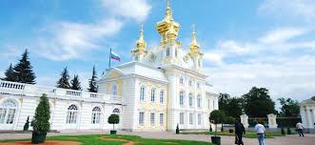
A Great Heritage without rules?

Slide 9
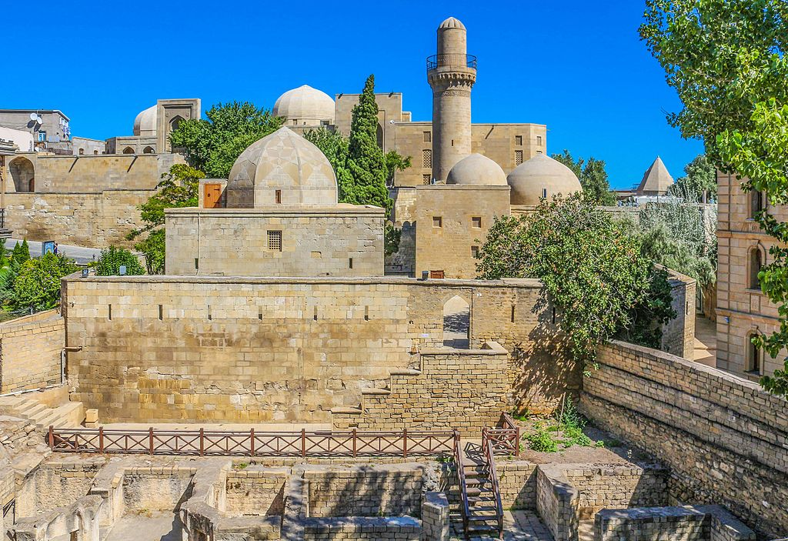
Maiden Tower - Baku
Palace of Shirvanshahs - Baku

Slide 10
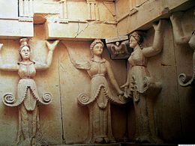
Bojana Church - Bulgaria
Thracian Tomb of Shvestari
Bulgaria

Slide 11
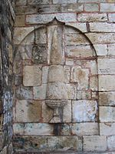
Kralj-Kap - Jugoslavia
Mehmet Pascia Fountain - Jugoslavia

Slide 12
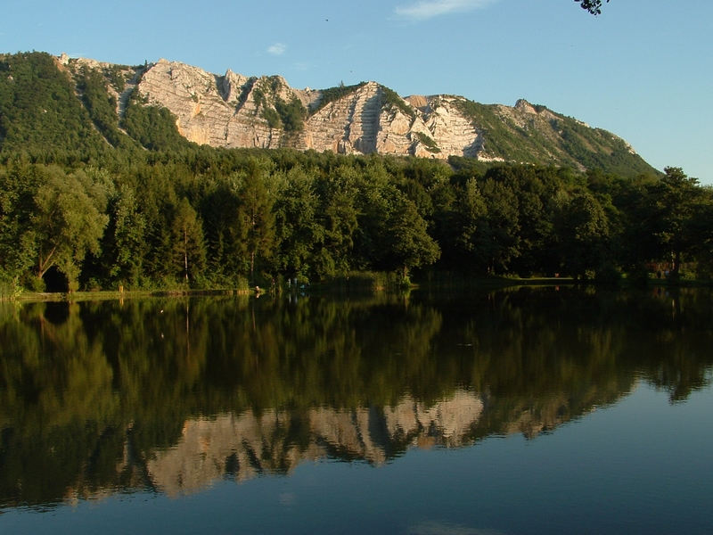
Lake Bukk - Hungary
Lake Balaton Park - Hungary

Slide 13
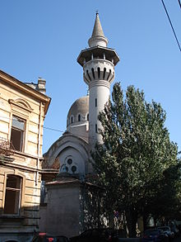
Fortress of Sibiu
Mosque of King Charles - Costanza

Slide 14
A problematic situation
A great amount of cultural monuments, testyfing a complex and reach history;
A not exactly defined consciousness of the relevance;
A not unitarian legislative system;
Attention given mostly to the problem of classification, rather than the problem of conservation and management;
Prevalence of the idea of cultural monuments and not of cultural heritage, in a fragmented conceptualization;
A not sufficient financial support by the State;
Complicated balance between public and private around what was «social property» till the end of Communism

Slide 15
What was before?...
The main elements
Cultural Heritage is understood as social property, belonging to the People and, in this way, to the State. Consequently, the role of the State is absolutely prevalent;
Cultural asset is considered as amount of cultural monuments, with the reference to monuments of historic, artistic, scientific value, but in a fragmented conceptualization, and not as cultural heritage, in an unitarian perspective;
An evident contrast between law and its application: laws contrasting with the concept of social property were not applied.

Slide 16
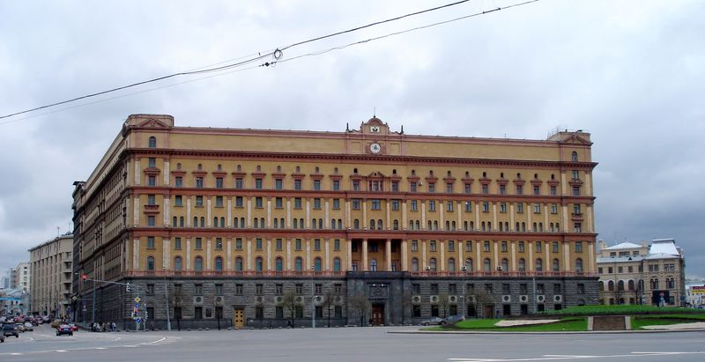
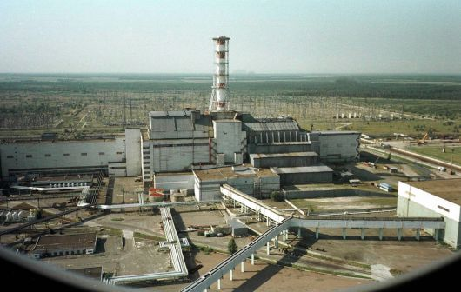
Cultural monuments as evidence of history Some examples…
Lubjanka
Lenin’s Mausoleum
Chernobyl

Slide 17
The General Law organising the system of protection under the socialist regimes
The system was organized on the model of the Law introduced
in Poland on February 15 1962. It represented the general law.
To this model almost each country under the socialist regime
adapted its legislation.
It declared cultural monuments all those immovable and movable
objects representing an interest for the legacy and cultural development
by virtue of their historical, artistic, scientific value.
It introduced the main concepts and instruments for the protection:
a)The concept of cultural evidence;
b)The Catalogue
c)The Register

Slide 18
The main consequences…
All the buildings become property of the State; the nominal owner – the citizen – becomes just an user;
The State has the duty to protect and manage all cultural monuments;
The State controls also the market of movable objects of cultural interest;
The State operates with a minimal personnel (5-6 person per office);
The role of private associations is (apparently) completely reduced.

Slide 19
The example of Bulgaria
A Law – similar to the Polish one – was introduced in 1969;
It defined cultural monuments: agglomerates of monuments, neighborhoods, works of urban and rural architecture, pieces of pictorial and plastic art, precious manusripts, rare books, ornaments, arms, money, sculptures, fountains, icons, tools, vases and containers, and everything included in a collection of a museum;
It protected the works of human activity constituing a genuine cultural and intellectual documentation thanks to their historical, cultural and scientific importance, and linked to historical events, to the artistic production of famous authors, to the lives of historical figures.

Slide 20
The actors of the protection
The protection was essentially entrusted to the State and the Bulgarian Academy of Sciences;
The State, through competent bodies, controlled the management and prevented damages;
The State covered expenses for restoration and requalification;
Private citizens were given some tax-rebates of expemption when – as private owners – they looked after management and protection of a cultural monument;
To visitors, private citizens, nothing obligatory was asked in terms of tickets or tariffs.

Slide 21
The main elements
The absolutely prevalent role of the State;
Protection was considered as a «highly patriotic national duty»;
Protection was extended also to contemporary art, but not produced «on Commission»;
Commissioned works under the direction of a National Committee on plastc arts, a National Committee of Painters, a National Committee of Architects.
Socialist Regime

Slide 22
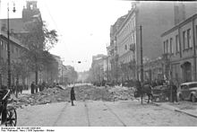
The matter of reconstruction The example of Warsaw

Slide 24
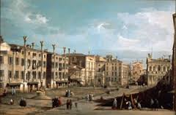
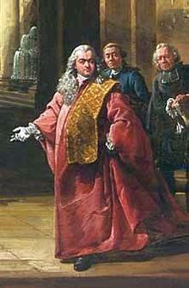
Rebuilding Warsaw…
Bernardo Bellotto
(1721-1780)
Industrial areas
Building areas
Services Centre
Green areas
Main roads
Raylway roads

Slide 26
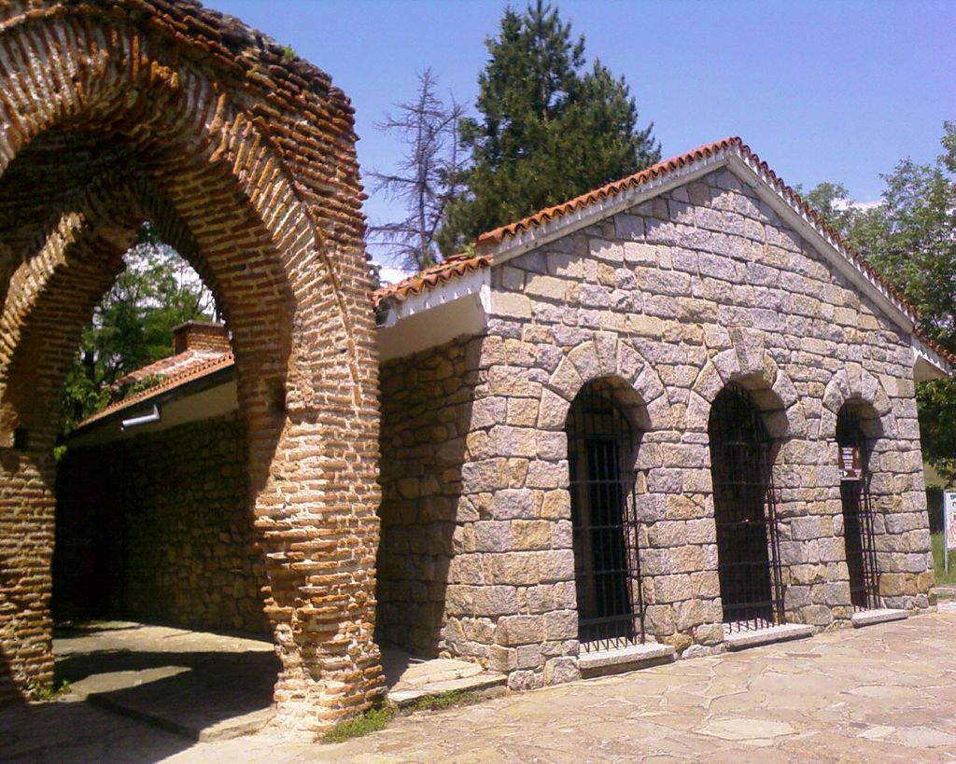
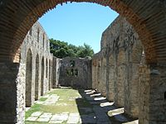
Seeking the origins of a national communism
Apulum – Alba Julia – Cluj-Napoca - Romania
Thracian Tomb of Kazaniak - Bulgaria
Butrint – Albania – Discovery began by
Luigi Maria Ugolini – under the regime
continued by Hasa Ceka

Slide 27
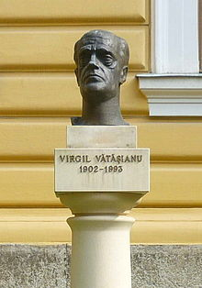
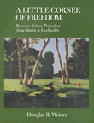
The presence of a debate
Virgil Vatasianu
(1902-1993)
Jan Zachwatowicz (1900-1983)

Slide 28
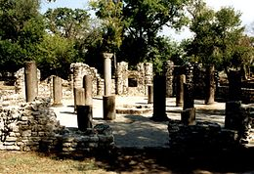
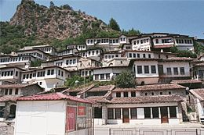
The matter of Historical Centres
Also in the Eastern Europe – as in the Western part – at the beginning of the 60s it emerges a matter related to the urban development. Against it the problem of protecting historical centres acquires relevance.
Some laws – expressively devoted to the problem of historical centres – are introduced during these years.

Slide 29
The matter of Historical Centres The Example of Albania
The Law June 2 1961 n° 170
It protects the city of Berat defining it as a «city Museum»
Art. 1: «The city of Berat shows great historical, artistic and cultural values, not only at a local level, but also at a national one, related to the history, art and culture of our country, and is consequently put under protection;
Art. 2: «Within the city Museum of Berat the State guarantees the protection of works and buildings constituing the city itself, monuments of culture, historical sites, architectural and urbanistic buildings, and its creative elements.

Slide 30
The Law for Berat
The city was divided and organized in three different zones, along geographical and cultural criteria:
1) The «Zone Museum»: containing monuments of first and second category: those ones representing the main characters of architecture (First category), those ones representing the characters of the zone Museum together with the first category;
2) The protected zone containing just monuments of the First category;
3)The free zone, containing just isolated monuments of the first category
Berat is today part of
The World Heritage List
of Unesco, representing
an example «perfectly
conserved of Ottoman
Architecture»

Slide 31
The system of protection of cultural heritage after the end of communism The case of Russian Federation
The classification
Historical objects;
Archaeological objects;
Urbanistic and architectonic objects;
Artistic objects;
Documents of interest

Slide 32
Some more details
Historical objects: Buildings, commemorative places and sites, objects linked to the most relevant facts related to the history of peoples, , to the development of society and State, to the development of science and technology, of culture and daily life of people, to the role of particularly relevant figures, heroes, representative figures of science and literature, to the fallen for freedom and independence of the Nation;
Archaeological objects: ruins and vestiges of ancient cities, relics of fortresses, of human works, roads, statues, peintures, ancient objects;
Urbanistic and architectural objects: architectural buildings, historical centres, barrels, squares, roads, buildings of civil, military, industrial architecture, buildings devoted to religion and popular rites;
Artistic objects: monuments and works of art;
Documents: libraries and archives

Slide 33
The main rules around property and protection
The main role remains entrusted to the State, which acquires the property of objects of historical, scientific, artistic, cultural value, together with juridical and physical persons;
The State can use the power of expropriation;
The State manages also the two most relevant libraries in the Russian Federation: the National Library and the Library of State

Slide 34
Authorities of protection
The Government of Russian Federation;
Governments of autonomous Republics;
Executive Committes of regional and territorial Deputies;
Deputy Councils local and regional;
Bodies of the State expressively encharged:
Ministry of Culture of Russian Federation;
General Direction of Archives;
Local cultural bodies and local archives

Slide 35
Instruments of protection
A General Inventory, organized along three categories: national, republican and local objects;
Cultural objects are used for the development of science, instruction, culture, patriotic, ideological, moral, international and aesthetic education;
A particular system is established for the financial support of historical and cultural buildings, apart from the religious buildings;
They are prohibited demolition, alteration, modification;
Cultural objects placed in the territory of Moscow can be alienated to enterprises and private citizens, apart from some particular categories;
It is established a Museal Fund of the Federation, organized along three categories: statal, municipal and private

Slide 36
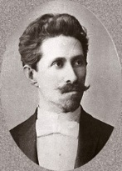
The matter of religious past
Aleksandr Nevski Cathedral
Built in a Neo-Byzantin style to glorify
the memory of 200.000 russian soldiers
fallen during the Turkish-Russian War of 1877
Aleksandr Pomerantsev
(1849 – 1918)

Slide 37
Re-building history after 1989…
Lenin’s Mausoleum – March 1925

Slide 38
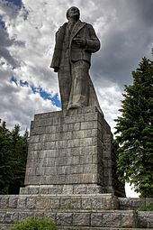
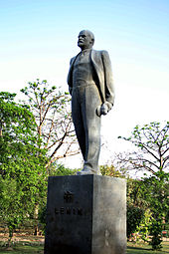
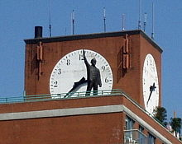
Lenin’s Square - Krasnoyarsk
Lenin’s statue - Dubna
LeninPlatz – East Berlin
Lenin at Nehru Park – New Dehli
East Village – New York

Slide 39
Stalinallee - Berlin
Penza Planetarium - 1954

Slide 41
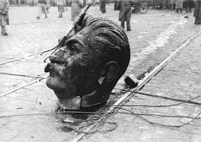

Slide 43
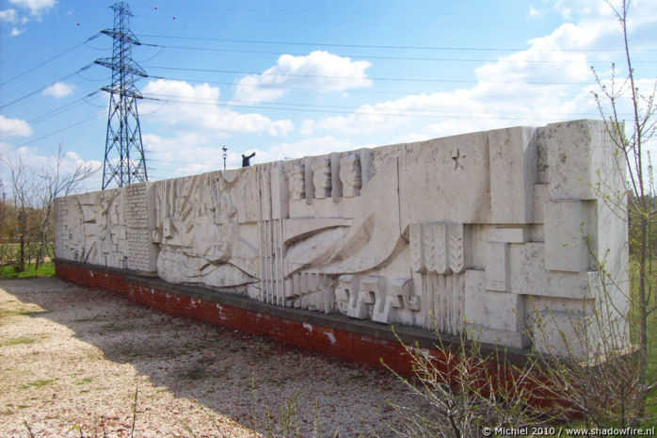

Slide 44
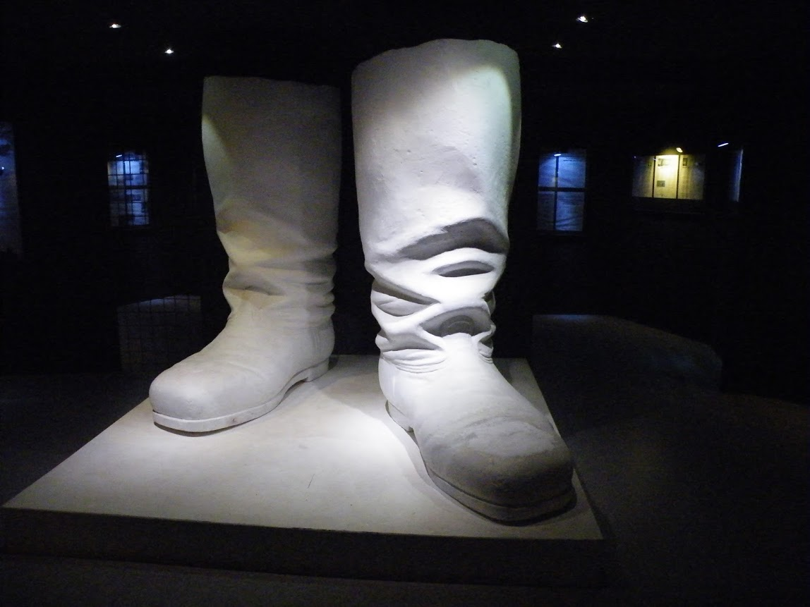

Slide 45
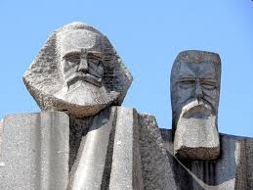
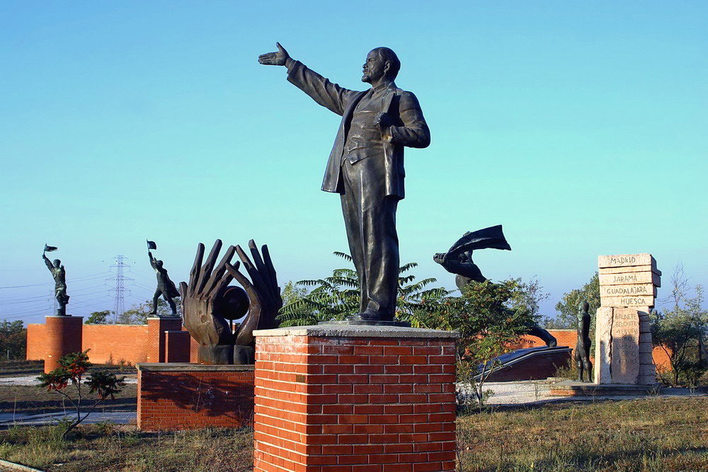

Slide 46
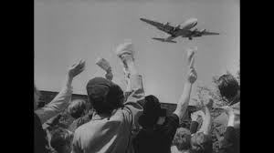
Museum of Contemporary History - Bonn

