Slide 1
Andrea Ragusa Politics for cultural heritage management A comparative approach
Andrea Ragusa – Interuniversity Centre for the History of Social Change and Innovation
ragusa3@unisi.it – Mobile: +39 – 324 - 7919475

Slide 2
Topics and aims…an introduction
1) To give a definition of cultural heritage, studying the evolution of the concept through history; approaching the study of cultural heritage from a methodological point of view, observing and considering the main categories to define and study the matter;
2) To build a general bibliography for the study of the matter and acquiring the main instruments to study and operate;
3) To have a general overlook around the most relevant experiences of politics for cultural heritage management through history, observing the main relevant areas of the world in an effort of comparison;
4) To try to understand the relevance of this particular subject of politics and social life in the general scene of globalization and new economic perspective

Slide 3
Table of Contents
1) Cultural heritage: a problem of definition – introduction to the subject
2) Defining cultural heritage in a historical perspective
3) The role of international law – The action of UNESCO
4) Tangible and Intangible cultural heritage: memory and identity
5) New perspectives in cultural heritage management: the most recent results
First aim and step

Slide 4
Table of contents
6) Politics for cultural heritage management in a comparative approach: comparing different experiences – The heritage of Enlightment and the case of France;
7) Politics for cultural heritage management in a comparative approach: comparing different experiences – The «State of culture» in Germany;
8) Politics for cultural heritage management in a comparative approach: comparing different experiences – Ancient and modern in England;
9) Politics for cultural heritage management in a comparative approach: comparing different experiences – The military and environmental culture in USA;
10) Politics for cultural heritage management in a comparative approach: comparing different experiences – The Euromed area;

Slide 5
Table of contents
11) Politics for cultural heritage management in a comparative approach: comparing different experiences – The Eastern Europe and the heritage of socialism;
12) Politics for cultural heritage management in a comparative approach: comparing different experiences – The Eastern Europe today: the peculiar case of Poland;
13) Politics for cultural heritage management in a comparative approach: comparing different experiences – The socialist world and the peculiar case of China;
14) A window on other worlds: the South-American continent and the heritage of colonial experience;
15) A window on other worlds: the case of Japan;
16) Different experiences of management: a cultural heritage of Commonwealth?
17) Different experiences of management: risks and opportunities for the EU
Third aim and step

Slide 6
Table of Contents
18) In the global world: risks and opportunities;
19) From an economic point of view…
20) A mean of cultural diplomacy?
Building a bibliography
Fourth aim and step

Slide 7
Lesson 1 Cultural Heritage: a problem of definition Introduction to the subject
Aims and Topics
To try to define the concept of cultural heritage, answering the question: What is cultural heritage?
To try to observe the elements characterizing cultural heritage, answering the question: what does cultural heritage consist of?
To try to introduce a first element of comparison, answering the question: is it the concept of cultural heritage the same all over the world?

Slide 8
What are We Discussing?
A very general definition, linked to the common sense:
Cultural heritage refers to the myriad manifestations of culture that human beings have inherited from their forebears: art, archtecture, rural and urban landscapes, crafts, music, language, literature, film, documentary and digital records, folklore and oral history, culinary traditions, indigenous medicine, ceremonies and rituals, religion, sports and games, dance and other perfoming arts, and recreational practices such as those involving hunting and fishing (James A.R. Nafziger, Introduction to Id.(ed.), Cultural Heritage Law, An Elgar Research Collection, Cheltenham UK – Northampton, MA, USA, 2012, pag. XIII).
James Nafziger is Thomas B. Stoel Professor of Law and Director of International Programs at the Willamette University College of Law, USA

Slide 9
Very general definitions
The Cultural Heritage consists of manifestations of human life which represent a particular view of life and witness the history and validity of that view.
Tangible – movable and immovable objects, sites, buildings;
Intangible – performing arts, crafts, music, dance, linked to particularly relevant values of a community, tribe, group.
(Lyndel V. Prott – Patrick O’Keefe, «Cultural Heritage» or «Cultural Property»?, in Cultural Heritage Law, quoted, pagg. 3-5).
Lyndel Prott is Professor of Cultural Heritage Law at the University of Sidney, Australia
Patrick O’Keefe is Associate Professor of Law at the University of Sidney, Australia

Slide 10
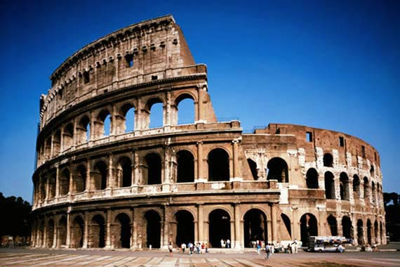
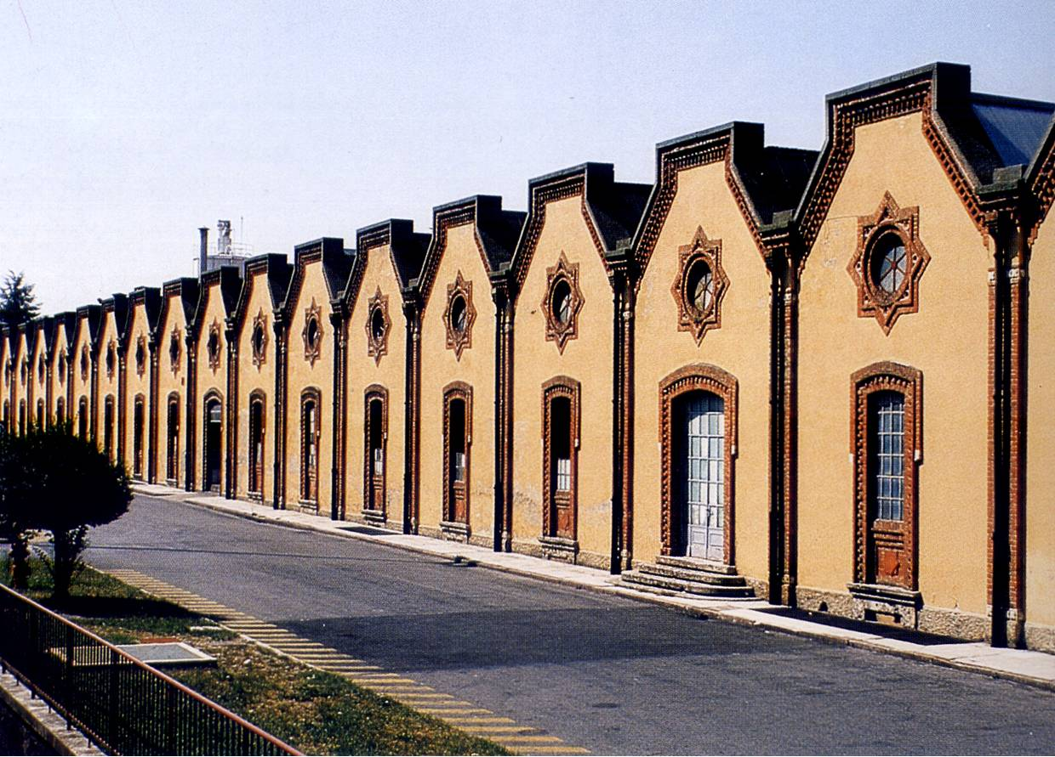
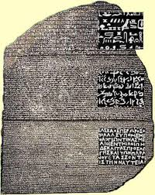
…Some examples…

Slide 11
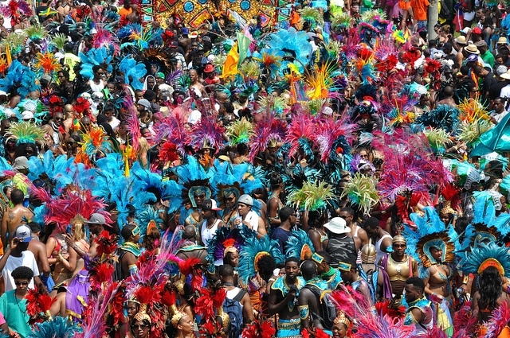
…Some examples…

Slide 12
What’s the problem to solve?...
…to consider as Cultural heritage only objects of «fine arts»?
…to consider as Cultural Heritage everything having value
of «testify of human civilization»?
…a problem of definition

Slide 13
A different terminology
«Cultural heritage is composed of all those movable and immovable things having artistic, historical, archaeological, ethnoanthropological, archivistic and bibliographical interest and the other things, listed by law or on the sense of law, testifies having value of civilization» (Cultural Heritage Code – Italy – 2004, art. 2).
[…] «especially in a comparative approach, it is a polyedric, multifaceted and undoubtely complex concept» (D. Vaiano, La valorizzazione dei beni culturali, Giappichelli, Torino, 2011).
polyedric
multifaceted
complex

Slide 14
A different terminology
The main italian dictionary – Vocabolario della lingua italiana Treccani – refers to the concept of «fine arts»: the old definition comprising monuments, objects of art, artistic buildings, sculptures, paintings…all considered in an aesthetic meaning.
The dictionary filled by Tullio De Mauro – Grande Dizionario italiano dell’uso (UTET, Torino, 1999), refers to two different concepts:
Asset: a group of spiritual, social, cultural or material rights, which through heredity or tradition belong to a collective;
Shared assets of humanity: the group of assets which deserve a special legal protection, given that, beacuse of their characteristics, they belong to humanity.

Slide 15
…a more detailed definition…
The Vocabolario italiano dell’uso shows a reference to the concept of cultural good: mobile or immobile good, having value from a scientific or artistic point of view, protected by law as collective good, even if of private property.
The Vocabolario Treccani shows a reference to the concept of artistic, archaeological, environmental goods, defined as national patrimony, both natural and historical, considered as complex of inalienable goods protected as public goods because they respond to collective need, so protected by laws of State and not by the private.
Defining the concept of culture, the Vocabolario Treccani shows a reference also to the concept of cultural patrimony: complex of goods having historical, artistic, scientific, archaeological, ethno-anthropological interest, or any other thing having value of testify of human civilization.
…a reference is shown also to the concept of cultural good, with regard to the French expression biens culturels introduced by the UNESCO Convention of 1949…

Slide 16
A different terminology
…from England…
The Oxford English Dictionary (1989²) refers to fine arts, result of art work, and related to the concept of skill or to the ancient greek word Ƭεχνέ.
Art Council: an organization established by Royal Charter in 1946 to promote and support (esp. financially) the development and appreciation of the arts in Britain
the furthering of international relations by cultural exchange; the act of publicizing and exhibiting examples of one’s national culture abroad
ART!!!!
CULTURAL DIPLOMACY

Slide 17
A different terminology
…from Germany…
Kunstschätze: linked to the idea of skills
Kulturgut: linked to the contradiction between Kultur and Zivilisation
Kulturgeist: linked to the idealistic culture

Slide 18
«Cultural Heritage» or «Cultural Property»?
Cultural Property: movable and immovable property that has cultural significance, whether in the nature of antiquities and monuments of a classical age or important modern items of fine arts, decorative arts and architecture (Black’s Law Dictionary, ed. by B.A. Garner, Thomson-West, Sao Paulo, 2004⁸).
Cultural Heritage
Cultural Property
Fundamental goal:
protection of the heritage for the enjoyment
of present and later generations.
Fundamental goal:
protection of the rights of the possessor
Crucial category
with a high level of ideological content
New term with a not relevant ideological content

Slide 19
What’s the problem to solve?
Social goals
Private goals
Balance

Slide 20
Property as a Western concept
In many states of USA there are no controls on archaelogical excavation on privately owned land beacuse to impose them would interfere with rights of private property.
MilirrpumVs.Nabalco (1971): the judge held that Australian Aboriginals were not owners of their land, but – on the contrary – they belonged to the land where they lived, given by their ancestors, and to which some duties and rituals were to be performed.
MullickVs.Mullick (1925): the Privy Council held that a Hindu family idol was not a mere chattel (movable property) which was owned and could be dealt with by the owner as he pleased, but a legal entity in its own right to which duties were owed.

Slide 21
Cultural Heritage: why to use this concept?
It puts some limits to the completely free use of the ownership: «it creates a perception of something handed down; something to be cared for and cherished. These cultural manifestations have come down to us from the past; they are our legacy from our ancestors. There is today a broad acceptance of a duty to pass them on to our successors, augmented by the creations of the present» (Prott – O’Keefe, quoted, pag. 7).
It allows to counteract the growing trend to commoditization of the cultural manifestations: where paintings are sold for tens of millions of dollars; where scandals involve art secured loans in the order of many million yen and some of the nation’s leading commercial companies, are consequences of damage: the destruction of sites and monuments through looting to support the market; the universal and different value of «cultural heritage» can help to counteract;
It recollects different manifestations of culture: not only art and monuments, but also intangible manifestations: folklore, music, literature, rituals, ceremonies. These – apart from the rules around copywright – are forms of culture difficult to be considered and protected by the concept of law. The concept of cultural heritage can help to give a coherent system of law to be applied, taking account of the peculiar nature and requirements of those manifestations.

Slide 22
…in other words…
Cultural Heritage is a concept that gives unity to the fragmented concept of «fine arts»
Cultural Heritage is a concept that moves from a merely aesthetic meaning and point of view to a cultural and civil meaning
Cultural Heritage is a concept that moves from a merely material conceptualization to an immaterial one, considering – together with objects – also activities and manifestations
It is an element of innovation

Slide 23
…summarizing…
1) Cultural Heritage is a complex, multifaceted concept
2) Cultural Heritage is a very recent concept, coming through a difficult historical evolution
3) Cultural Heritage includes and gives unity to different categories of sources to be protected
4) Cultural Heritage represent the last result of a terminological evolution
5) Cultural Heritage is a concept that moves from a material and aesthetic meaning and approach to a more inclusive material-immaterial and civil meaning and approach
6) Cultural Heritage is a concept deeply linked and defined by law together and against private property
Keywords:
Culture
Heritage
Social goods/needs
Property
Law

Slide 24
Cultural Heritage: a problem of Law
Plurality and interaction of legal orders «seeks to convey the idea that enforcement of the law in the area of cultural property entails a continuous interaction and hybridization of different legal orders, private and public, domestic and international, national and regional, and soft and mandatory law» (F. Francioni, Plurality and Interaction of Legal Orders in the Enforcement of Cultural Heritage Law, in F. Francioni-J. Gordley (ed.), Enforcing International Cultural Heritage Law, Oxford University Press, Oxford, 2013, pag. 9)
Francesco Francioni is Professor of International Law at the European University Institute of Florence
James Gordley is Irby Professor of Law at Tulane Law School and Shannon Cecil Turrner Professor of Jurisprudence Emeritus at the School of Law of the University of California - Berkely

Slide 25
National IdentityVs.Humankind
Cultural Heritage is part of the nation: it is justified the retention of cultural objects within the territory of the State and the imposition of export controls and limitations on private ownership over cultural goods in the name of public interest
Cultural Heritage is a part of the heritage of humankind. It underplays the role of cultural heritage as an element of national identity and emphasizes its significance as part of the heritage of humanity, supporting the broadest access to it and its international circulation to facillitate exchange and cultural understanding among different people of the world
National identity/Public element
Private property/human rights

Slide 26
International and National Law: fields of interaction
Cultural property law and human rights law: from the concept of «cultural property» to the concept of «cultural heritage»;
Prevention in case of armed conflict – Hague Convention for the protection of Cultural Property in case of armed conflict
Prevention of illicit traffic of movable objects
Unesco Convention concerning the Protection of the World Cultural and Natural Heritage (1972)
Underwater heritage – Unesco Convention on the Protection of the Underwater Cultural Heritage (2001)
Intangible Cultural Heritage – Unesco Convention on the Protection of the Intangible Cultural Heritage (2003)
Borrowed fora: dispute settlement mechanisms
established for other other categories of international
norms and used to enforce the law around
Cultural Heritage
Absence of courts and
mechanisms to settle disputes

Slide 27
National and international Law: the problem of «cultural property»
When does the expression «cultural property» firstly appear?
Hague Convention for the Protection of Cultural Property in the Event of Armed Conflict (Hague – 1954)
Recollecting the results of other previous Conventions on Armed Conflict, it protected the property of municipalities and of institutions dedicated to religion, charity and education, the arts and sciences, prohibited seizure or distruction of or wilful damage to such institutions, historic monuments, works of art and science.
It passed over other definitions such as biens culturels (France) or beni culturali (Italy), inadequate to comprehend the whole of what is covered by the «cultural heritage»
Discussed in Nahlik, La protection internationale des biens culturels en cas de conflict armé, «Recueil des Cours de l’Academie de la Haye» (1967)

Slide 28
Why has been the expression «Cultural Property» introduced?
Tangible C.H.
Immovable
Tangible C.H.
Movable
Intangible C.H.
Art works
Intangible C.H.
Rituals, ceremonies
Informations
on the others
Cultural Property

Slide 29
Who has what rights in?
The private or the community?
The State or other public bodies?
As there is a consensus between different systems of law on many aspects of cultural heritage protection, the problem remains to balance the private rights of owner and the public needs of community: whether a legal system favours public or private property depends on political and historical basis of that society

Slide 30
On defining the cultural heritage The system of international Law
Hague Regulations concerning the Law and Customs of War on Land - 1907
Hague Convention for the Protection of Cultural Property – 1954
Unesco Recommendation on the conduct of archaelogical excavations – 1956
Unesco Recommendation concerning the most Effective Means of Rendering Museums – 1960
Unesco Recommendation concerning the Safeguarding of the Beauty and Character of Landscapes and Sites – 1962
Unesco Recommendation concerning the Preservation of Cultural Property Endangendered by Public or Private Works – 1968
Unesco Convention on the Means of Prohibiting and Preventing the Illicit Import, Export and Transfer of Ownership of Cultural Property – 1970
Unesco Convention concerning the Protection of the World Cutura and Natural Heritage - 1972

Slide 31
…reflecting a cultural development…
Against the War
To enforce the State authority
A new concept of protection
Hague Convention - 1954
Unesco Convention - 1970
Unesco Convention - 1972

Slide 32
What’s the problem to solve?
…many conventions and recommendations…no one definition on the principles…
«…for various reasons each Convention and Recommendation has a definnition drafted for the purposes of that instrument alone; it may not, at this stage, be possible to achieve a general definition suitable for use in a variety of contexts» (L.V. Prott, Problems of private international law for the protection of the Cultural Heritage, «Recueil des Cours» – 1989)
…cultural heritage is a concept that has itself imported concepts from other academic disciplines such as anthropology and archaelogy without incorporating the theoretical background which led to its development…
«While cultural experts of various disciplines have a fairly clear conception of the subject-matter of their study, the legal definition of the cultural heritage is one of the most difficult confronting scholars today»

Slide 33
Cultural Heritage: «culture»+«heritage»
Culture is a difficult and complex concept as:
«…it is a totalizing concept beacuse everything becomes, or is considered, culture. There are material culture, ritual culture, symbolic culture, social institutions, patterned behaviour, language-as-culture, values, beliefs, ideas, ideologies, meanings and so forth».
«…second, not only is almost everything in a society culture, but the concept is also totalizing beacuse everything in the society is supposed to have the same culture (as in the concept of culture as shared values»

Slide 34
Heritage: a limiting concept
It offers a more limited category than that of «culture», and a more manageable set of elements.
It includes «material culture, ritual culture, symbolic culture[…], language-as-culture, values, beliefs, (in some circumstances) ideas, ideologies and meanings»
Cultural Heritage
Culture
The symbolic relationship of the cultural
Heritage to culture is central to understand
the nature of cultural heritage

Slide 35
The keyword….
Inheritance

Slide 36
Inheritance: meaning and content
Passage and transmission through generations
Non re-newable resource
Cultural Heritage as Common Heritage of Mankind
The intangible content of Cultural Heritage

Slide 37
Passage through generations
1972 Unesco Convention: states the duty «of ensuring the identification, protection, conservation, presentation and transmissions to future generations of the cultural and natural heritage»

Slide 38
Non re-newable resource
«That the natural heritage is global is now beyond dispute. Fresh water and fossil fuels, rain forests and gene pools are legacies common to us all and need all care. Cultural resources likewise form part of the universal heritage» (D. Lowenthal, The Heritage Crusade and the Spoils of History, Viking, 1997, pag. 227).

Slide 39
The Common Heritage of Mankind
Defined by C. Joyner, Legal Implications of the Concept of the Common Heritage of Mankind, I.C.L.Q. (1986), pagg. 190-199, regarding the common space areas, with five characteristics:
The areas are not subject to appropriation of any kind and sovereignty is absent;
All people are expected to share in the management of the area and States act only as agents of «all mankind»;
Resources should only be exploited under the auspices of a common space regime mandate and any economic benefits should be shared internationally;
Uses of the area should be exclusively for peaceful purposes;
Scientific research should be freely and openly permissible and for the benefit of all peoples.

Slide 40
The Intangible Content of Cultural Heritage
The concept of cultural heritage involves – since the work produced by Unesco in the mid-1980s – the intangible culturale heritage, as testifies of human life to be preserved.
Council of Europe Heads of State (1993) called to «give expression in the legal field to the values that define oure European identity»
Helsinki Conference (1995): «the relationship that must exist between the cultural heritage and the natural and social environment to which it belongs is underestimated. Lastly, being based on architectural and archaeological heritage, these definitions focus on the physical side, completely ignoring the question of its function in contemporary society» (art. 5).
Helsinki Conference – document of Finland: «in a wide sense the concept of the cultural heritage covers all the manifestations and messages of intellectual activity in our environment. These messages are passed on from generation to generation through learning, intellectual quest and insights»
MEDIATION: values of intangible cultural heritage are mediated through tangible objects

Slide 41
Cultural Heritage as part of human rights
The existence of human rights is fundamental for the protection of cultural heritage: even if they were not designed for this purpose, the existence of cultural rights is a prerequisite for the protection of culture. Unesco jas a special role in relation to cultural rights. Article 1 of its Constitution reads: ‘the purpose of the organisation is to contribute to peace and security by promoting collaboration among nations through education, science and culture in order to further respect for justice, the rule of law and for the human rights and fundamental freedoms which are affirmed for the peoples of the world, without dinstinction of race, sex, language or religion, by the Charter of the United Nations» (Prott. Quoted).
The concept has been accepted in the International Covenant on Civil and Political Rights, and International Covenant on Economic Social and Cultural Rights (1966), but also in further Unesco Conventions. And, today, in the recognition of the right to culture, such as the right to safety, instruction, a decent environment and so on.

Slide 42
Common elements of cultural heritage
Different categories of objects: tangible (immovable and movable) and intangible (know-how, arts, dance, music, folklore, rituals, ceremonies and values mediated through material objects)
The concept of inheritance: from past, to present, to future,, through generations
Building and defining the identity – of a group, tribe, nation, or supranational entity
The cultural heritage is the result of historical conditions and political choises
The relationship with human rights

Slide 43
…summarizing…
Cultural Property
Culture and Heritage
A problem of Law – National and International Law
The contents of cultural heritage
Keywords:
Property
Law
Culture
Heritage
Identity
Human Rights

